Slide 1
Assets and advocacy for social change
Dr. Lynn Donahue – PSJS 250: Social Change through Service

Slide 2
Asset-Mapping
Mapping the assets, resources, and challenges of our communities.

Slide 3
How do we use an Asset-Based Perspective?
Acknowledging that within the community-based partnerships exists the creativity, hope, and skills to address the community’s needs.
Creating a reciprocal learning experience.
Taking note of the solutions, not just the problems that exist in the daily happenings at the SL site.
Seek out the lessons to be learned in each experience and being open to what’s possible.
Ask the Question: What can your service-learning client or partner teach you?

Slide 4
Community Asset-mapping
Asset mapping is a process of discovering the rich assets and resources of a community to create a healthy, vibrant community.
Asset-mapping drive through neighborhoods: Tour 10 locations in two neighborhoods.
Photographic documentation: Of the locations and other sites observe
Chart of the Assets (Resources) and Challenges: Notes from tour and research on history, community festivals, and demographics
Reflection #6: 2 assets and challenges of community and individuals; How use

Slide 5
ASSET-MAPPING EXERCISE

Slide 6
Community asset-mapping
Edgerton Neighborhood
Jones Square Park
RCSD School #57
Edgerton Recreation Center
Maplewood Library
Seneca Parkway between Dewey and Lake Avenue
Maplewood Rose Garden
YMCA and/or VOA on Lake Avenue
Arnett Neighborhood
Wilson Academy HS on Genesee St.
Sojourner House
Teen Empowerment on Genesee St.
St. Mary’s Hospital on Genesee St.
Brue Coffee Shop
Downtown
High Falls District
Riverside Convention Center
The Metropolitan on Main St.
Eastman School of Music
YMCA on Main St.
Susan B. Anthony House
The Strong Museum
Frontier Field
Beechwood Neighborhood
New City Café on Parsells Ave.
441 Ministries on Parsells Ave.
Community Place on Parsells Ave.
East High School on Culver
Ryan Recreation Center

Slide 7
Demographic Research
Major Ethnic/Racial/Cultural Groups
Male/Female
Educational Attainment
Median Household Income
Unemployment Rate
Type
Condition
Median Cost
Vacant Properties
https://www.areavibes.com/rochester-ny/19th+ward/housing/
https://www.areavibes.com/rochester-ny/beechwood/livability/?zip=14609&ll=43.1625+-77.5705
https://www.areavibes.com/rochester-ny/edgerton/livability/?ll=43.17282+-77.63462

Slide 8
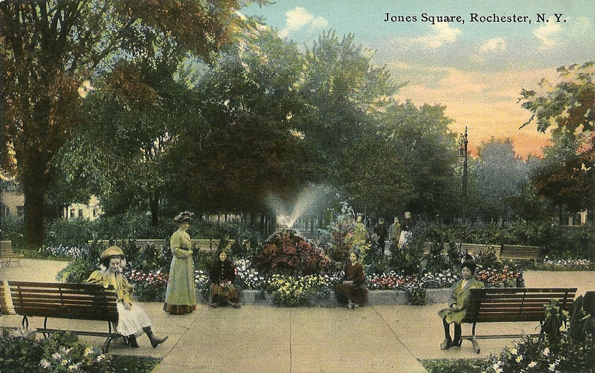
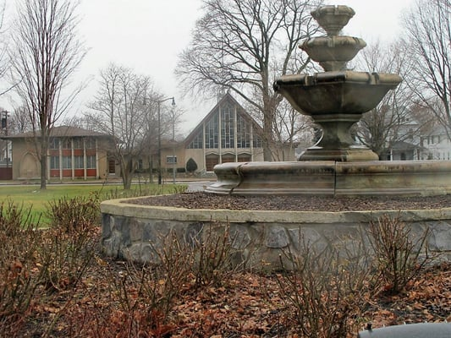
History and culture Research
Frederick Law Olmsted designed Jones Square Park, one of the city’s oldest public squares. It was used as a training ground for Civil War soldiers and as early baseball fields.
Maplewood Rose Garden Festival
Lower Gorge
Seneca Parkway is the spine of the Maplewood Historic District. The Olmsted firm prepared landscape plans for this street in 1893.

Slide 9
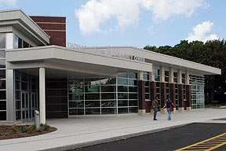
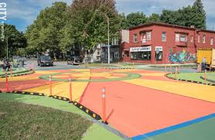
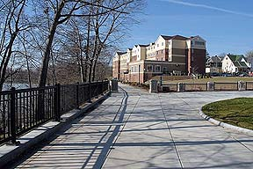
results
Small Businesses and Industries
Social Service Agencies and Nonprofit Organizations
Churches and Religious Organizations
Recreation and Leisure (Libraries, Parks, YMCA)
Schools and Educational Resources
Emergency Support
Health Care Agencies

Slide 10
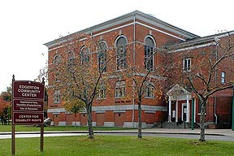
results
Reflections on the experience
2 examples of assets of the neighborhoods?
2 examples of challenges of the neighborhoods?
How use assets to mitigate the challenges?

Slide 11
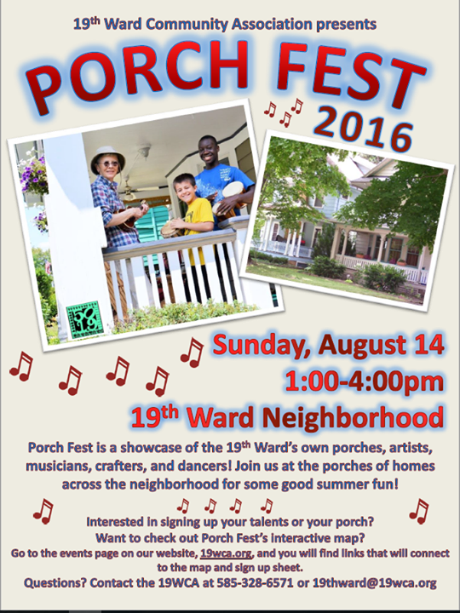
Individual assets
What are the assets of the individuals you are working with?
Conscientious
Curious
Collaboration and Cooperation
Problem solving
Building bonds
Taking initiative
Self awareness
Self confidence

Slide 12
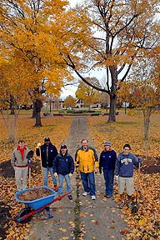
Reflection and discussion
How has your view of the community changed?
How can you apply your learning to the SL work?
What are the assets of the individuals you are working with?

Slide 13
ethics of service-learning and Better form of charity
Ethics, Reciprocity, Emotional Intelligence

Slide 14
Standards for ethical action
The Golden Rule (Conscious Proactivity): “Do unto others as you would have them do unto you.” We actively seek to do something good for others.
The Platinum Rule: "Treat others the way they want to be treated."
The Silver Rule (Conscious Self-Restraint): “Do no harm.” We fulfill relevant laws, rules, and regulations, but consider ethical dimensions that may be overlooked in decision making.
The Open Forum Rule (Conscious Transparency): Don’t do anything you could not satisfactorily explain to concerned stakeholders on television (or your mother!).

Slide 15
The challenge of charity
Charity (voluntary assistance to those in need) can lead to unintended consequences:
Create unhealthy dependencies
Rob people of the power they need to escape poverty
Encourages paternalism (control of resources and decision-making “for their own good”)
Maintains the status quo and dominant worldview that perpetuates unjust social systems and cultural institutions
The Challenge and Dilemma: Obligation to assist and an obligation to challenge the dominant values systems and worldviews

Slide 16
The Christmas story
https://youtu.be/SLZNusYeauw
(2 minutes)
Community Service Corp
Christmas Store Dollars
Donations vs. cash
Community development vs. charity
Communities have adequate assets to initiate renewal

Slide 17
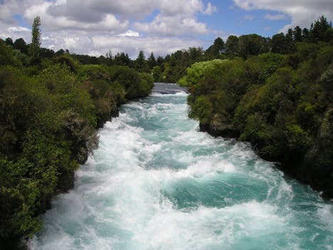
Upstream thinking
Good Samaritan activities (“we throw out lifelines where and when they yell for help or we find them drowning”)
Focus on your talents (“once you are up on your feet, we will remind you that you have something to contribute to the community”)
Challenge unfair rules (“charities alone will not change the cities of America”)

Slide 18
Emotional intelligence AND QUIZ
Self-awareness
Emotional Awareness
Self-confidence
Self-regulation
Self-control
Trustworthiness
Conscientiousness
Adaptability
Innovation
Motivation
Commitment
Initiative
Optimism
Empathy
Service Orientation
Developing Others
Political Awareness
Understanding Others
Social Skills
Communication
Leadership
Conflict Management
Building Bonds
Collaboration and Cooperation

Slide 19
Reflection and discussion
According to James in The Wealth of the Poor, what can be a negative consequence of charity?
What “better form of charity” was developed by James at the church?
What metaphor AND three steps are introduced at the end of the article to describe how to best address poverty?
Does your service-learning work feel like a “better form of charity”?
What are specific examples from your service-learning work?

Slide 20
Combatting poverty together
RMAPI; Connected Communities; ROC the Future

Slide 21
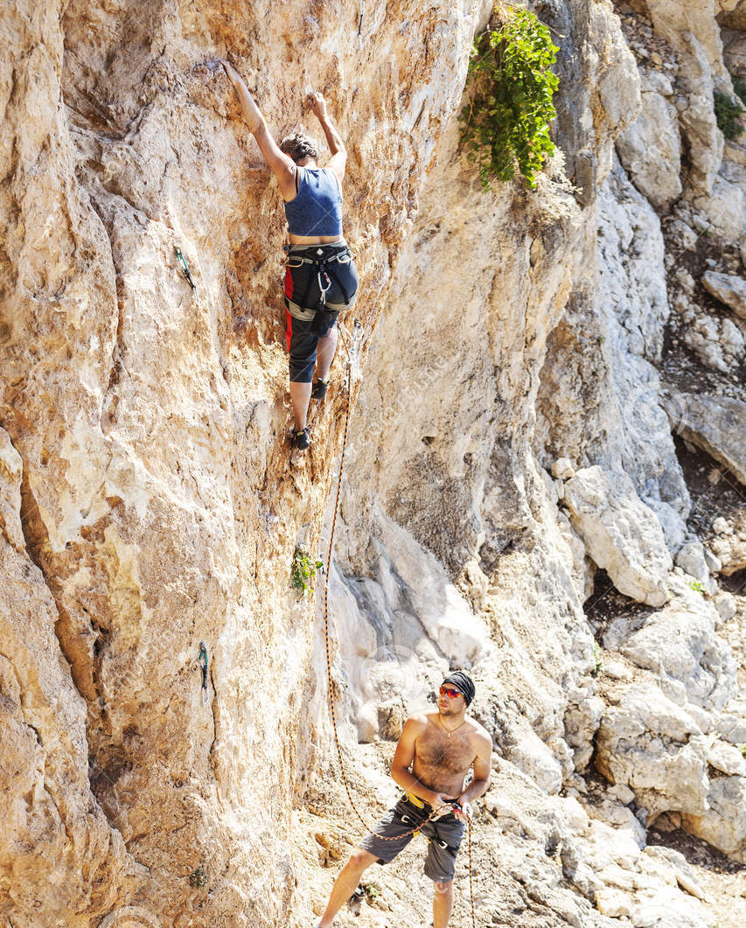
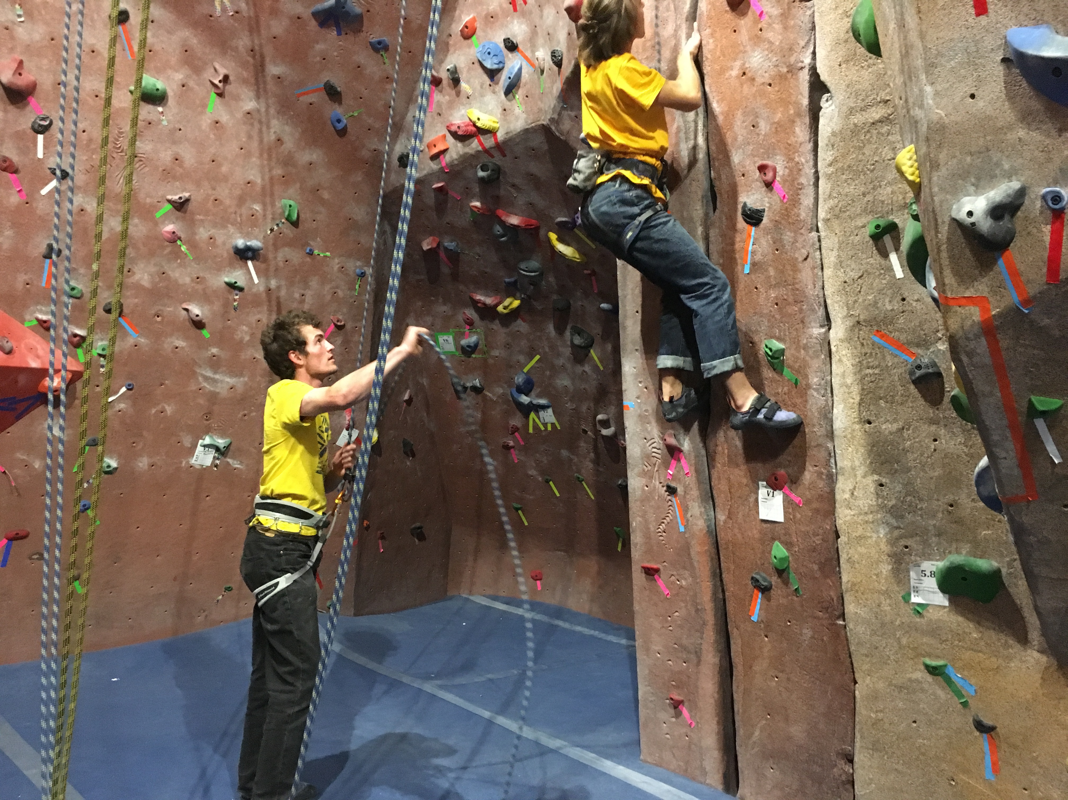
Expert vs. “non-expert” approach
Focus on individual vs. experience as the source of knowledge.

Slide 22
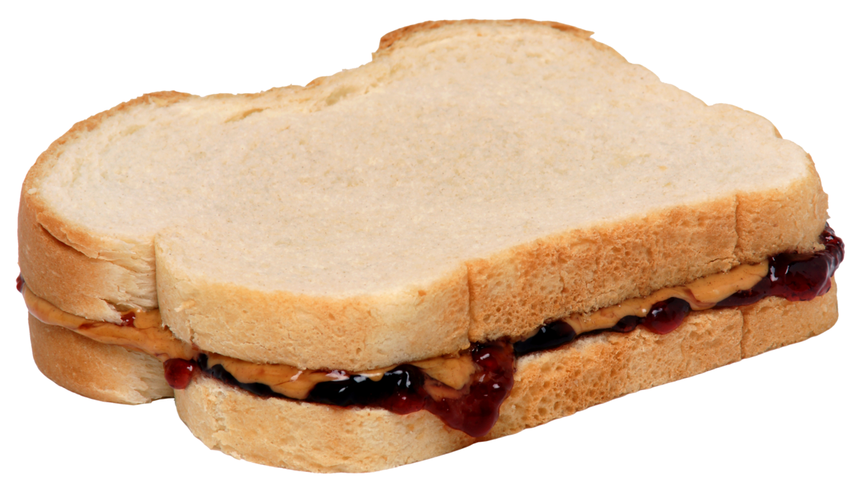
Making a peanut butter and jam sandwich (in 5 steps)

Slide 23
Rochester-Monroe Anti-Poverty Initiative
A Community Collaboration involving leaders and about 1,000 volunteers.
Focused on both short- and long-term needs to reduce poverty by 50% in 15 years.
Coordinated with New York State.
Hosted by the United Way of Greater Rochester.
Facilitated by a dedicated professional staff.
Year in Review Report:
https://www.uwrochester.org/getattachment/Connect/Rochester-Monroe-Anti-Poverty-Initiative/RMAPI-2017-Year-in-Review-and-Timeline.pdf.aspx?lang=en-US

Slide 24
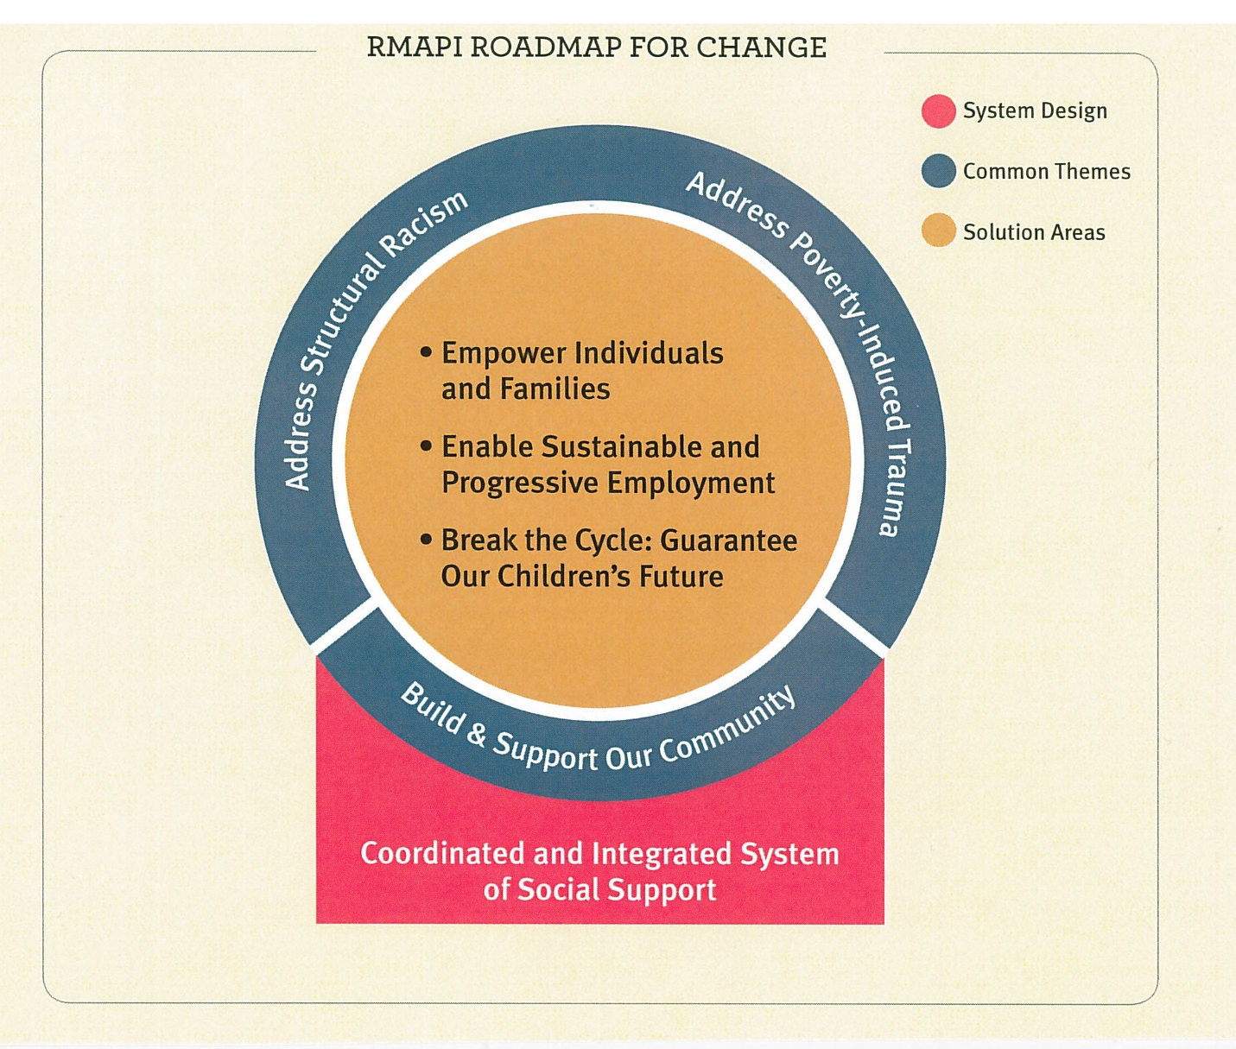
RMAPI
RMAPI Roadmap
(Three major themes)
Community Building
Structural Racism
Poverty-Induced Trauma
https://www.youtube.com/watch?v=Q8rUZWue8sA
(13 minutes)

Slide 25
Dedicated to building up EMMA and Beechwood neighborhoods from within by engaging residents, service providers, and community partners in our holistic approach.
“Personal responsibility is essential for emotional, social, and spiritual well-being. To do for others what they have the capacity to do for themselves is to disempower them. Getting to know community leaders first requires us to listen and respect indigenous leadership and learn the dreams of the people. And be willing to have our own ideas transformed. Connected Communities efforts seeks to be community-driven rather than volunteer-driven, community-led rather than volunteer-led.”
http://www.connectedcommunitiesroc.org/challenge/

Slide 26
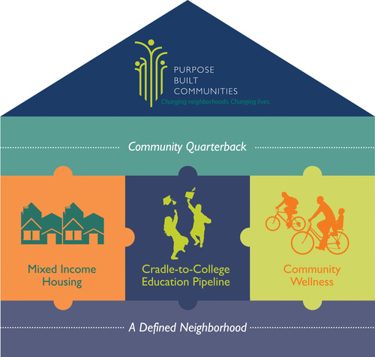
Connected Communities Roadmap
Asset Based Development
Geographically Focused
Holistic Revitalization
Collective Impact

Slide 27
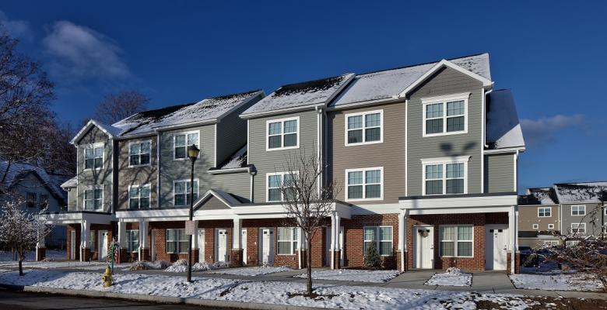
Warfield Square – new start for EMMA/Beechwood residents
Video: https://www.facebook.com/connectedcommunitiesroc/videos/1064678207038933/
(5 minutes)

Slide 28
Catholic family center bridges to success and family independence initiative (marrying knowing (expert) with understanding (experience)
BRIDGES TO SUCCESS
Bridges to Success is one of the first initiatives from the Rochester/Monroe Anti-Poverty Initiative (RMAPI). The initiative will be evaluated for its effectiveness to improve and expand the program in the future.
Focus is on building conditions for growth and pathways to a living wage (150 families)
https://www.cfcrochester.org/our-services/elevating-rochester/family-prosperity/#bridges-to-success
FAMILY INDEPENDENCE INITIATIVE
FII puts families at the center of all we do, following their lead and relying on their guidance. We trust and invest in low-income families as well as the solutions they discover on their own.
Use a individualistic mentoring model over 5-7 years using self-sufficiency framework.
https://www.cfcrochester.org/our-services/elevating-rochester/family-prosperity/#family-independence-initiative
BTS: 32% to 62% employment in one year; FII: 58% to 71% employment in one year.

Slide 29
Roc the future
ROC the Future is a collaborative community-wide initiative. Our mission is to promote alignment and focus community resources to improve the academic achievement of children in the City of Rochester.
ROC the Future is part of StriveTogether, a national network of communities supporting:
the success of every child from cradle to career
through a focus on a common agenda, shared measurement, continuous communication and mutually reinforcing activities among all participants
for collective impact, mobilizing resources, and increasing equity.
SJFC is one of the “conveners”

Slide 30
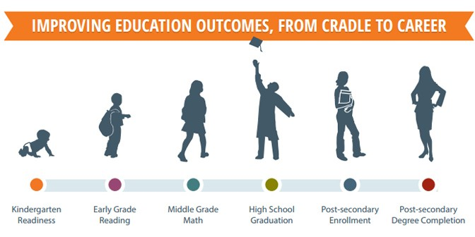

Slide 31
Roc the future
http://rocthefuture.org/
Four Overarching Goals
Key Accomplishments
Every Child is School Ready
Every Child is Supported
Every Child is Successful
Every Child is College and Career Ready
2018 Report Card: https://www.strivetogether.org/wp-content/uploads/2018/11/ROC-the-Future-Report-Card-2018.pdf
Chronic absences improved 30% to 27%
Completed 600 health and developmental screenings for 3-year olds.
PK-2nd grade students received 10 free books over the summer.
RCSD students completed early FAFSA applications inc. by 17%
2018 Cradle to Career Network Convening Video:
https://www.youtube.com/watch?v=ARJVXX4fFJM

Slide 32
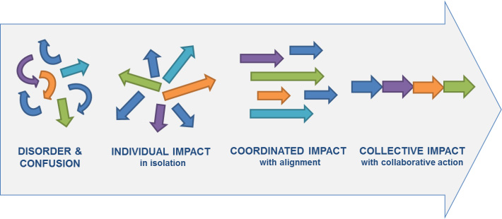
Collective impact

Slide 33
Solutions through advocacy
What do we know? What are the root causes? What would you like to see change? How?

Slide 34
Going Deeper with Service
Service-Learning Projects
Resiliency Education | Life Skills Education
Needs
Need social-emotional learning in school & home | Need life skill role models and education growing up
Need to gain greater SEL for future success in school and life | Need preparation for career and independence
Need positive relationships | Need positive relationships
Root Causes
Poverty | Abuse
Trauma | Drug/Alcohol dependency
Lack of role models | Lack of steady job
Homelessness – in transition | Lack of healthy food

Slide 35
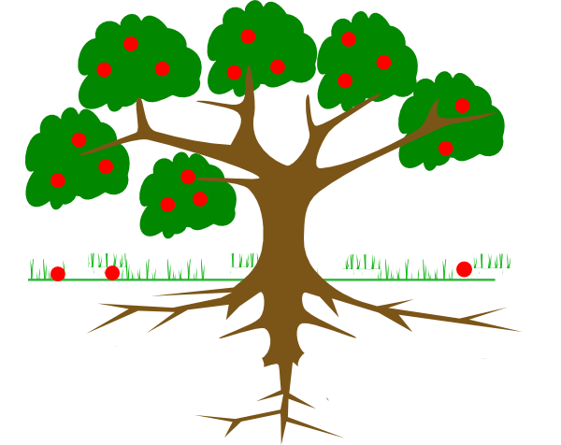
Step #1: Problem statements
Problem:
Children in poverty struggle with resiliency and overcoming emotional challenges?

Slide 36
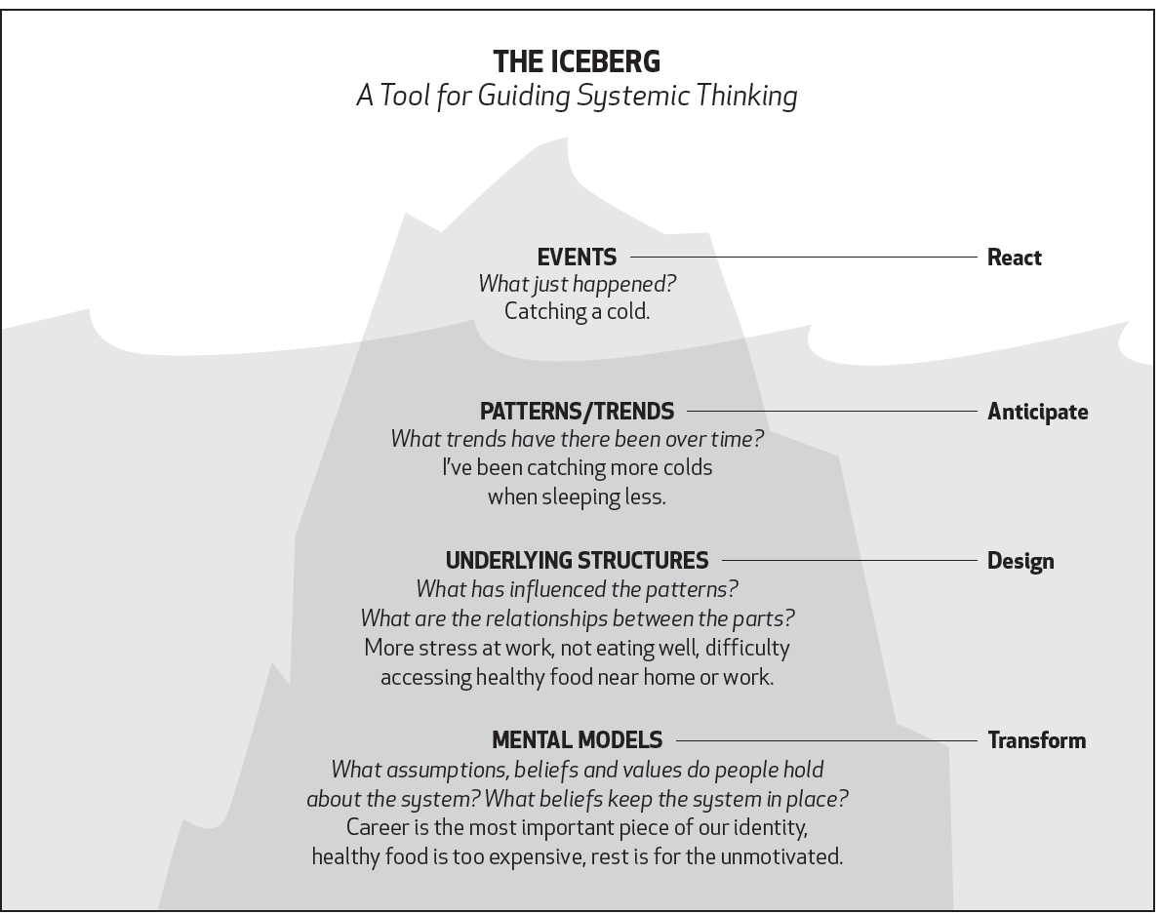

Slide 37
5 whys analysis of root causes
Step 1: Agree on the problem statement and write it down.
Writing the issue helps you formalize the problem and describe it completely. Don’t skimp on this step because if you have a muddy problem definition you will have a muddy solution.
Step 2: Ask “Why Did This Happen”
Simply determine what happened to cause the problem. Just go one layer at a time here by asking the 5 “Why” questions. Write the answer down below the problem as a potential cause.
Step 3: Check – Is This a Root Cause?
Stop and ask yourself if the Why you just wrote down is the real and underlying root cause of the problem. If it’s not then you have another symptom and you need to go back to Step 2 and ask again.
Step 4: Fix the underlying cause and develop a solution.
Now you need to fix both the underlying cause that you have uncovered and the symptom.
https://www.augusta.edu/ie/projects/.../pi_5whysrootcauseexplanationtemplate.docx

Slide 38
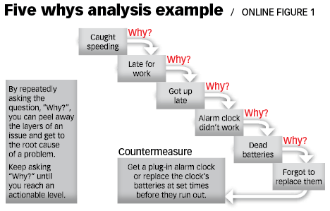
5 Whys Analysis of root causes

Slide 39
Application to Examples
Community Service Corp (The Christmas Story)
RMAPI
Connected Communities - Warfield Square
ROC the Future

Slide 40
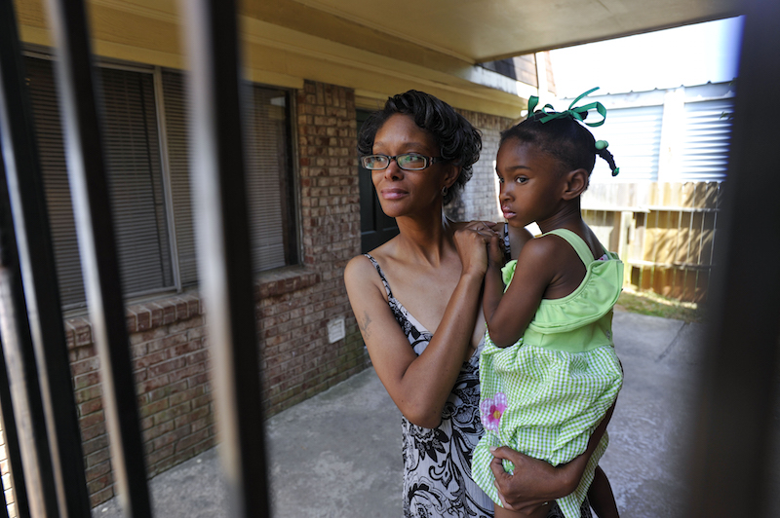
develop a solution
Problem #1: Didn’t have access to books & wasn’t read to:
Increase access to books in home and school.
Problem #2: Didn’t have access to food and nutrition:
Improve education and access to healthy foods.
Problem #3: Faced poverty and stress in the home:
Provide affordable childcare support so mother can have ability to get a well-paying job.

Slide 41
Strategies for social change
From Strategies for Social Change http://www.abilitymaine.org/rosc/cogstrat.html
Education& Public Events (Speeches, study circles, training sessions, conferences, educational materials, informational fairs, canvassing, presentations, film showing, benefit concert)
Legal and Policy Action (Electing people, supporting candidates, drafting legislation, getting out the vote, testifying on proposed bill, creating policy changes)
Alternative Institutions (alternative schools, cooperatives, barter networks, new technology, alternatives to criminal justice system & military defense, organic agriculture, alternative media)
Direct Action (boycotts, protests, sit-ins, marches, puppet demonstrates, resistance, tabling for signatures)

Slide 42
Social change presentation
Now that you have completed your service-learning work and gained added understanding and skills from classwork, you will create an advocacy presentation. Advocacy work involves identifying the root causes of the problem, educating the community, and influencing change in policy. Your presentation (in PowerPoint or Prezi format) should include the following components. It will be given as a group, but components will be presented individually for about 30 minutes total.
What were the goals of your service-learning project? What were the primary problems that your service-learning project addressed (e.g. gaps in achievement, social-emotional skills, lack of self-sufficiency)? What are some root causes of the issues you learned in this class (e.g. poverty, unequal access to resources, racism, food desert, trauma)? What are the assets you identified in the community, the organization, and the clients/children?
State the impact of the project. How was service-learning effective in addressing these challenges and enhancing the assets? What skills from this class were most important to help you achieve this impact (e.g. empathy, cultural communication, perception, ethics, etc.)?
Now propose a solution that addresses the root causes and harnesses the assets. For example, if you could work at your site all year, what might you do to go above and beyond your current SL work? If you could apply for a grant for $100,000, what might you use the money for to address the issues? If you could create a new staff position what might that person do? If you could create some policy changes, what might those be? If you could develop a PR campaign, what would the primary message be? Make sure your next steps are a counter-measure that addresses the root causes and makes use of the assets you outlined.
What was the strongest academic, personal, and/or professional impact of this class on YOU? What will you do with what you learned in PSJS 250?

