Slide 1
Orientation to Community-Engaged Learning
St. John Fisher College
Dr. Lynn Donahue
Assistant Director, Institute of Civic and Community Engagement
585-385-7342; ldonahue@sjfc.edu

Slide 2
Institute for Civic and Community Engagement
Suite 104, Lower Level Library
College-wide Partnerships
Community-Engaged Learning
First Generation Scholars
Service Scholars

Slide 3
Community-Engaged Learning (CEL) is the integration of community-based projects in academic courses to meet identified community needs, enhance student learning, and strengthen communities.
Meaningful Service:
Collaboration between College and Community to meet identified needs and enhance assets
Meaningful Implementation:
Reflection and Assessment leading to deeper understanding of course content and civic engagement
Meaningful Learning:
Applying Academic Knowledge and Critical Thinking Skills to meet course and learning goals

Slide 4
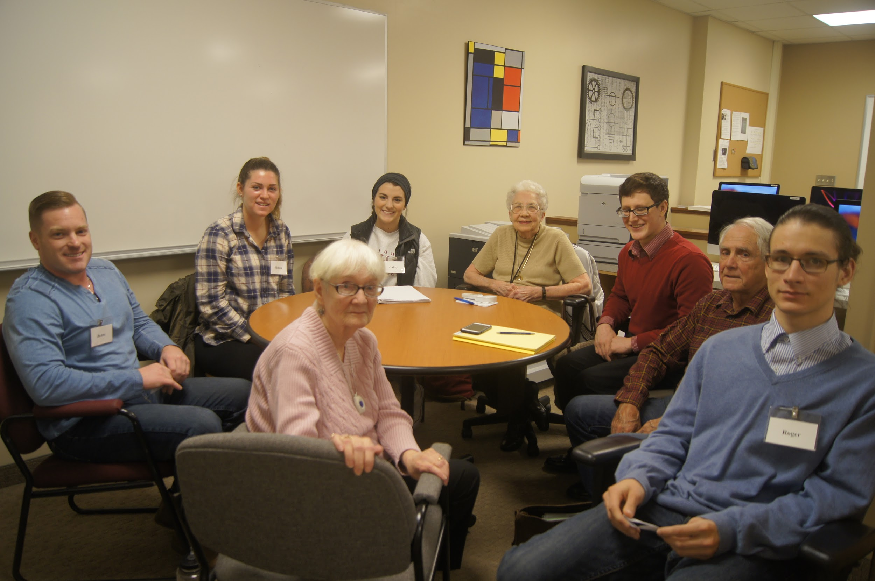
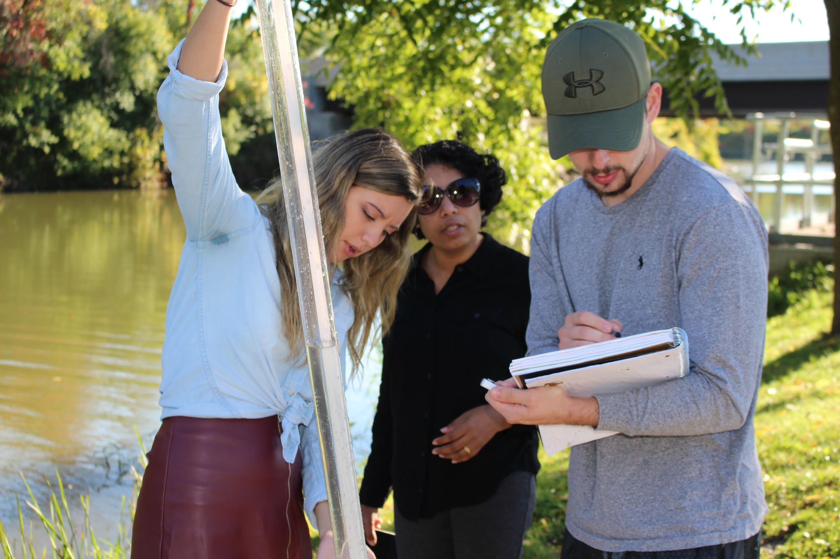
Client Support: Students teach resiliency to children, conduct financial literacy workshops to women in transition, and create life stories with elders.
Capacity-Building Projects: Students create marketing plans, research reports, data analytics, and social media content as a type of student consultant.
Academic Assignment: Found in all the disciplines; Is Optional or Required; Requires 15 to 30 hours on average

Slide 5
What are the Benefits of CEL?

Slide 6
Fulfilling the American Dream Report
In June 2018, Hart Research Associates conducted a survey of 1000 companies that have at least 25 employees on behalf of the Association of American Colleges and Universities (AAC&U).
Results revealed that employers are more likely to hire recent graduates with:
Real world experience like internships and service-learning (94%)
Community-based projects interacting with individuals with different cultures (83%)
Professional skills (85%-99%):
Good communication
Ability to work independently
Work effectively on a team
Ethical judgment
Critical thinking

Slide 7
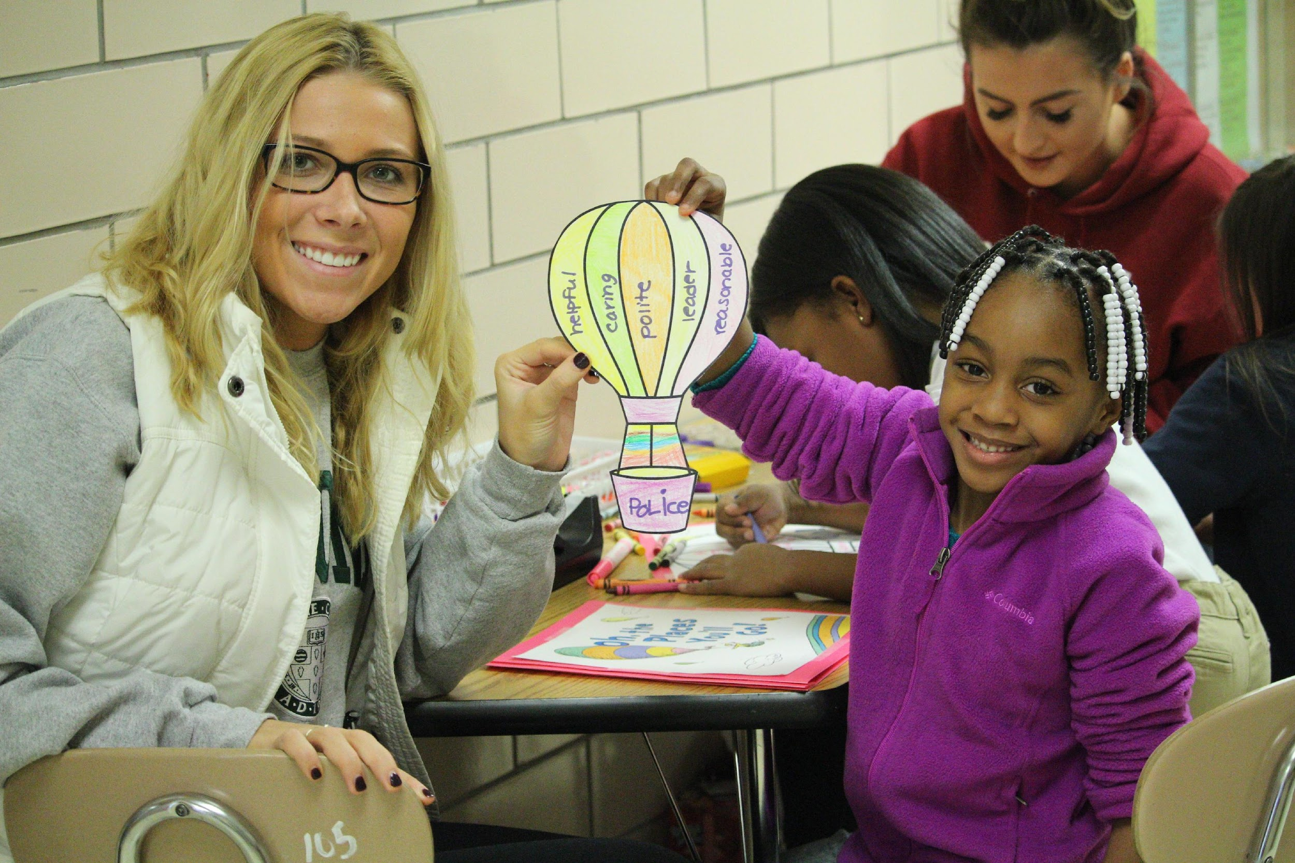
Professional Skills Impact of Community-Engaged Learning
(~500 SJFC Student Impact surveys)
85%-99% indicated that CEL helped them:
Apply their course learning to real world problem-solving
Work with individuals from diverse backgrounds
Develop strong communication and teamwork skills
Learn how to take initiative, problem solve, and think critically

Slide 8
Academic Impact of Community-Engaged Learning
Increase Meaningfulness
Increase Application & Understanding
On average, 95% of students report each semester that SL increases the meaningfulness of their course material.
"This wasn't just a project to get a grade
like in other classes. It was a real-life
project that will hopefully have a positive
impact.“
On average, 95% of students report each semester that SL better understand course concepts and how they can be applied to everyday life.
“This project gave me meaningful hands-on experience with the data and how to use different types of analyses.”

Slide 9
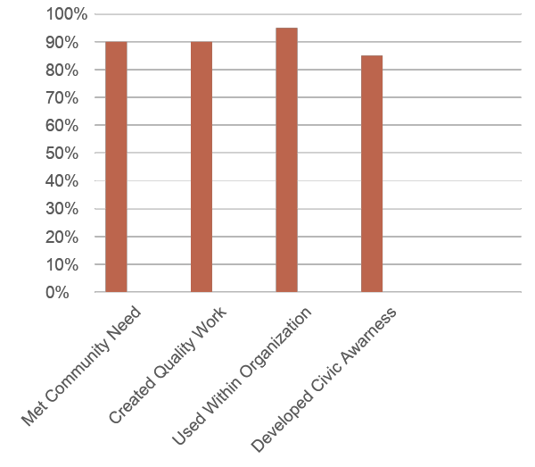
Impact on the Community
“Over the past 10 years, I have developed a growing appreciation for the efforts of the College to engage the whole Rochester community. Our work together is community collaboration at its best.” (Sister Christine Wagner, St. Joseph’s Neighborhood Center)

Slide 10
How can you make the biggest impact (get the most out of it)?

Slide 11
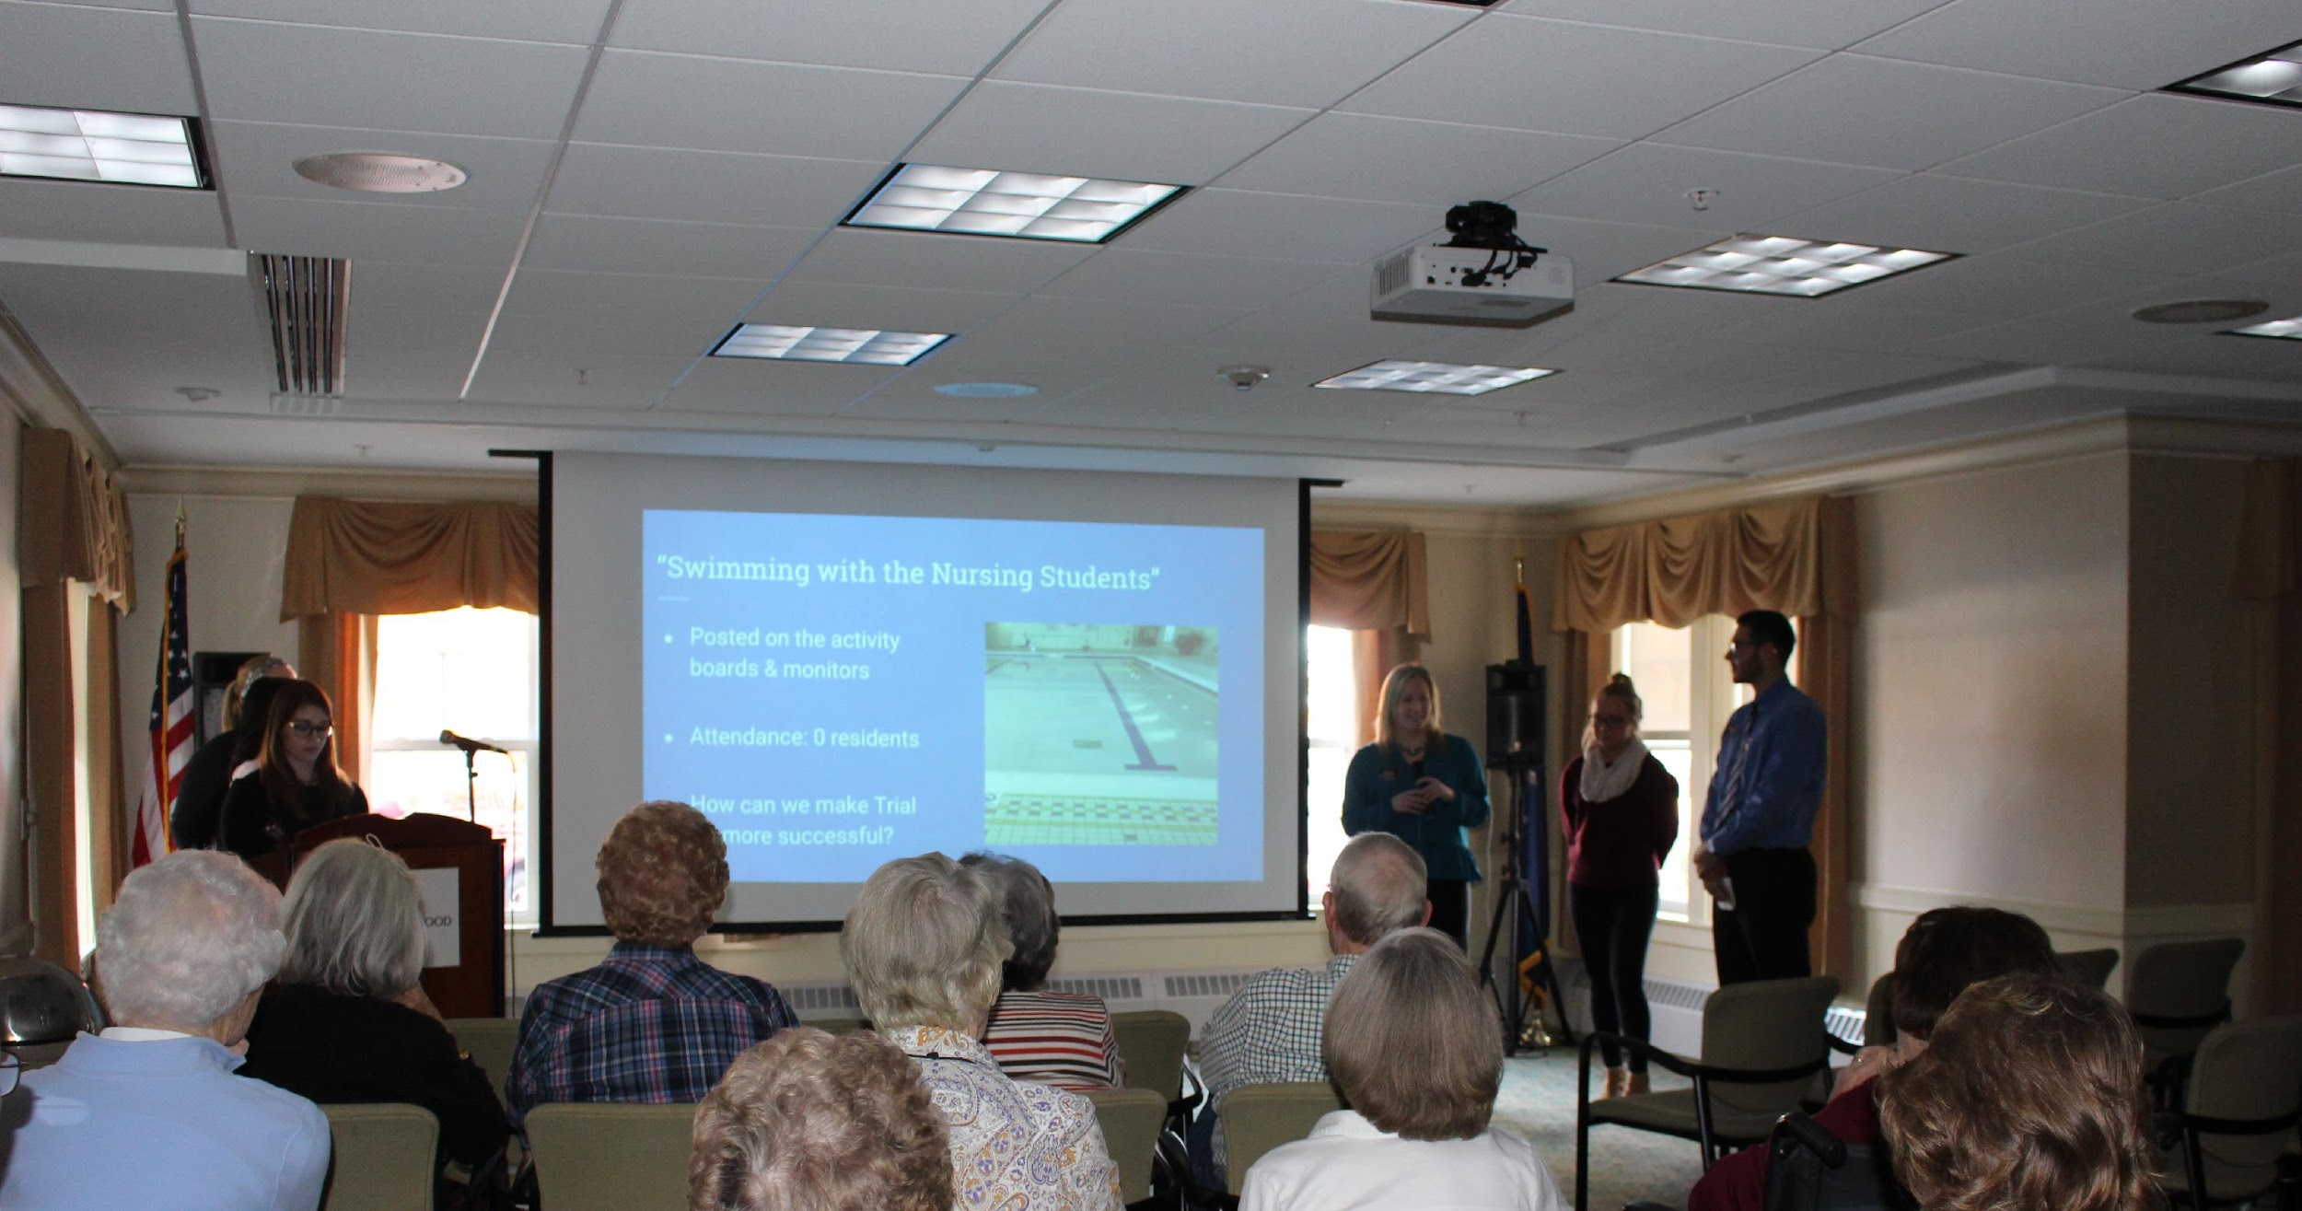
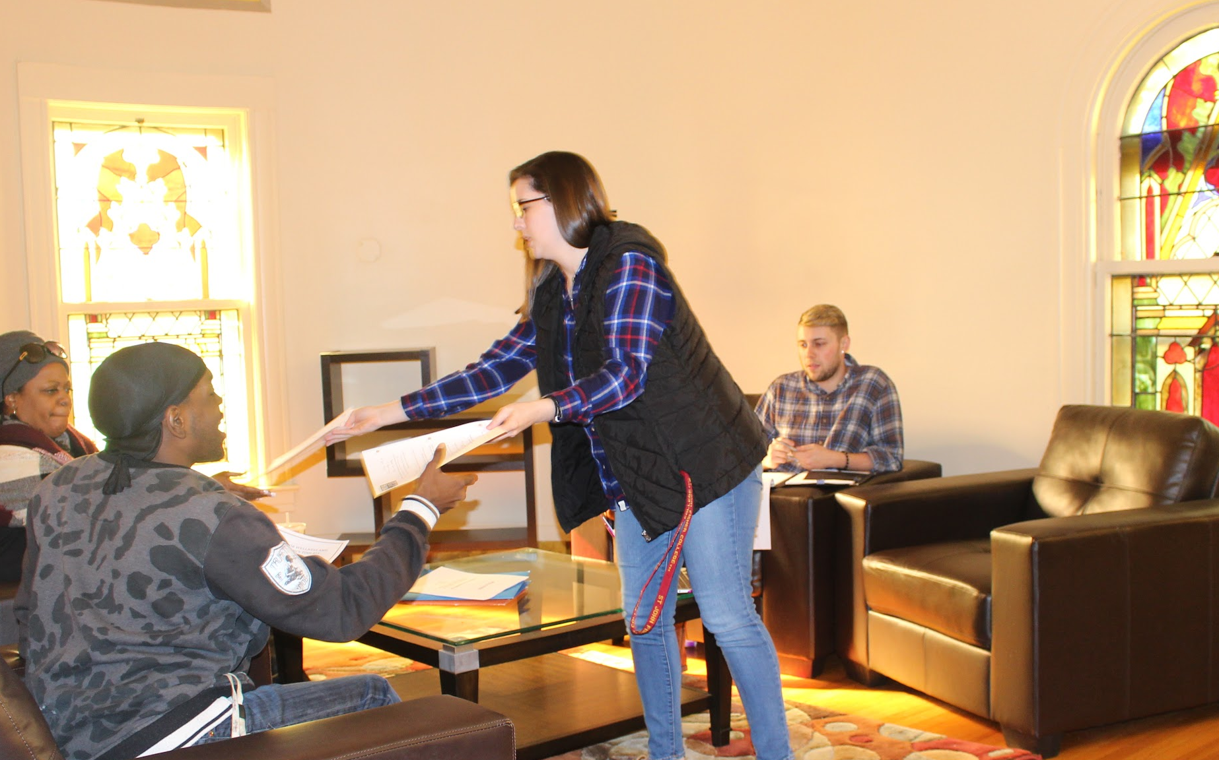
Tips for Professional Behavior
Participate in the initial training and orientation.; Learn about your partner's expectations and policies.
Challenge yourself to go outside your comfort zone.; Adopt a positive attitude.
Fully understand your assignment, role and responsibilities, and desired outcomes.
Use professional and clear communication.; Be on time and reliable.
Request feedback and be willing to make changes to best meet the needs.
Create a quality product or service

Slide 12
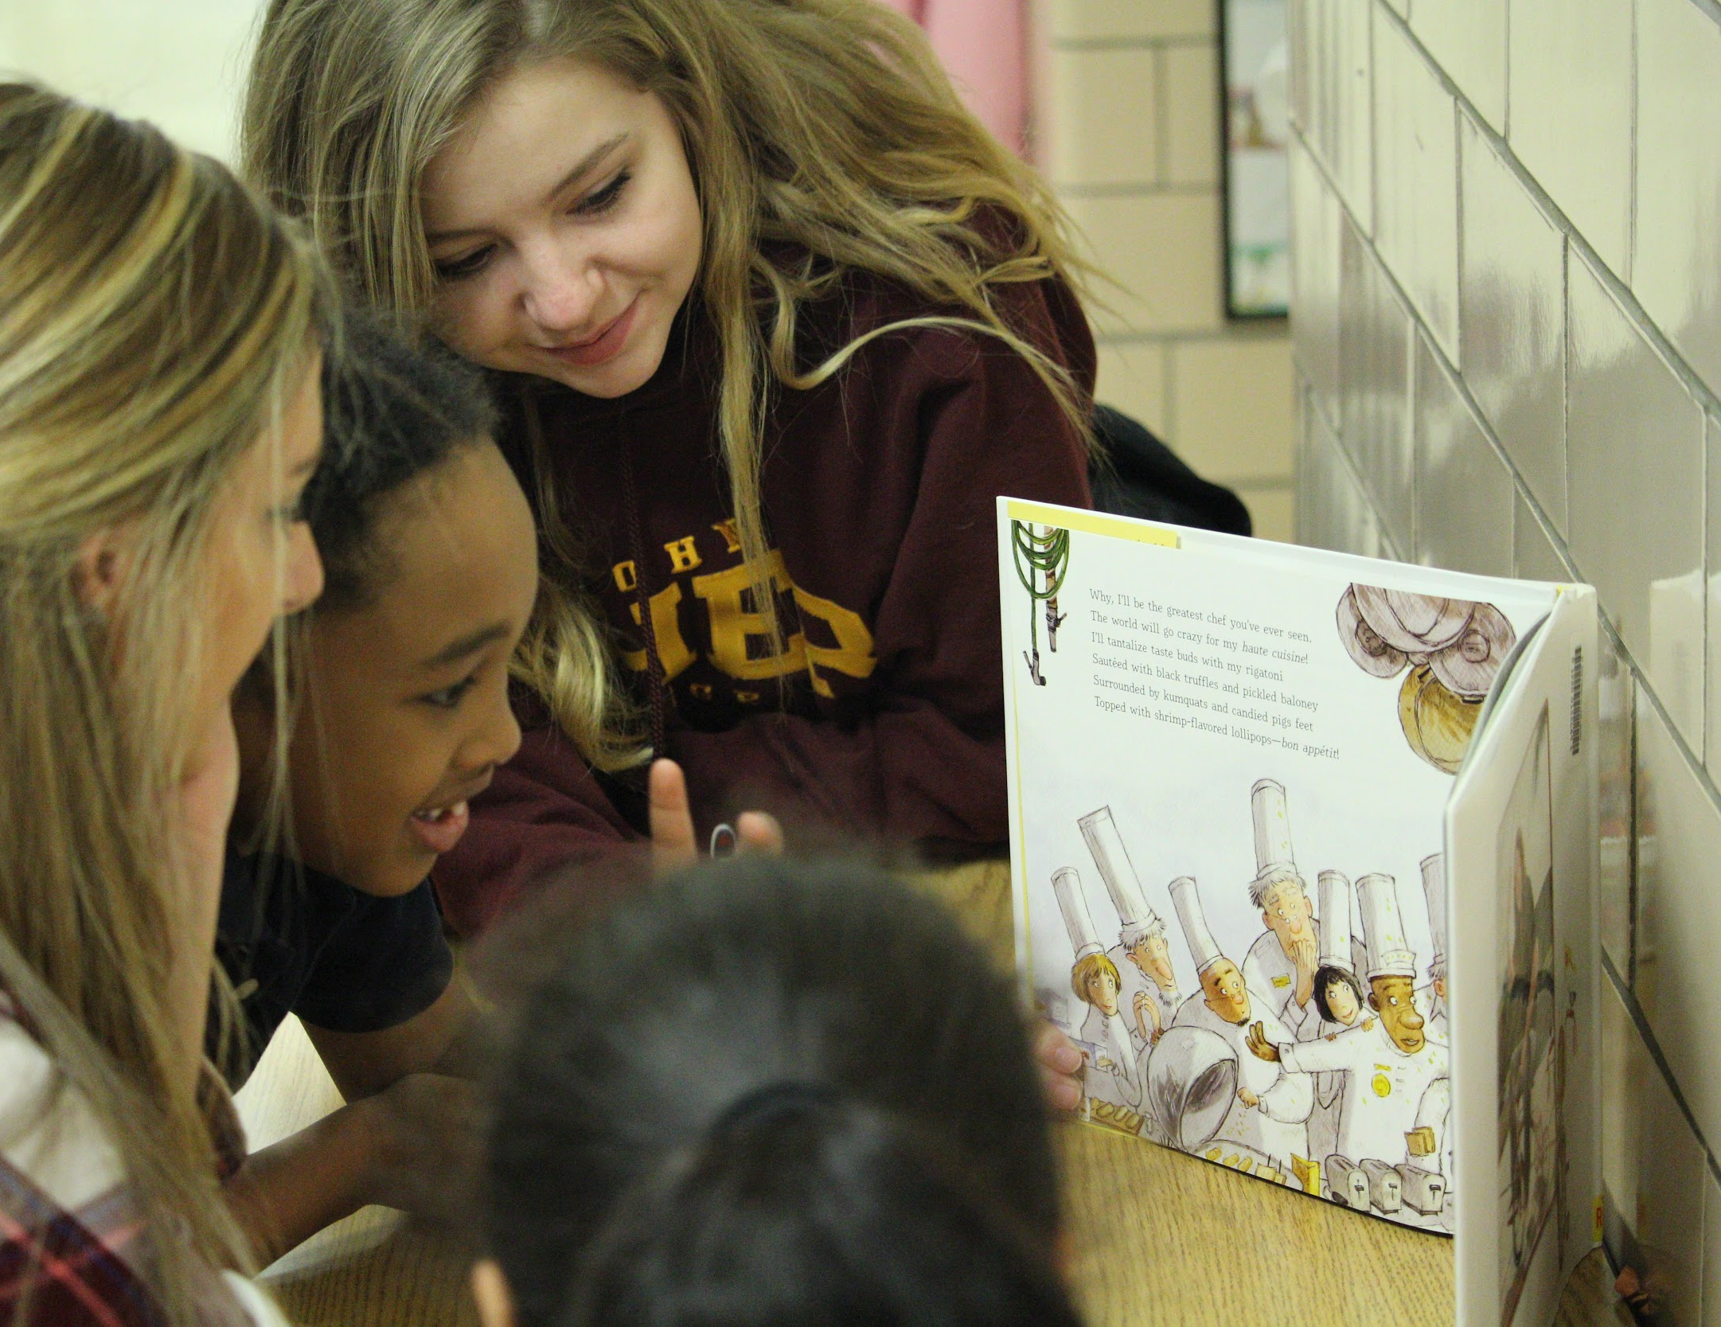
Cultural Sensitivity and Reciprocity
Take time to develop mutual trust, respect, and humility.
Listen to understand rather than listening to speak; Maintain an open mind and commit to learning from others.; Reduce barriers.
Focus on the strengths and assets of your partner, not just the deficits.; Know you will learn from each other.
Respect boundaries; Maintain safety.

Slide 13
What’s Next?
Market it! Add your CEL experience to your resume and use it to promote your skills during an interview.
More CEL! Consider additional community-engaged learning courses to expand your experiences and knowledge and gain work-ready skills (look for SLC Attribute on course registration page).
Go Further! Consider applying for Rochester Summer Urban Fellow or Rochester Youth Year after graduation. https://www.youthyear.org/
Go Beyond! Look into CEL or internships abroad through international service opportunities or study abroad programs.

Slide 14
Resources
CEL Website and Resources:
https://www.sjfc.edu/major-minors/community-engaged-learning/
Civic Engagement Grants
Civic Engagement Awards and Celebration
Contact
Dr. Lynn Donahue
Assistant Director, Institute for Civic and Community Engagement
Lavery Library 104
385-7342
ldonahue@sjfc.edu

Slide 15
What Will CEL Look Like in Your Course?

Slide 16
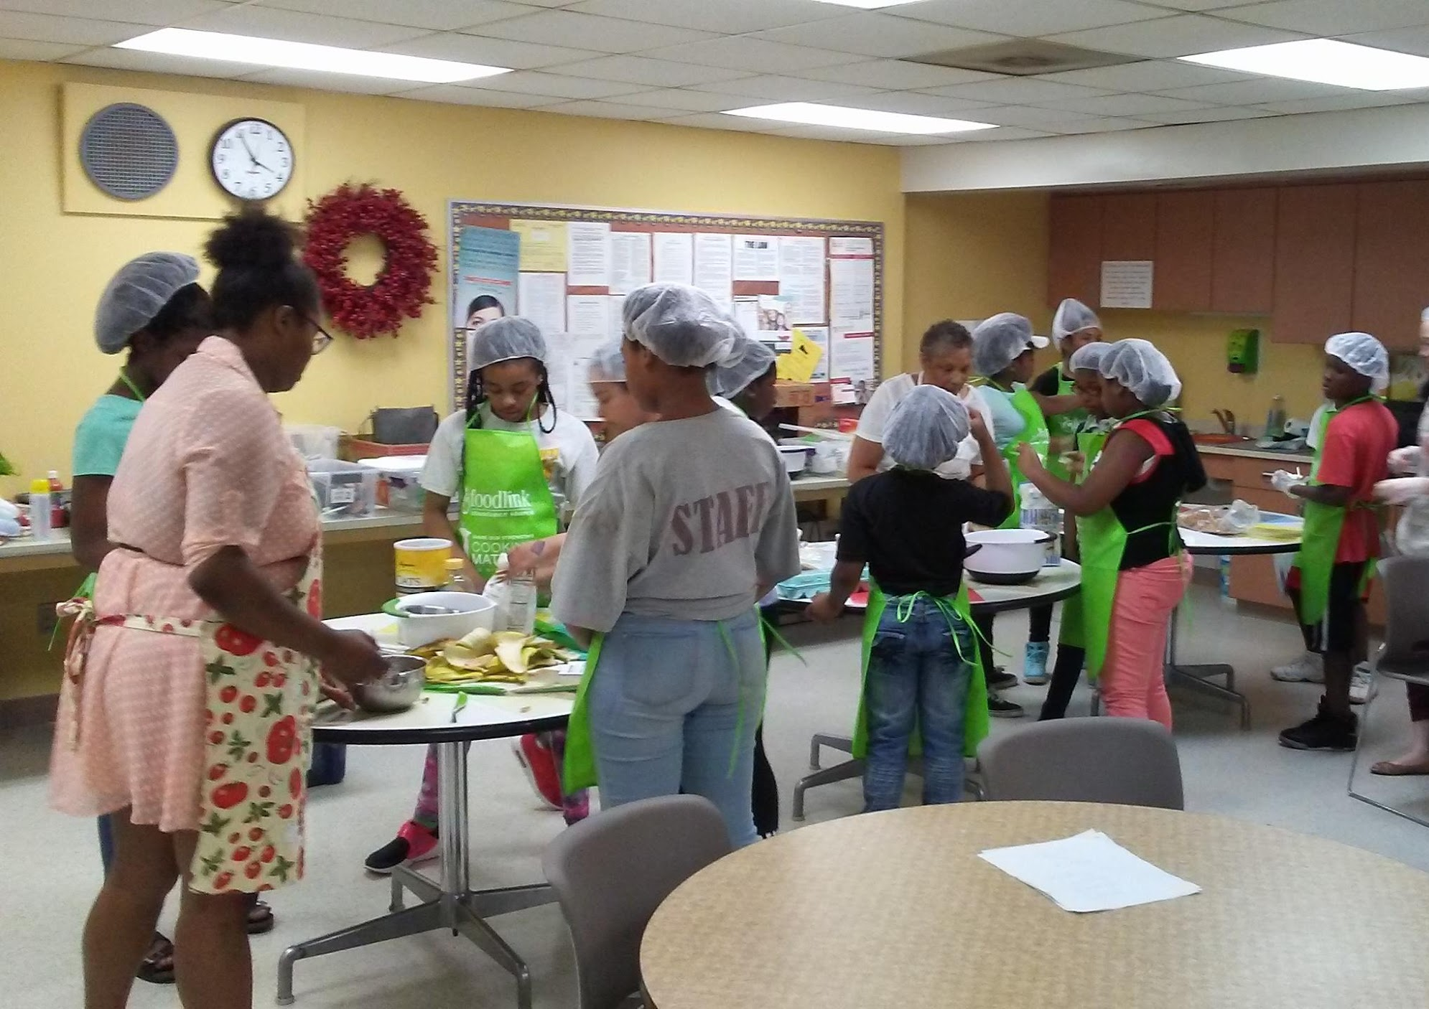
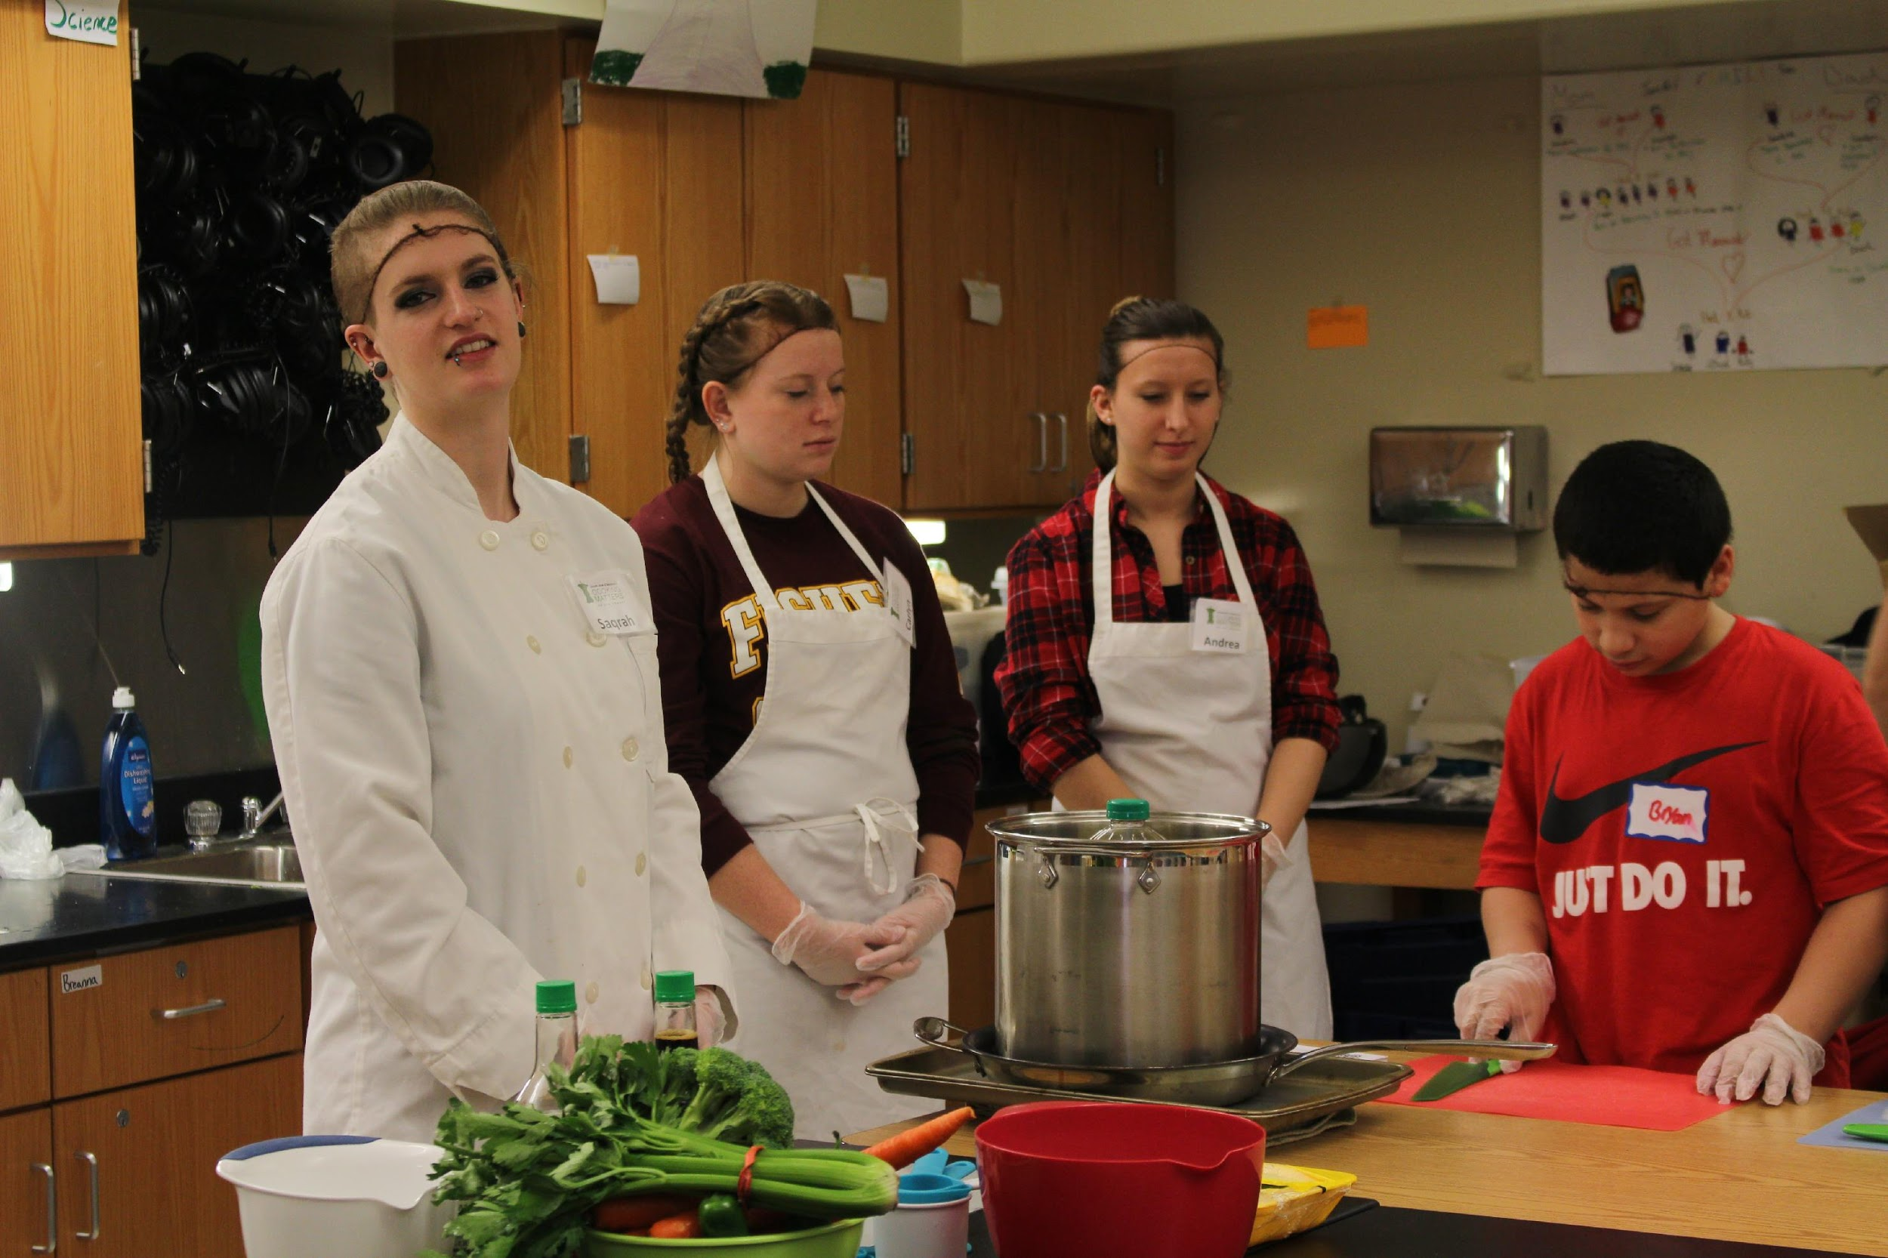
BIOL 108C Fundamentals of Nutrition with Foodlink
Foodlink operations target the root causes of hunger by distributing food to a network of human service agencies, serving meals though our commercial kitchen, and offering more than 30 food-related programs such as Cooking Matters classes to children and adults.
Students will provide support for the Cooking Matters program by transporting supplies, reviewing course instructor guide each week, helping to teach cooking stations, engaging participants in conversations about cooking and nutrition topics based on lesson topics at each class, doing dishes, and assisting with both set up and break down of class.

Slide 17
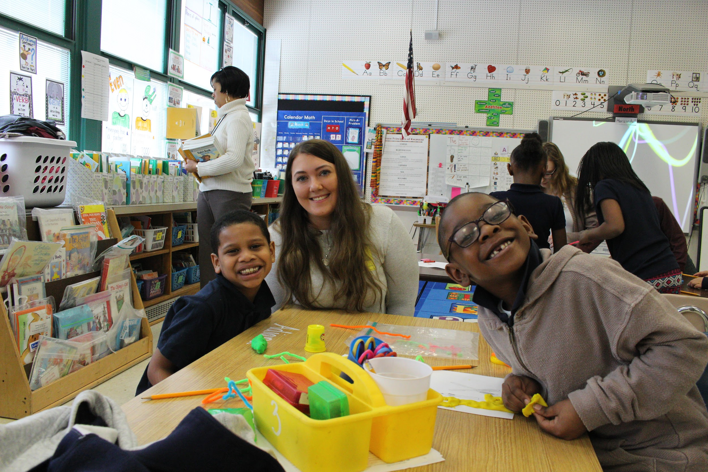
PSJS 250: Social Change through Service
http://sjfcsocialchangethroughservice.weebly.com/; http://seedsofsuccesssjfc.weebly.com/
Seeds of Success is a resiliency and social-emotional learning program offered through St. John Fisher College’s Institute for Civic and Community Engagement. Seeds of Success is designed to develop a resiliency mindset in young, underserved children (grades 1-3) residing in the city of Rochester, NY. Resiliency is defined as “a set of qualities that helps a person to withstand many of the negative effects of adversity” (Gilligan, 2000).

Slide 18
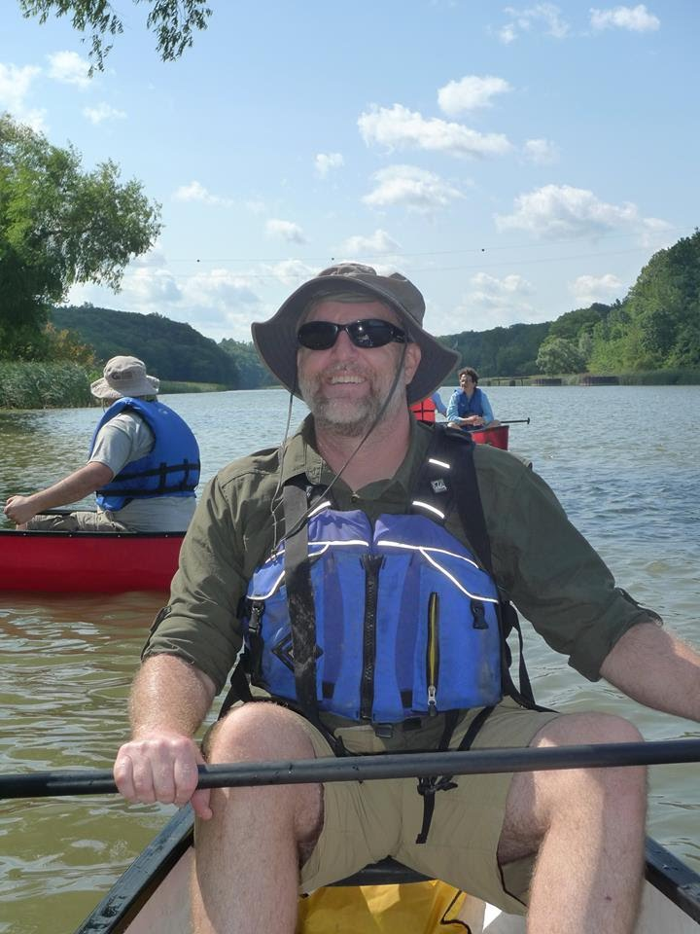
BIOL10: Environmental Issues
Research the history of the neighborhood and how environmental justice looked in history vs. the present (culturally rich, predominantly black). (people and pollution)
Research the history of natural environment of the neighborhood- How did change impact physical and natural environment and its people. (Nature)
Develop environmental justice and urban agriculture curriculum for different ages school age -Adult .
Develop outreach and marketing into the neighborhood (postcards, promotion) to promote programs.
Research the biology of appropriate plants (ornamental, pest controlling, edible and medicinal) that could do well in the courtyard consistent with curriculum ideas. Take a lead on class project of planting of seedlings in the greenhouse for the courtyard garden.
Develop an event honoring environmental sustainability (Earth Week) and template for future events (logistics, involvement of posters, activities, books for read-aloud, etc.) Create a kit for future event implementation.

Slide 19
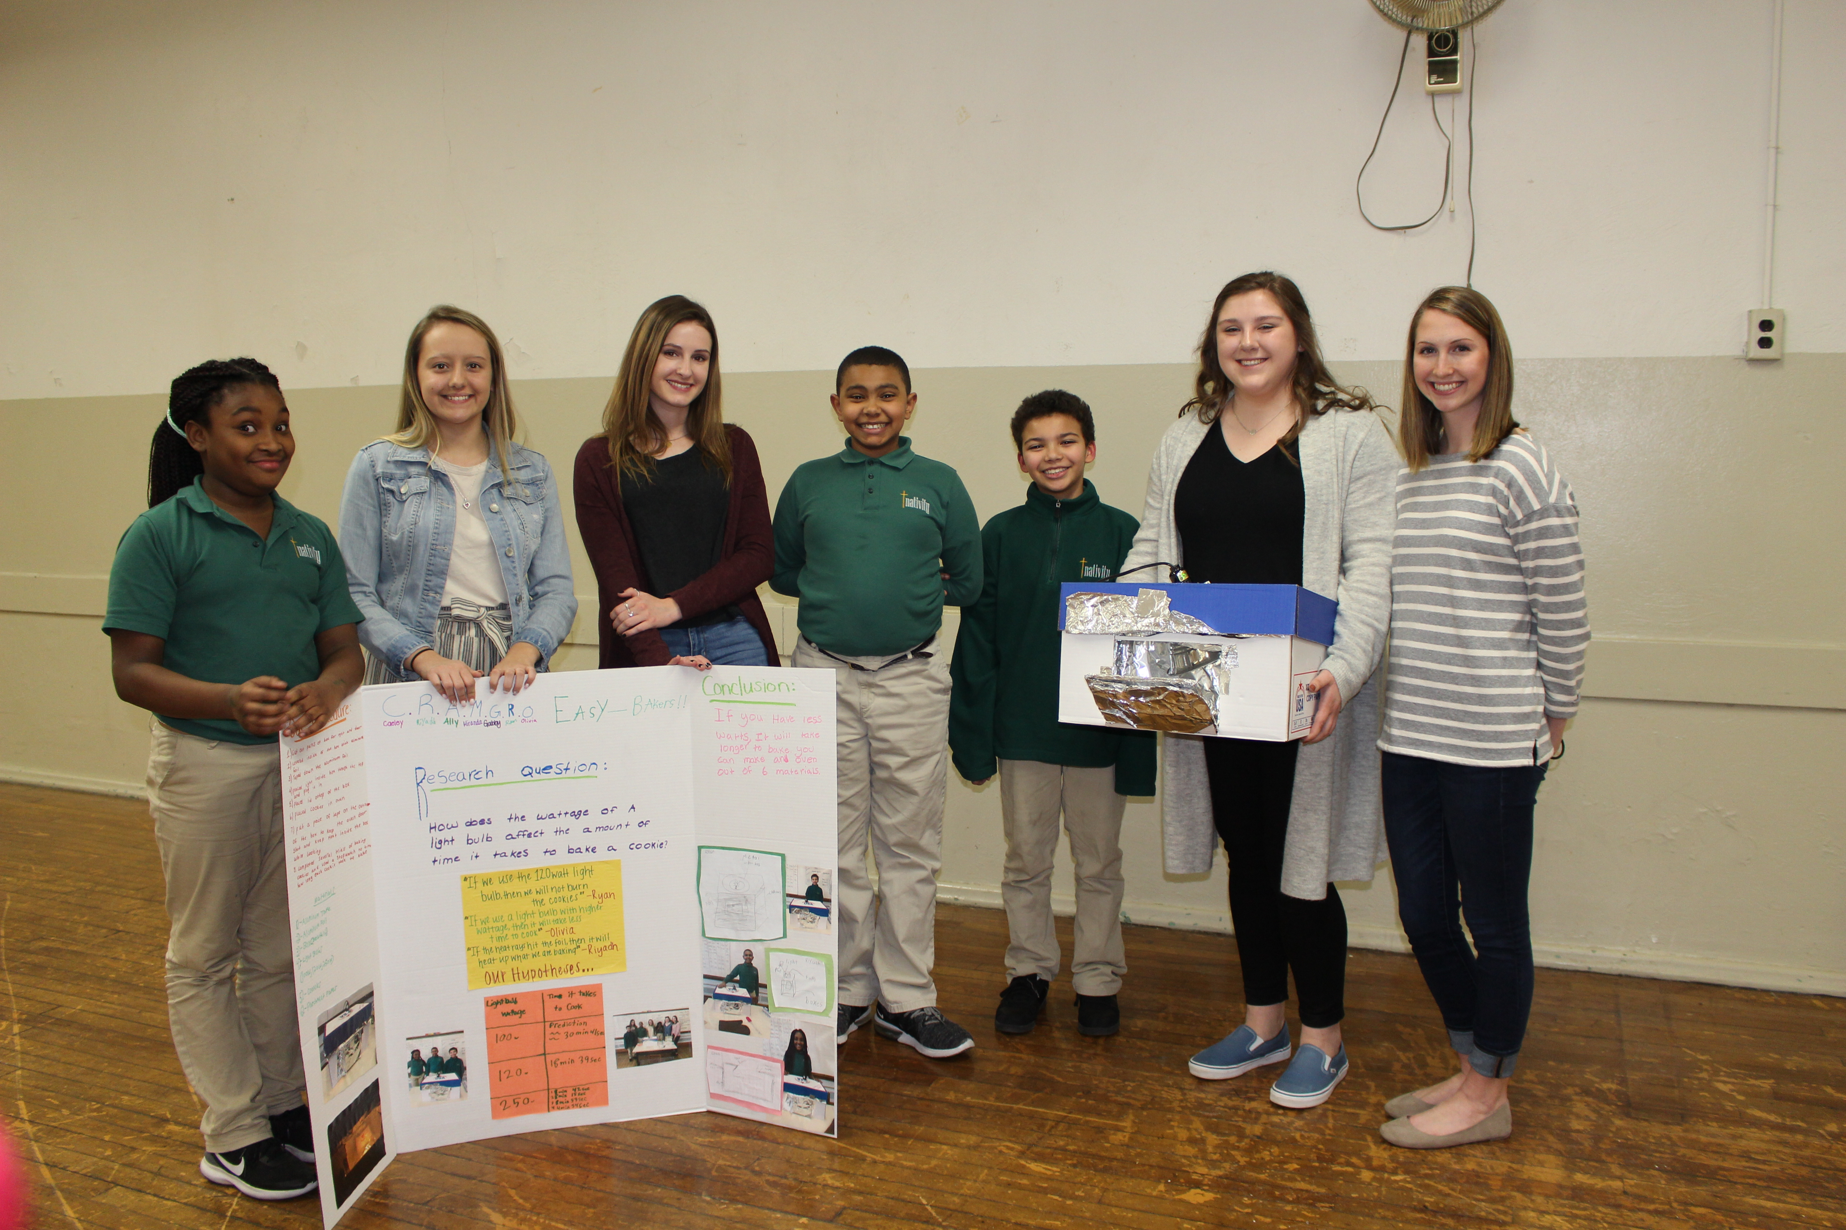
CHEM 214: Biochemical Systems
Students will run a propelled car to illustrate principles of chemistry and make science fun for the Nativity Preparatory Academy.
Students will first design the car, and then determine the chemical reaction needed to propel the car. Common kitchen ingredients will be used such as citric acid and baking soda.
Discussions will focus on how the car was created, how it can be made to move, etc.
The project will include a final competition.

Slide 20
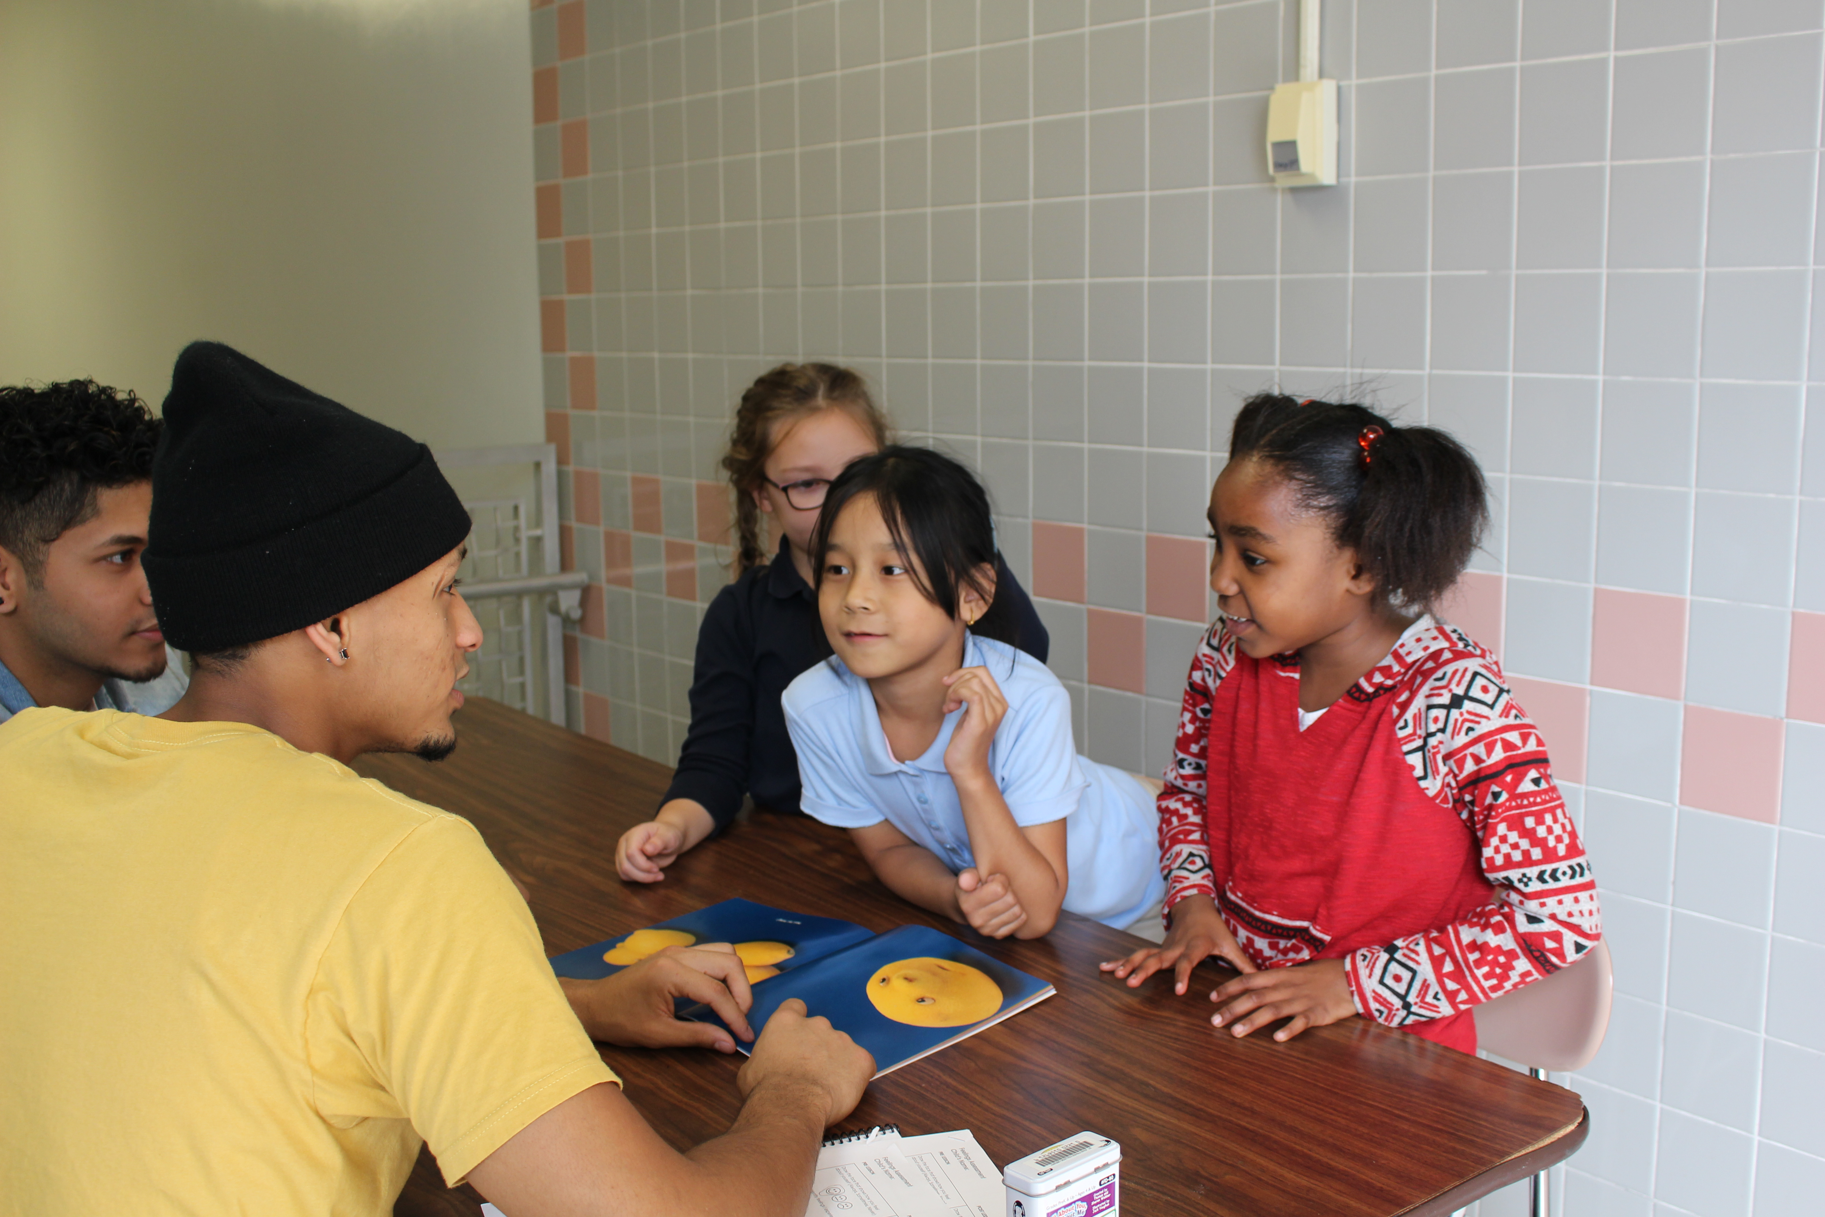
PSYCH 227: Developmental Psychology
Seeds of Success: A Resiliency Education program is designed to build resiliency in children grades 1-4 residing in the City of Rochester, NY impacted by poverty, trauma, and other challenges.
Over the course of the semester, St. John Fisher College service-learning and community service students will serve as “guides” and read books and run activities on topics like autonomy, persistence, and goal setting. Resiliency enhances a child’s ability to cope with adversity and life stressors, which then leads to positive relationships and academic success
Each session will last about 45 minutes about 8 weeks. Students will be asked to lead a reflection activity at the conclusion of the program and organize a celebration where all children will receive a certificate of completion.
Ms. Lena McDaniels | maddalena.mcdaniels @rcsdk12.org | 3rd grade | Tues., Wed. & Thurs. 9:00-11:55; 12:30-2:45
Ms. Tammy Lezeska | tammiek.lezeska @rcsdk12.org | 3rd grade | Tues., Wed. & Thurs. 9:00-11:55; 12:30-2:45

Slide 21
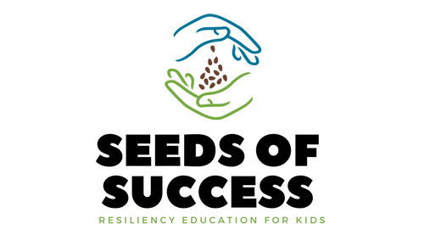
PHIL 230CC: Philosophy of Education
The course examines modern approaches to the philosophy of education, with emphasis on the work of thinkers such as Plato, Rousseau, Maritain, Whitehead, and Dewey. Topics include educational theory, the role of the school in society, the philosophical assumptions of curriculum development, and the problems of teacher accountability.

Slide 22
GPH 505: Social and Preventative Health
Students will support the mission of HIS Branches and Joy Family Medicine to provide health and wellness education to residents of the Beechwood neighborhood and beyond through three options:
Workshop Facilitation
Curriculum Development
Data Collection and Research

Slide 23
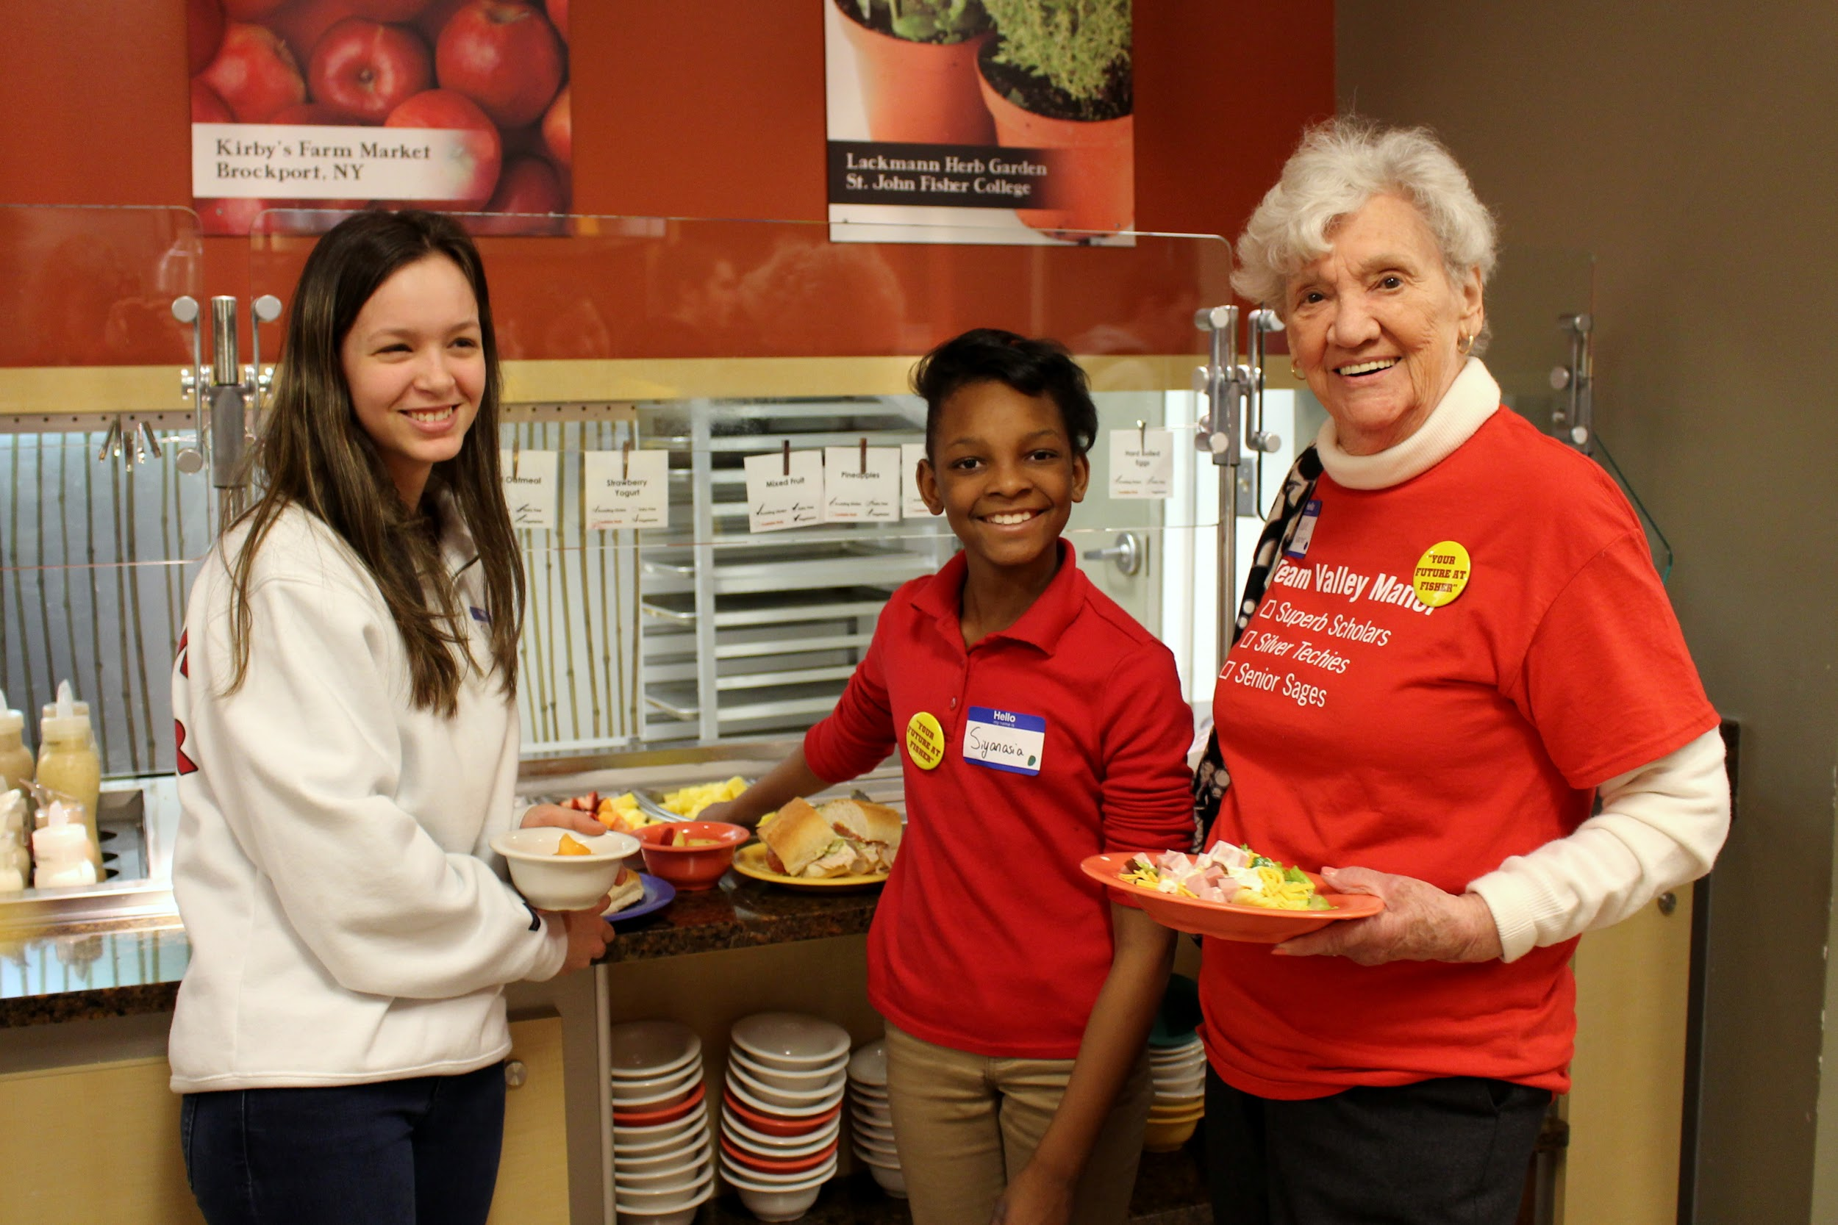
SOCI 221: Helping Professions in Action
Seeds of Success: A Resiliency Education program is designed to build resiliency in children grades 1-4 residing in the City of Rochester, NY impacted by poverty, trauma, and other challenges.
Over the course of the semester, St. John Fisher College service-learning and community service students will serve as “guides” and read books and run activities on topics like autonomy, persistence, and goal setting. Resiliency enhances a child’s ability to cope with adversity and life stressors, which then leads to positive relationships and academic success
Valley Manor Kids on Campus and Career Days introduces students to life at college and the educational requirements of different careers that will be introduced at Kids Career Day at Valley Manor.

Slide 24
FINA 218: Personal Financial Planning
Students will lead lessons and work one-on-one with teens and in group sessions to implement the Junior Achievement curriculum using a curriculum guide provided by JA. SJFC students will be assigned to a classroom for the JA program duration. Sessions will include:
Earning, Employment, and Income
Budgeting
Savings
Credit and Debt
Consumer Protection
Smart Shopping
Risk Management
Investing

Slide 25
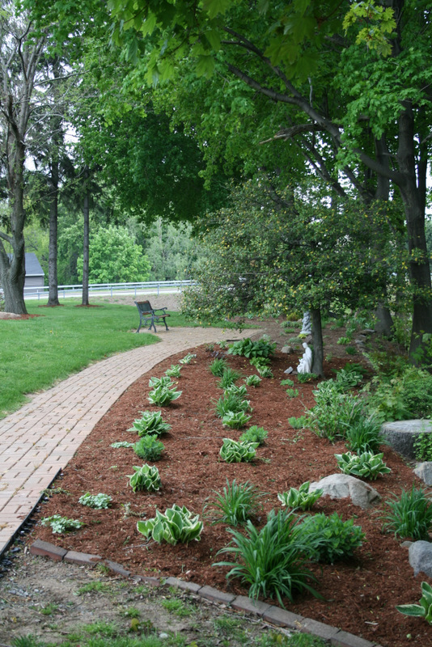
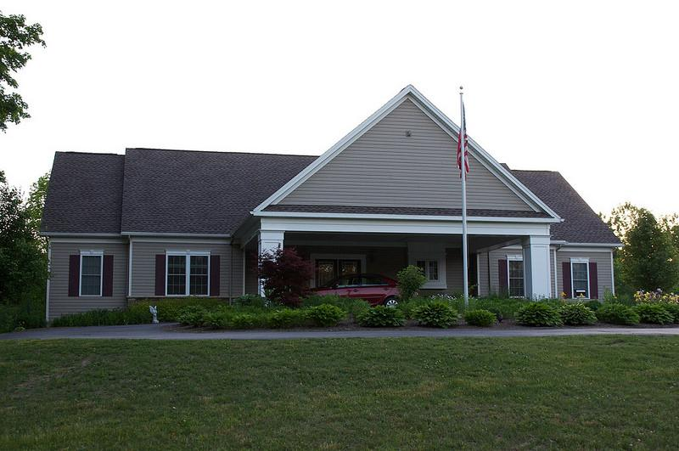
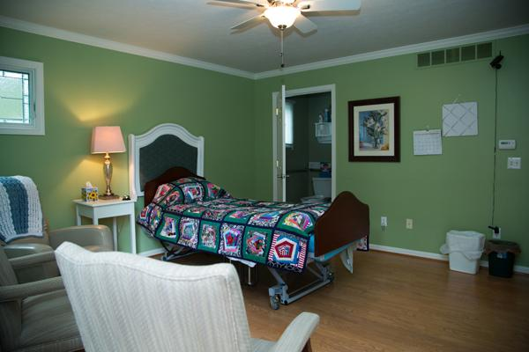
NURS 312 Palliative and End of Life Care with Comfort Care Homes
Students will engage in 16 hours of hands-on, client support work at one of the listed comfort care homes. Work can include the following:
observing clients/staff/interactions
spending time with an identified client (reading, talking, playing an instrument)
identifying a need of the home and developing a project to meet that need
supporting programmatic needs including cooking, office help etc.

Slide 26
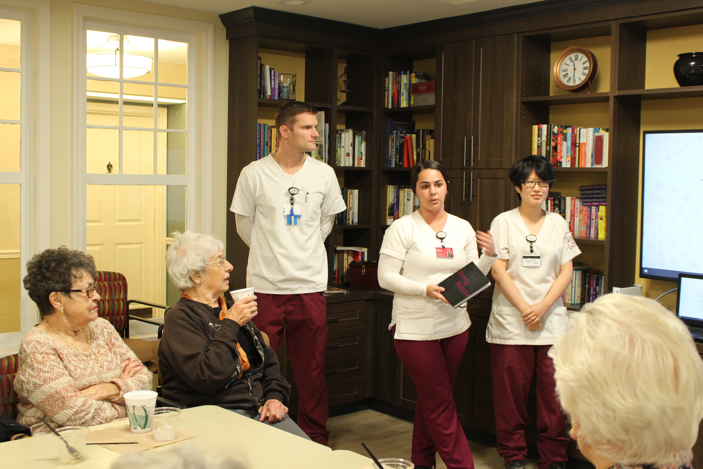
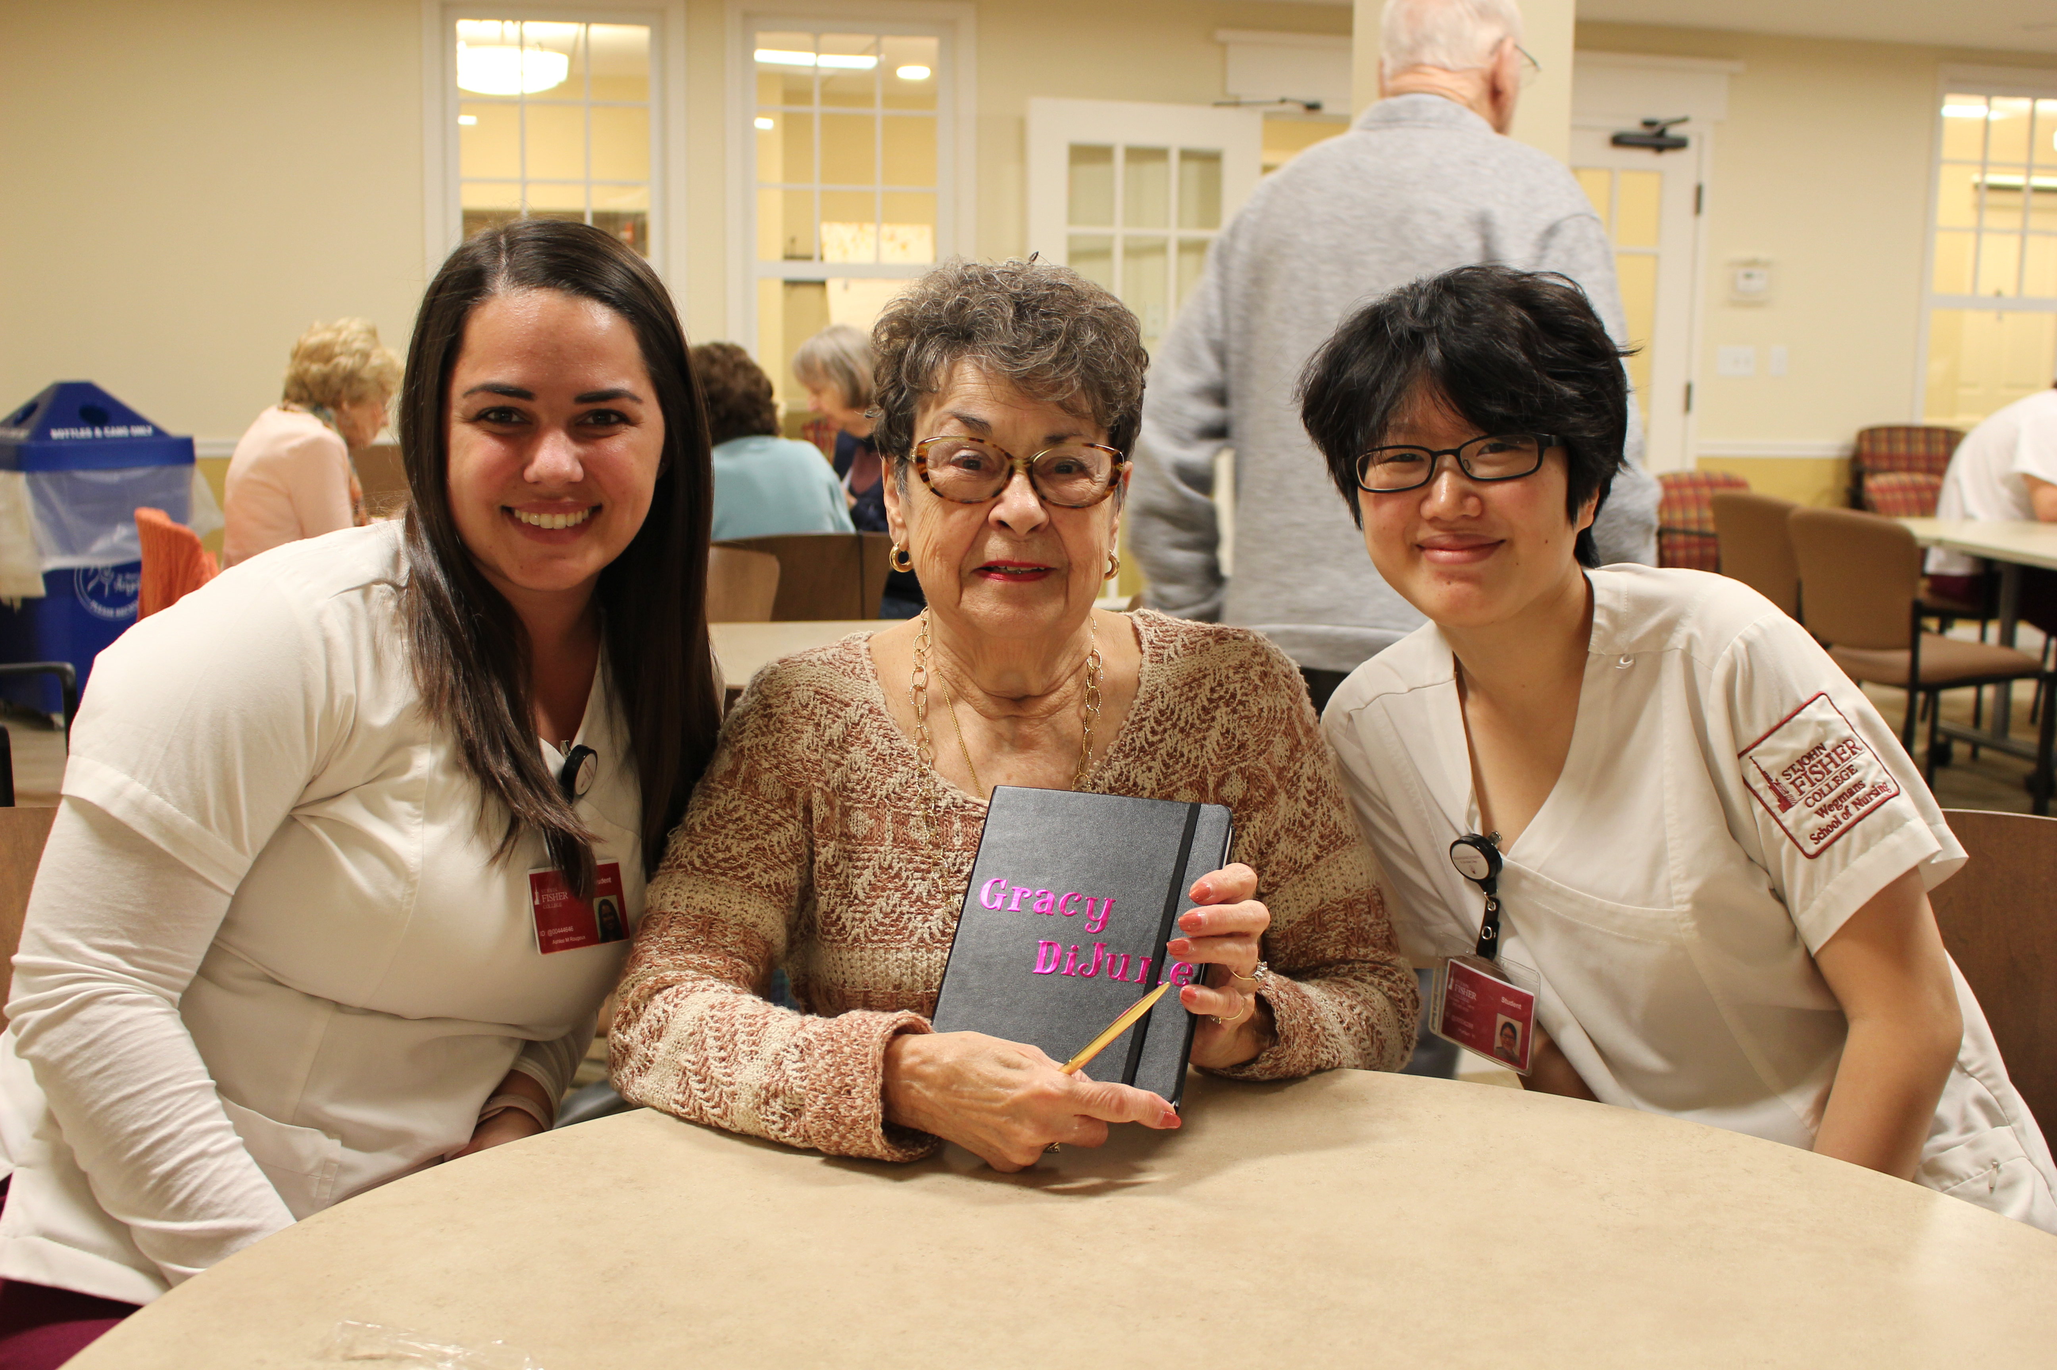
NURS 429: Population Health/Community Nursing
Students who are completing their Population and Community Health clinical hours will be on-site 1 day/week for 8 weeks. Students will learn the community levels of care in this setting (St. Ann’s Community and Warfield Square)
Students can incorporate outcomes from previous semesters focusing on the learning needs of residents in the assisted living level of care.
Students will have an opportunity to learn about specific residents, their needs, Case Management and Care Coordination efforts and a host of opportunities available.

Slide 28
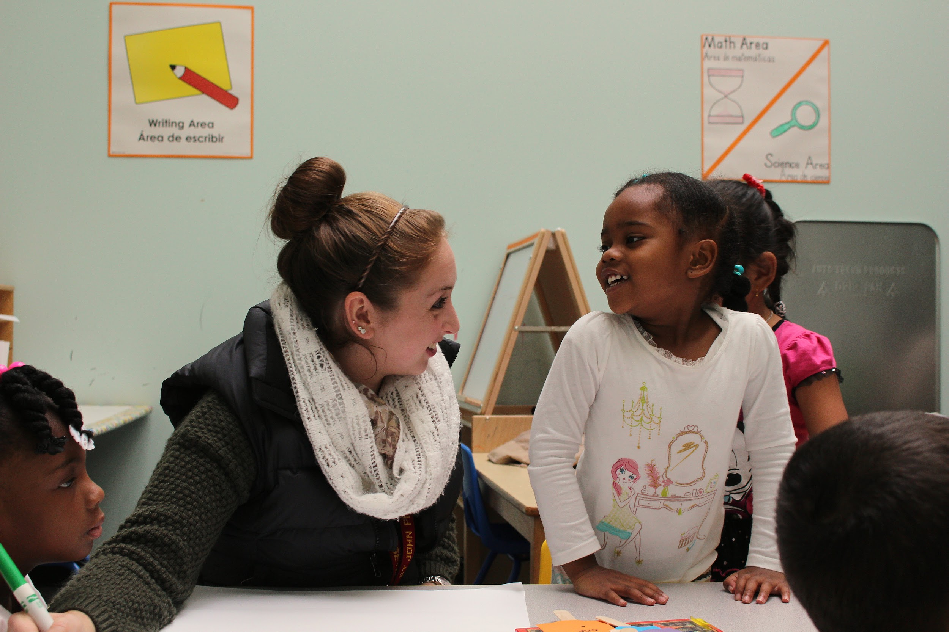
EDUC 226: Foundations of Language and Literacy
Teacher candidates will gain theory to practice connections by directly observing the natural and atypical variations in language development and early literacy that occur within a classroom of children.
Teacher candidates will gain an increased understanding of cultural differences as they relate to language development and develop a plan for including children whose primary language is not English
Teacher candidates will conduct read aloud activities, and shared reading and writing activities with small groups of students

Slide 29
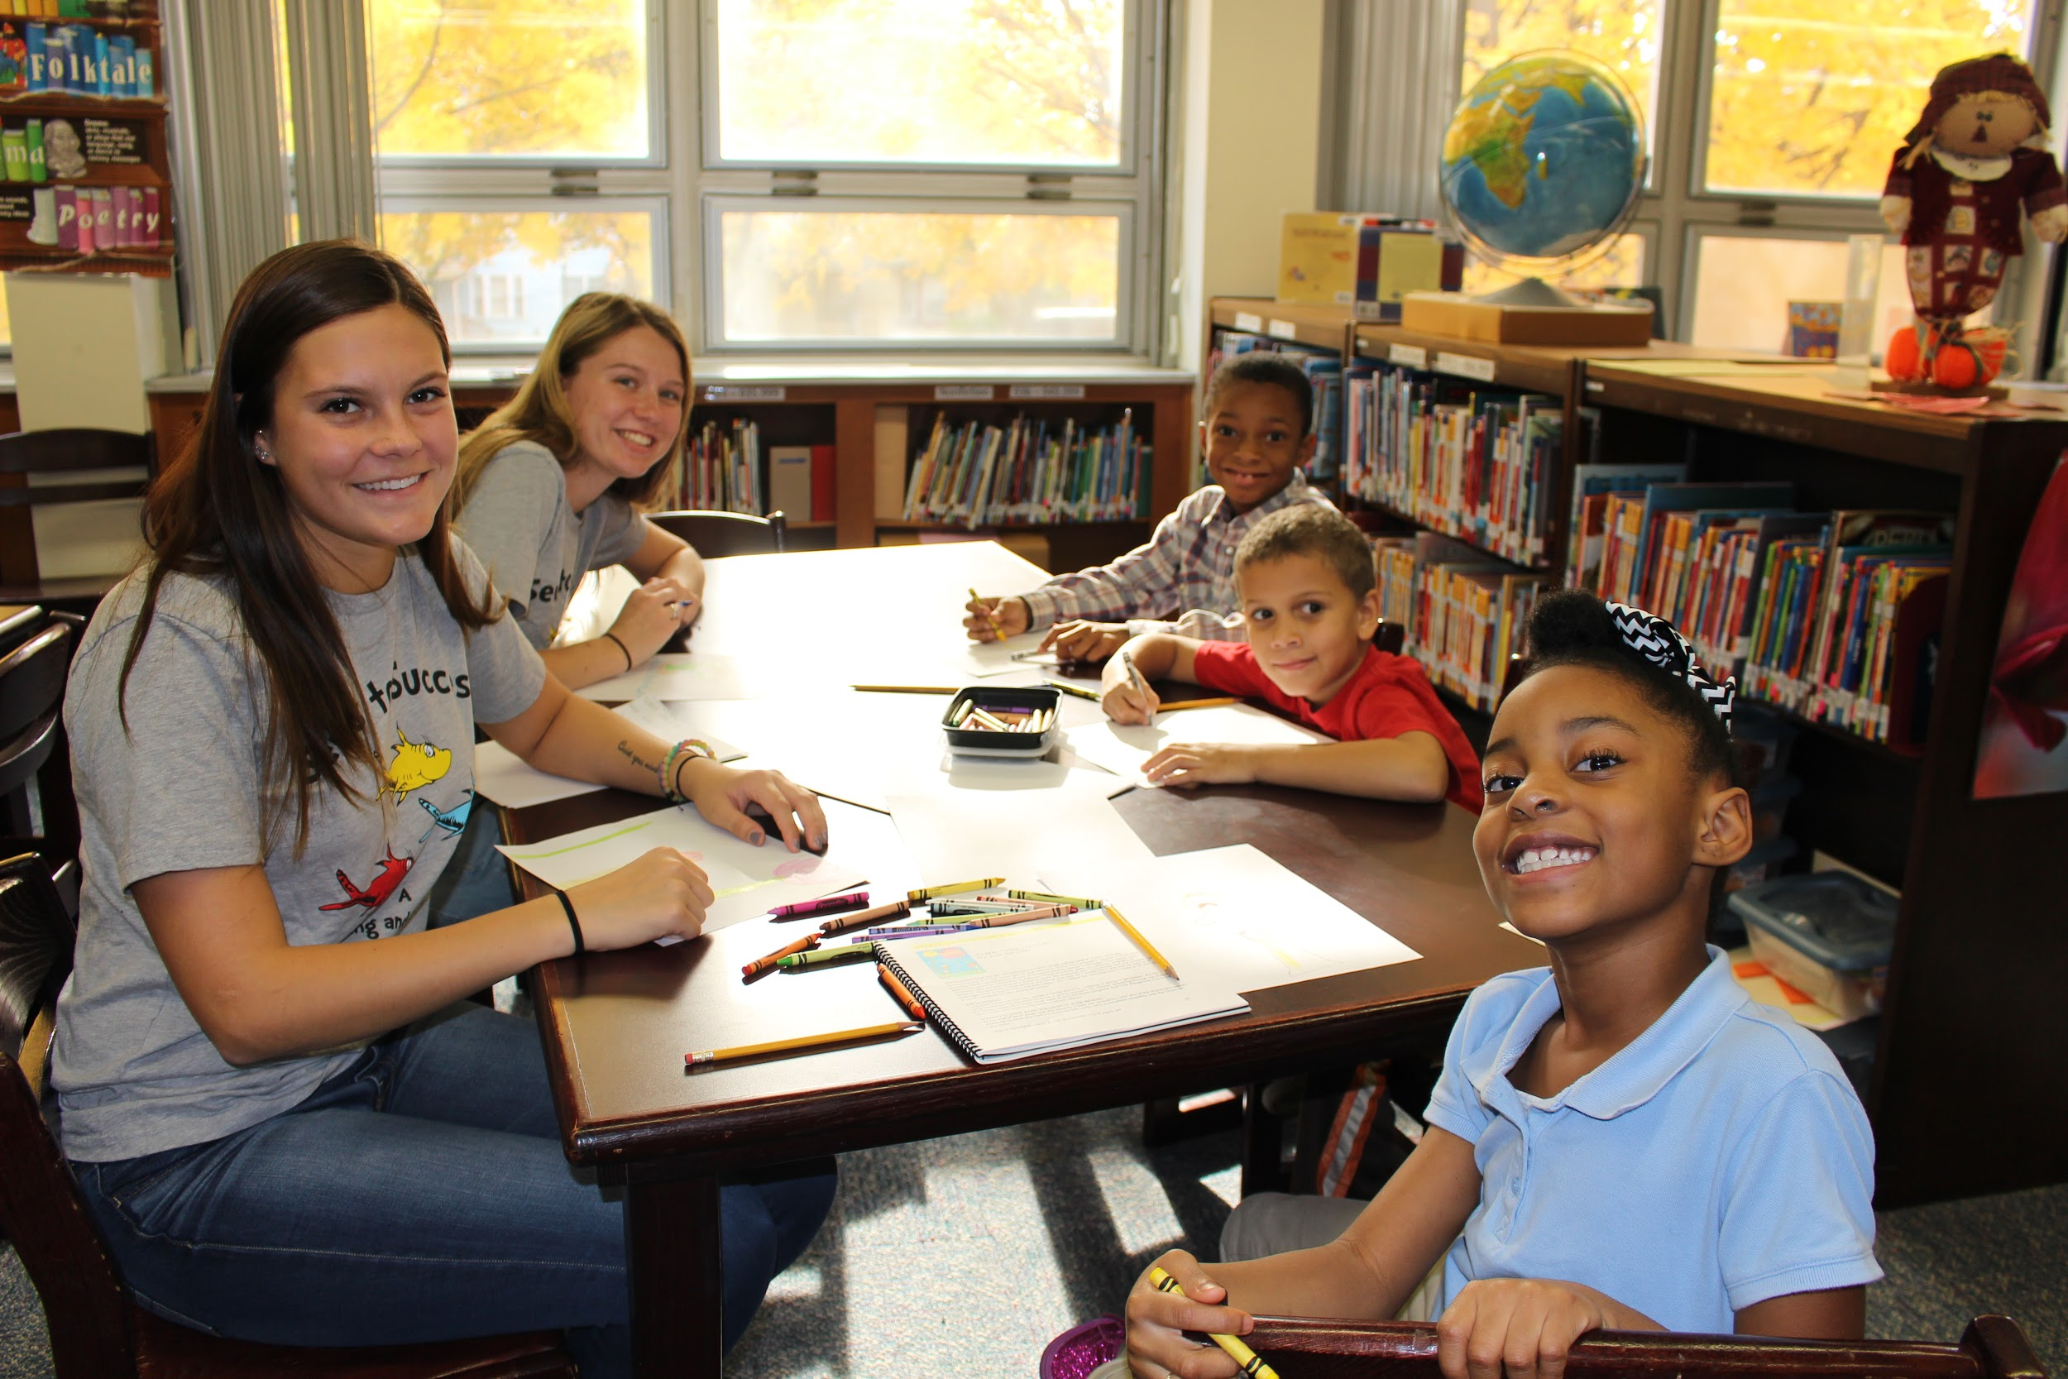
PSYCH 281: Learning
Seeds of Success is a resiliency and social-emotional learning program offered through St. John Fisher College’s Institute for Civic and Community Engagement. Seeds of Success is designed to develop a resiliency mindset in young, underserved children (grades 1-3) residing in the city of Rochester, NY. Resiliency is defined as “a set of qualities that helps a person to withstand many of the negative effects of adversity” (Gilligan, 2000).

Slide 30
ENG 356: Editing and Publishing
Fisher students will partner with students from the Teaching and Learning Institute at East High School through a literary publishing experience focusing on literature and identity representation.
An anthology of students’ writing and a reading event in Rochester will be the final outcome. Students may focus on the I Am poems or Future of Rochester Essay for this anthology, or a new prompt developed together.
A second team of students will work in developing ANGLES, Fisher’s national online publication for creative writing by college-aged writers.
Meetings will occur at the East High campus, St. John Fisher, and potentially Writers and Books.

Slide 31
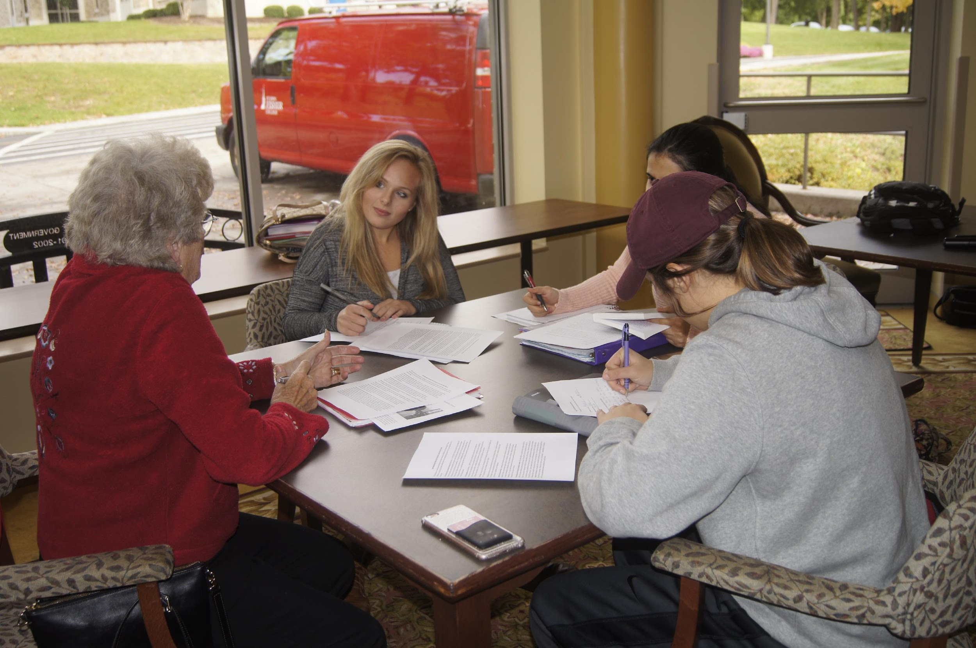
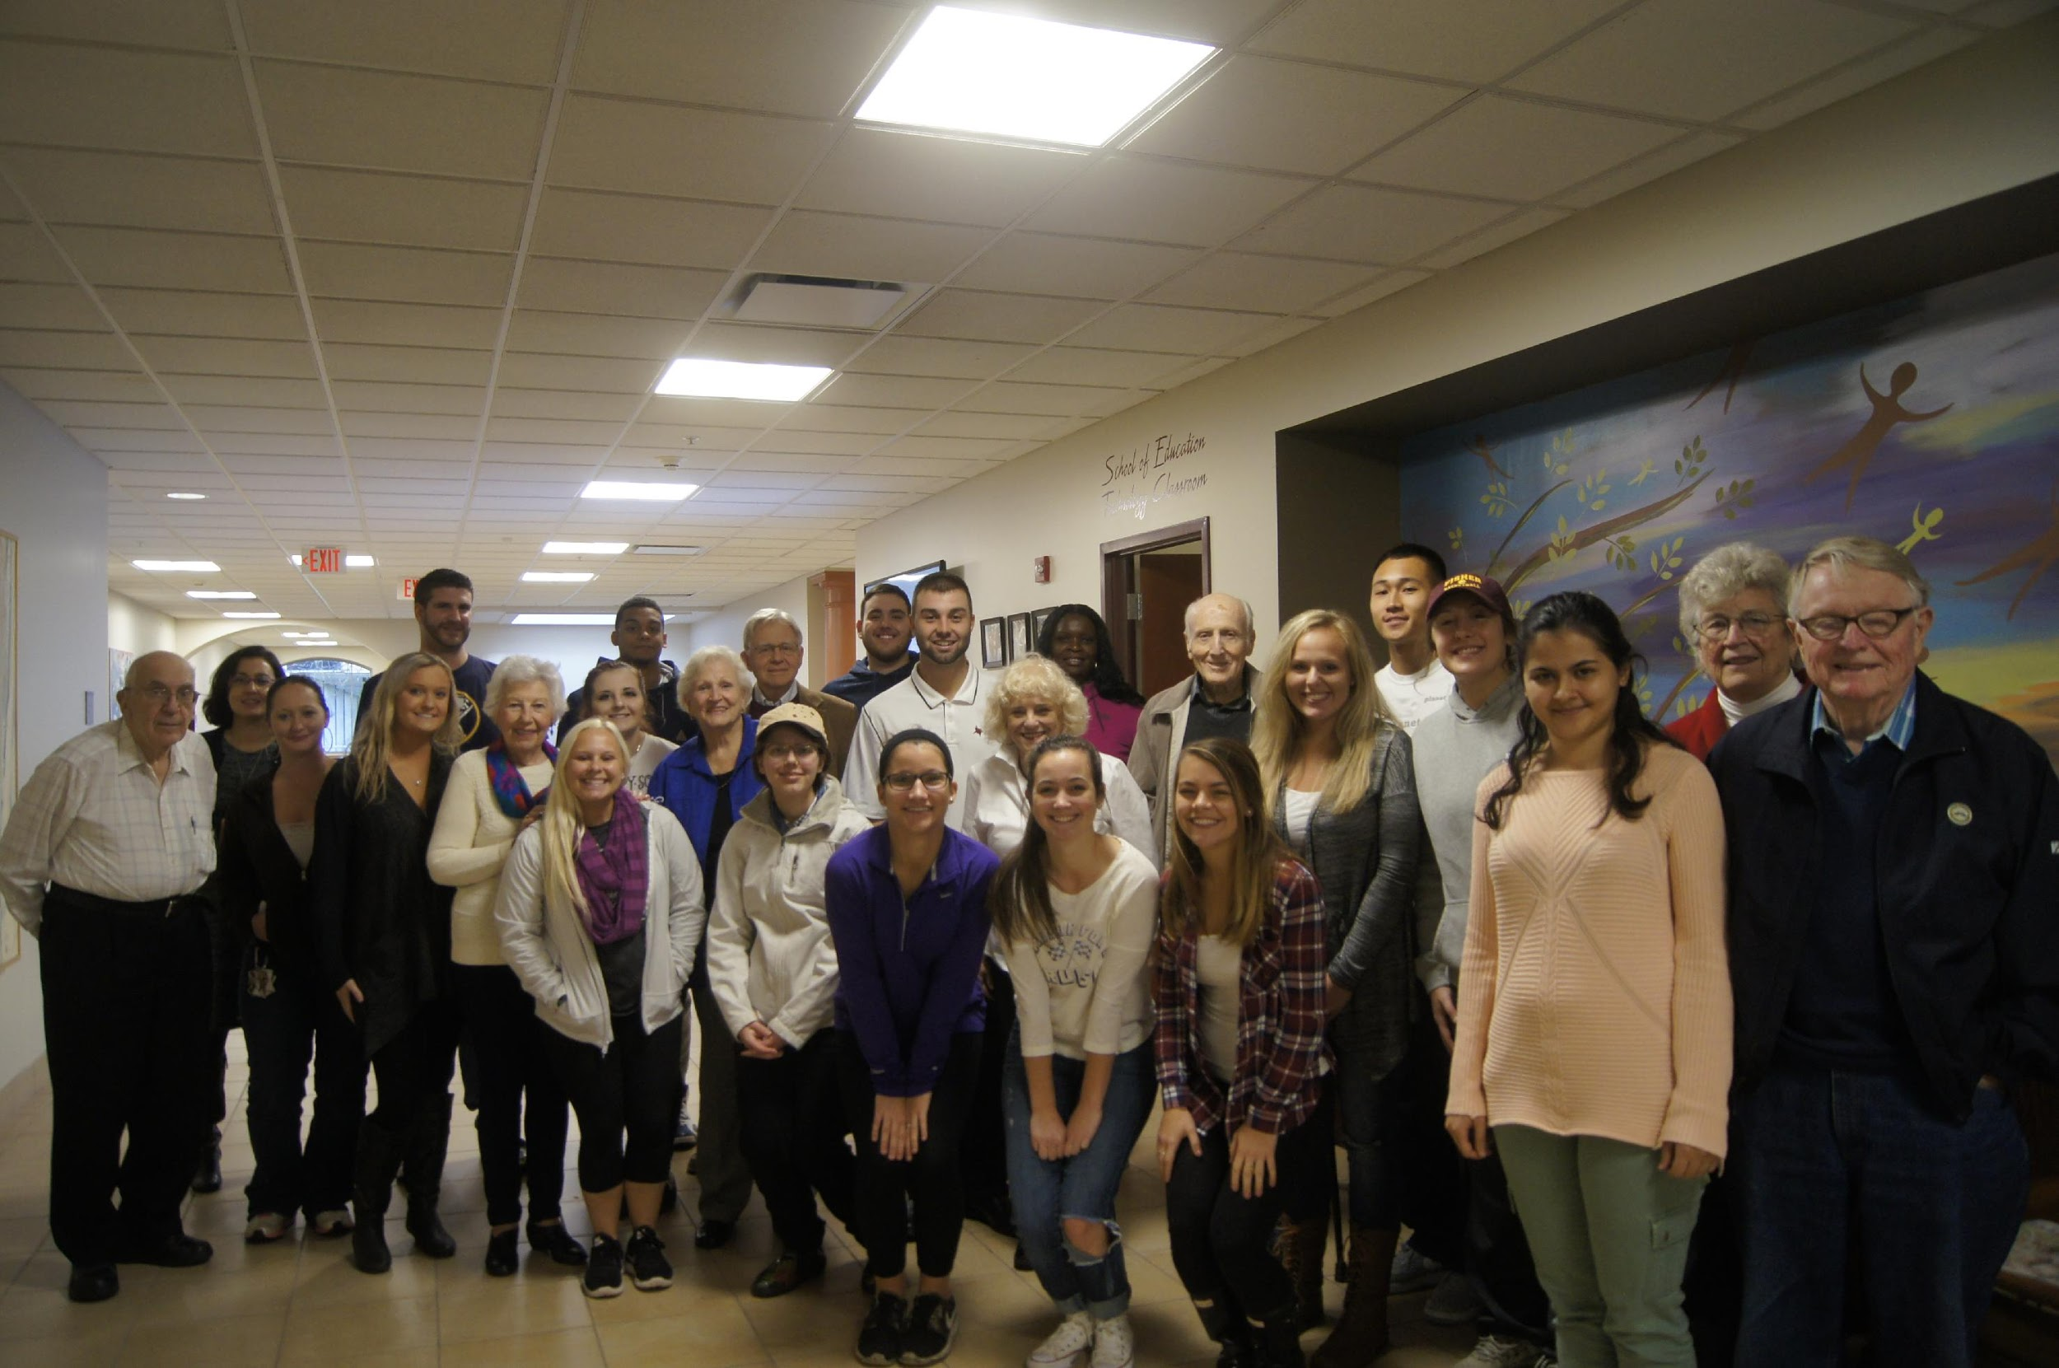
SOCI 322 Sociology of Aging and the Life Course with Episcopal Home
Students and Episcopal Home seniors (and CPGR?) will participate in a shared experience to learn about issues related to ageing, engage in small and large group discussions, and reflect and write on personal relevance.
Topics will include women, ageism, family, intergenerational relationships, peer networks, health and health care, aging in CCRC, end of life issues, religion and spirituality.
Students will collect and summarize the elder’s responses and stories for a written document to be given to the elder and his or her family and staff, and will be used for those participating in the 2nd semester Aging Games.

Slide 32
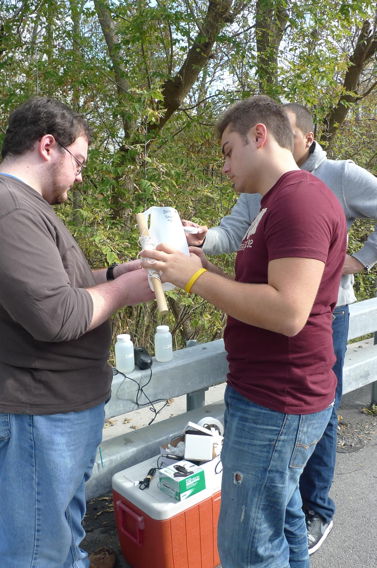
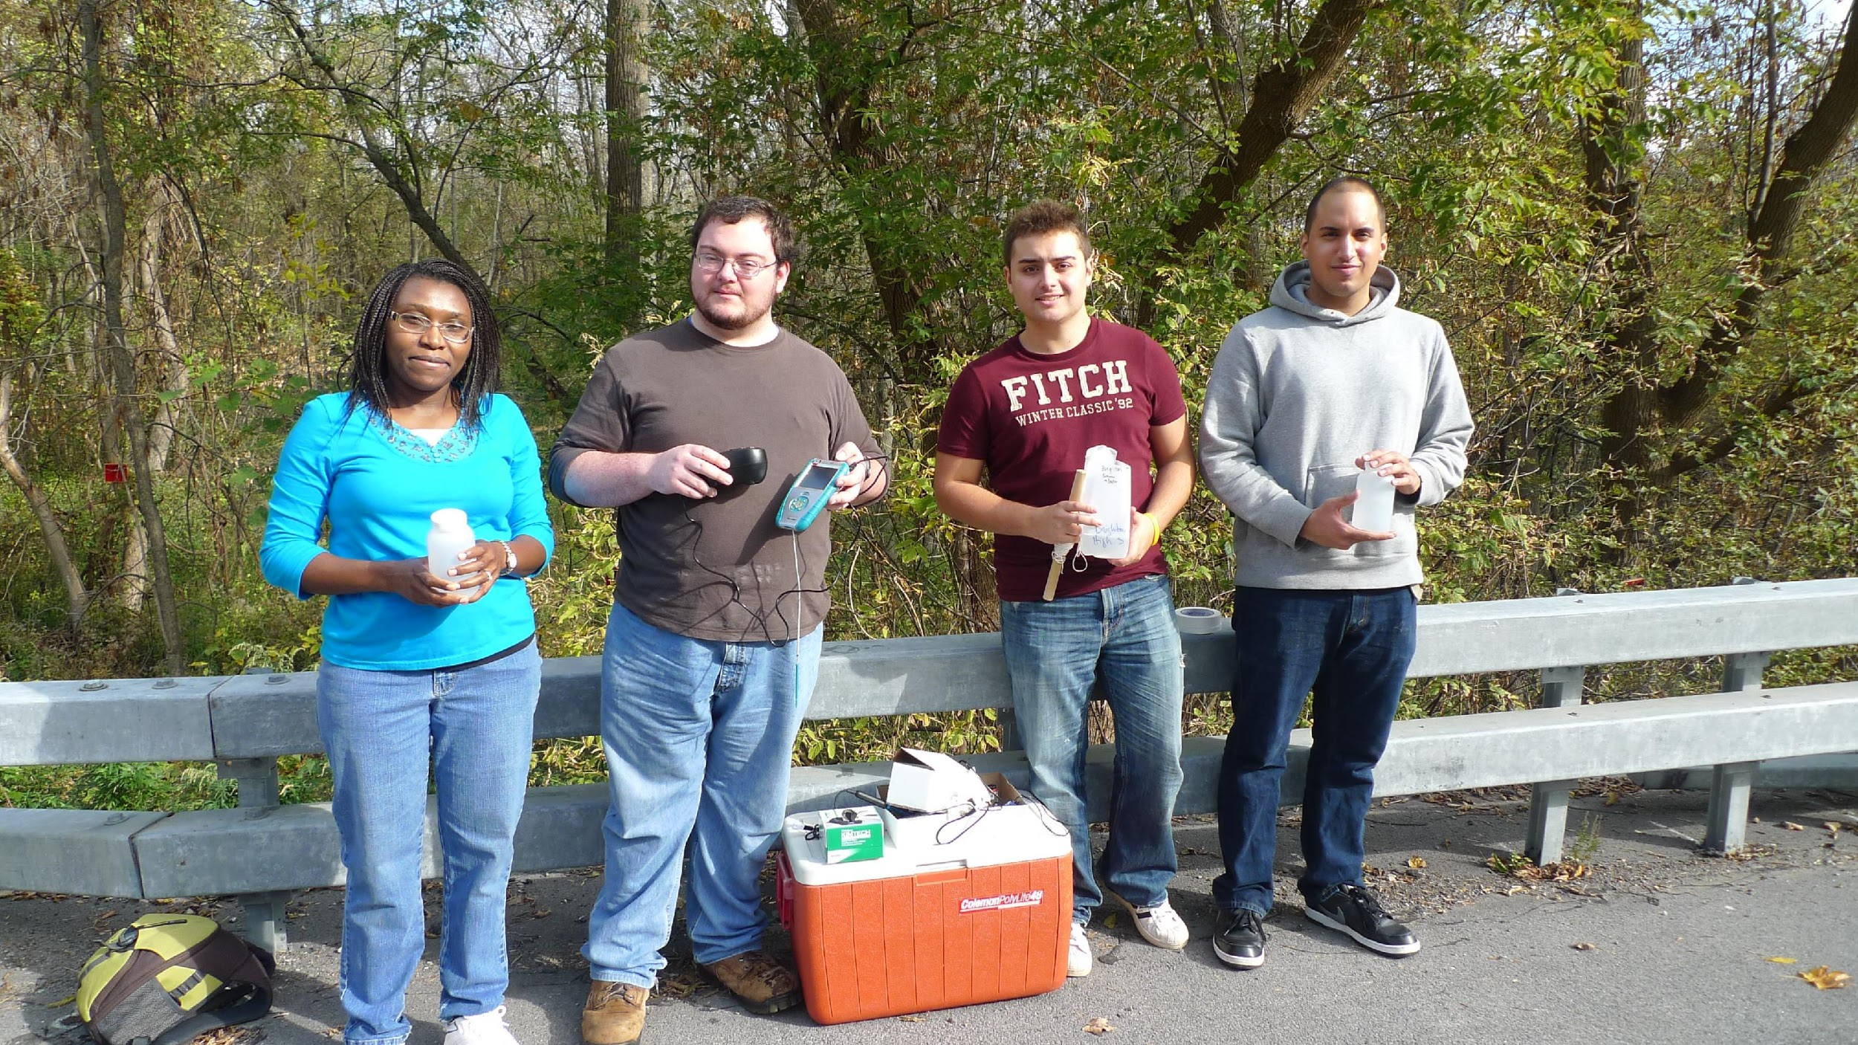
CHEM 315L: Analytical Chemistry Lab
Students will gather water from designated sites identified as important by Genesee River Watch.
Students will test for the presence of total phosphorous and reactive phosphorous from the middle of the river
Will explore if there are sediment points that need monitoring that are indicated in the Kodak study.
Students may also work alongside citizen scientists during sampling day

Slide 33
COMM 363: Media Research and Analytics
It is time to put your web analytics & media research skills to test by taking on a new and previously unexplored research area for the client. You will need to combine research methods, inferential statistics, and client communication in order to:
1) Audit the company’s existing digital product portfolio
2) Develop a recommended communications plan for at least one of the company’s customer facing platforms.

Slide 34
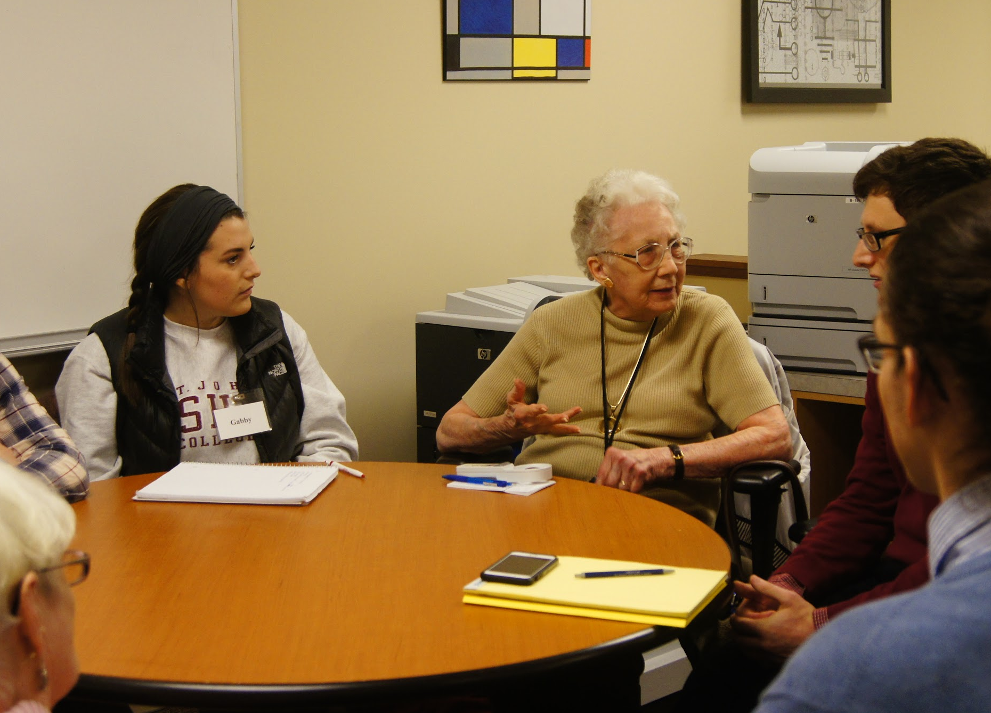
POSC 224: Campaigns and Elections
Students will participate in collaborative discussions with seniors from St. John’s Meadows on pre-identified political science topics related to campaigns and elections. All will participate in discussion as both leader and follower – as both teacher and learner.
The primary goal of the discussions is to apply and discuss concepts and theories behind campaigns and elections to the 2018 midterms. Conversations will also focus on how and why individuals have come to form the beliefs they hold.
Topics will include the following:
Political parties, gerrymandering
Policy platforms and candidate traits
Money in politics
Forecasting, media coverage
Vote choice and turnout
Modern campaigns and elections in historical and international context

Slide 35
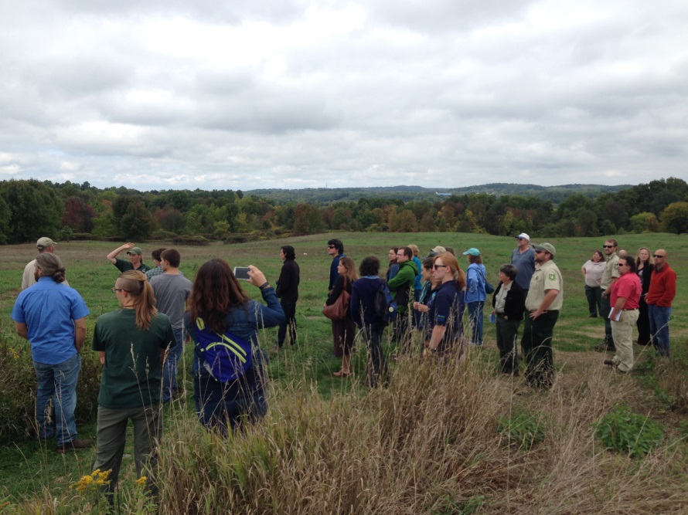
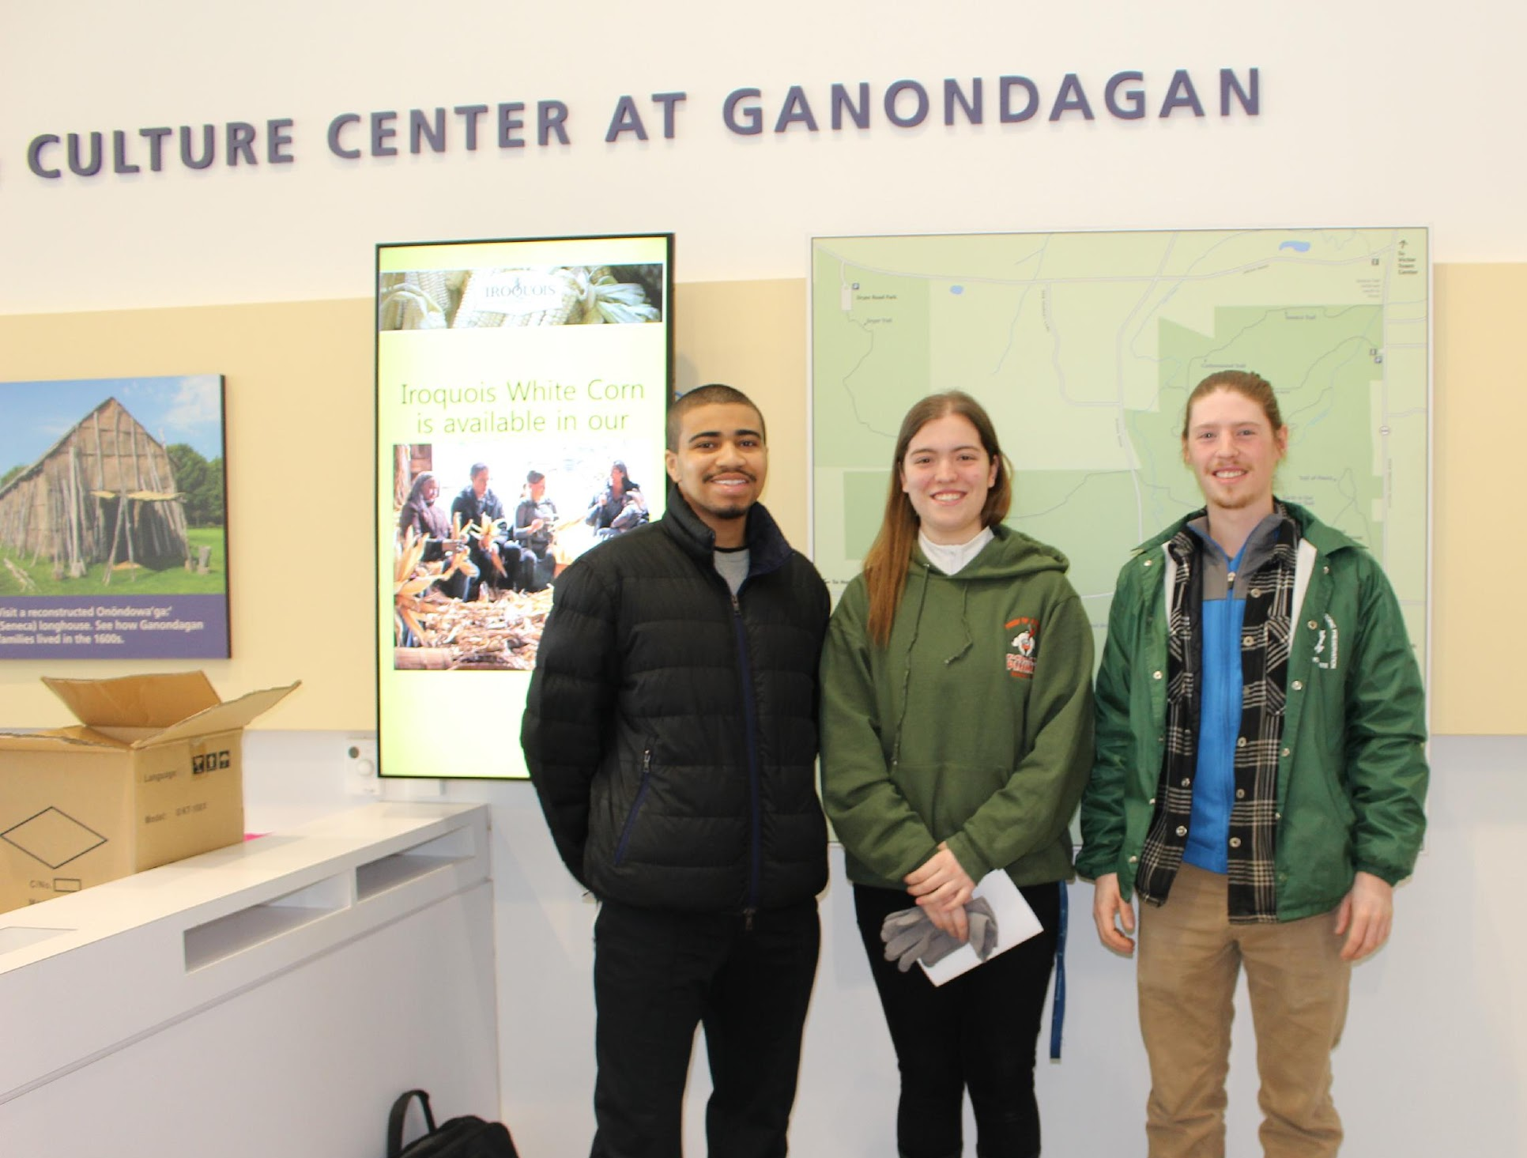
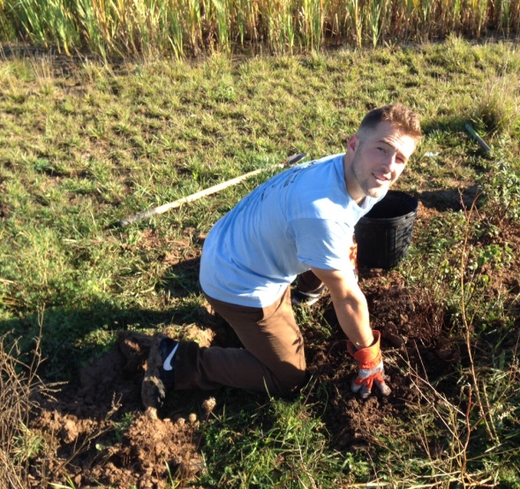
BIOL 406 Animal Natural History with Ganondagan Historic Site and Environmental Field Office
Students will monitor the health of Great Brook and White Brook streams through electrofishing. Analysis will be added to the grant report for the Great Lakes Recreation Institute.
Students can also continue the bird and raptor surveying project.
Students from both projects can present their findings to Ganondagan staff.

Slide 36
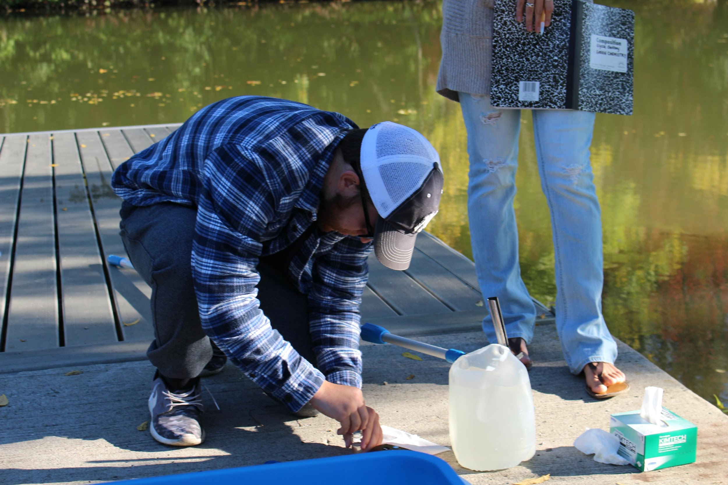
BIOL 408 Ecological Field Methods with Genesee River Watch
Students will research and gather information on biological qualities of the river including its organisms, biodiversity, and wild life.
Students will replicate the “cubic foot project” and focus their analysis on small areas of the river for broader application and education.
Students will create a report of findings for GRW to use for the new Institute planning purposes and to provide raw material (photos and data) for GRW promotional materials and exhibits.

Slide 37
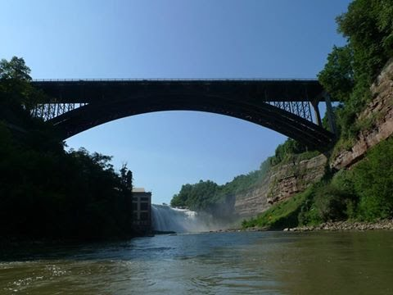
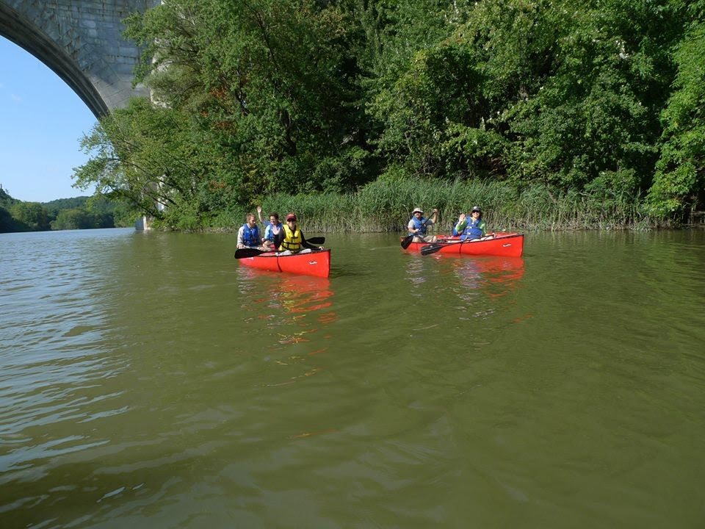
POSC 211 Introduction to Public Policy with Genesee River Watch
Students will examine the river as a case study for public policies and challenges with policy making.
Students will propose ideas for how to engage stakeholders in the river as important data for the growth of the Institute.
Students will also look at policy issues of other cities regarding how river policies came about and can they could be applied to Rochester.

Slide 38
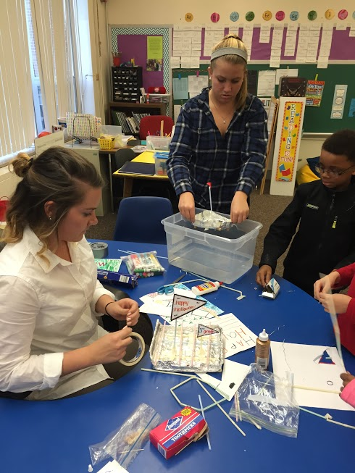
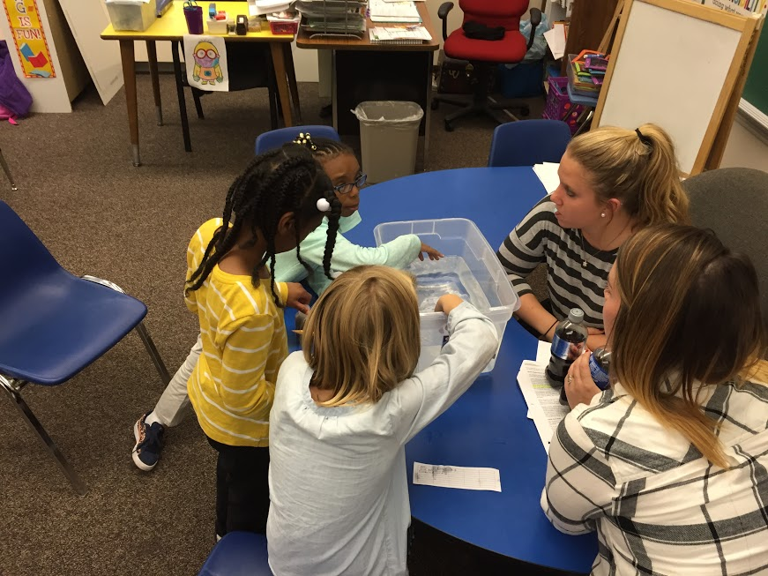
EDUC 350 C, I & A Math, Science, Technology I with YMCA After-School Program
Students will design science lesson plans and teach children enrolled in the Carlson Metro YMCA after-school program about STEM. A primary goal is to enhance comfort, interest, and engagement with science. Principles will be introduced from the perspective of the arts. Field trips to arts organizations may be integrated such as to RMSC, MAG, Fisher, Artisan Works, glass blowing.

