Slide 1
Orientation to Service-Learning
St. John Fisher College
Dr. Lynn Donahue
Assistant Director, Institute of Civic and Community Engagement

Slide 2
Institute for Civic and Community Engagement
Lower Level Library
Anchor Institution w/ EMMA/Beechwood
ROC the Future
Service Scholars
First Generation Scholars
International Service
Service-
Learning
Civic Engagement Funds

Slide 3
Focus on Community & Service
Focus on
Mutual Benefit
Focus on
Student & Learning
Service-Learning
- Internships
- Field Study
- Nursing Clinicals
Pharmacy
Preceptorships
- Student Teaching
- Community Service
- Relay for Life
- SWAV
- Service Scholars
- First Generation Scholars
- Service Trips

Slide 4
Meaningful Service:
Collaboration between College and Community to meet identified needs and enhance assets
Service-Learning
Meaningful Implementation:
Reflection and Assessment leading to deeper understanding of course content and civic engagement
Meaningful Learning:
Applying Academic Knowledge and Critical Thinking Skills to meet course and learning goals

Slide 5
What are the Benefits of SL?

Slide 6
Fulfilling the American Dream Report
In June 2018, Hart Research Associates conducted a survey of 1000 companies that have at least 25 employees on behalf of the Association of American Colleges and Universities (AAC&U).
Results revealed that employers are more likely to hire recent graduates with:
Real world experience like internships and service-learning (94%)
Community-based projects interacting with individuals with different cultures (83%)
Professional skills (85%-99%):
Good communication
Ability to work independently
Work effectively on a team
Ethical judgment
Critical thinking
85%-99% of SJFC students indicated that service-learning helped them:
apply their course learning to real world problem-solving
work with individuals from diverse backgrounds
develop strong communication skills
learn how to take initiative

Slide 7
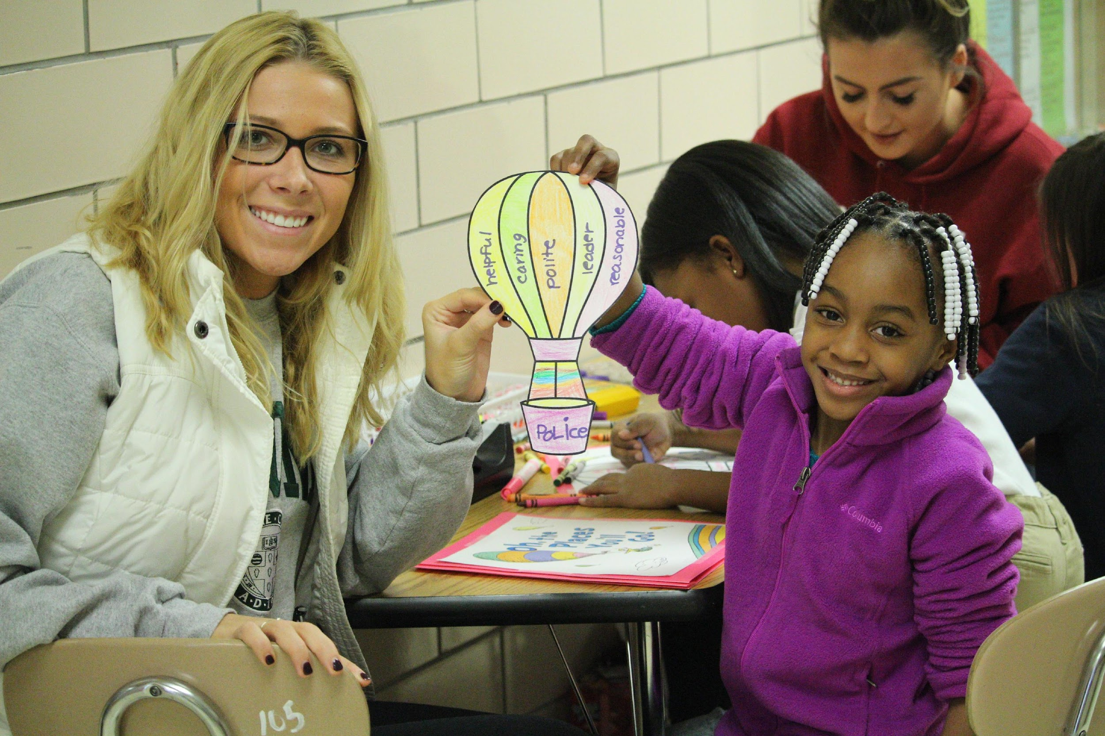
Testimonials
“SL gave me insight on working with people from different backgrounds. I experienced life in a community that is high needs and learned how to orient myself as an equal” (Student, ITED 422: Diversity in American Society).
“As we learned about language development, I found myself analyzing the development of the children I was working with and applying our course concepts. Learning became much more meaningful” (Student, EDUC 229: Language Acquisition).

Slide 8
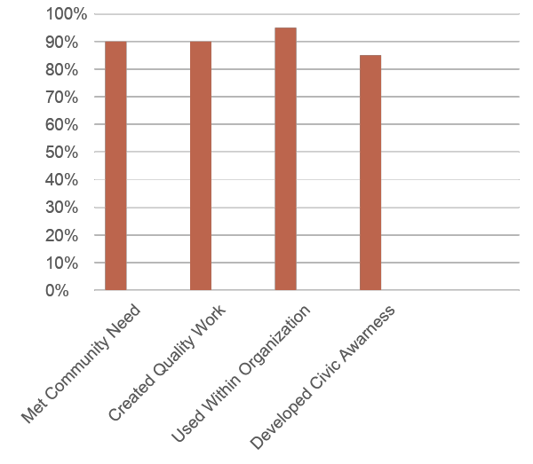
Impact on the Community
“Over the past 10 years, I have developed a growing appreciation for the efforts of the College to engage the whole Rochester community. Our work together is community collaboration at its best.” (Sister Christine Wagner, St. Joseph’s Neighborhood Center)

Slide 9
Common Questions
Is it extra work? How many hours will I spend doing service-learning?
Where would I work? On or off campus?
How can I find SL courses to take?
Is SL in the core? In my major?
Will I need a car?
Other questions?

Slide 10
How can you make the biggest impact (get the most out of it)?

Slide 11
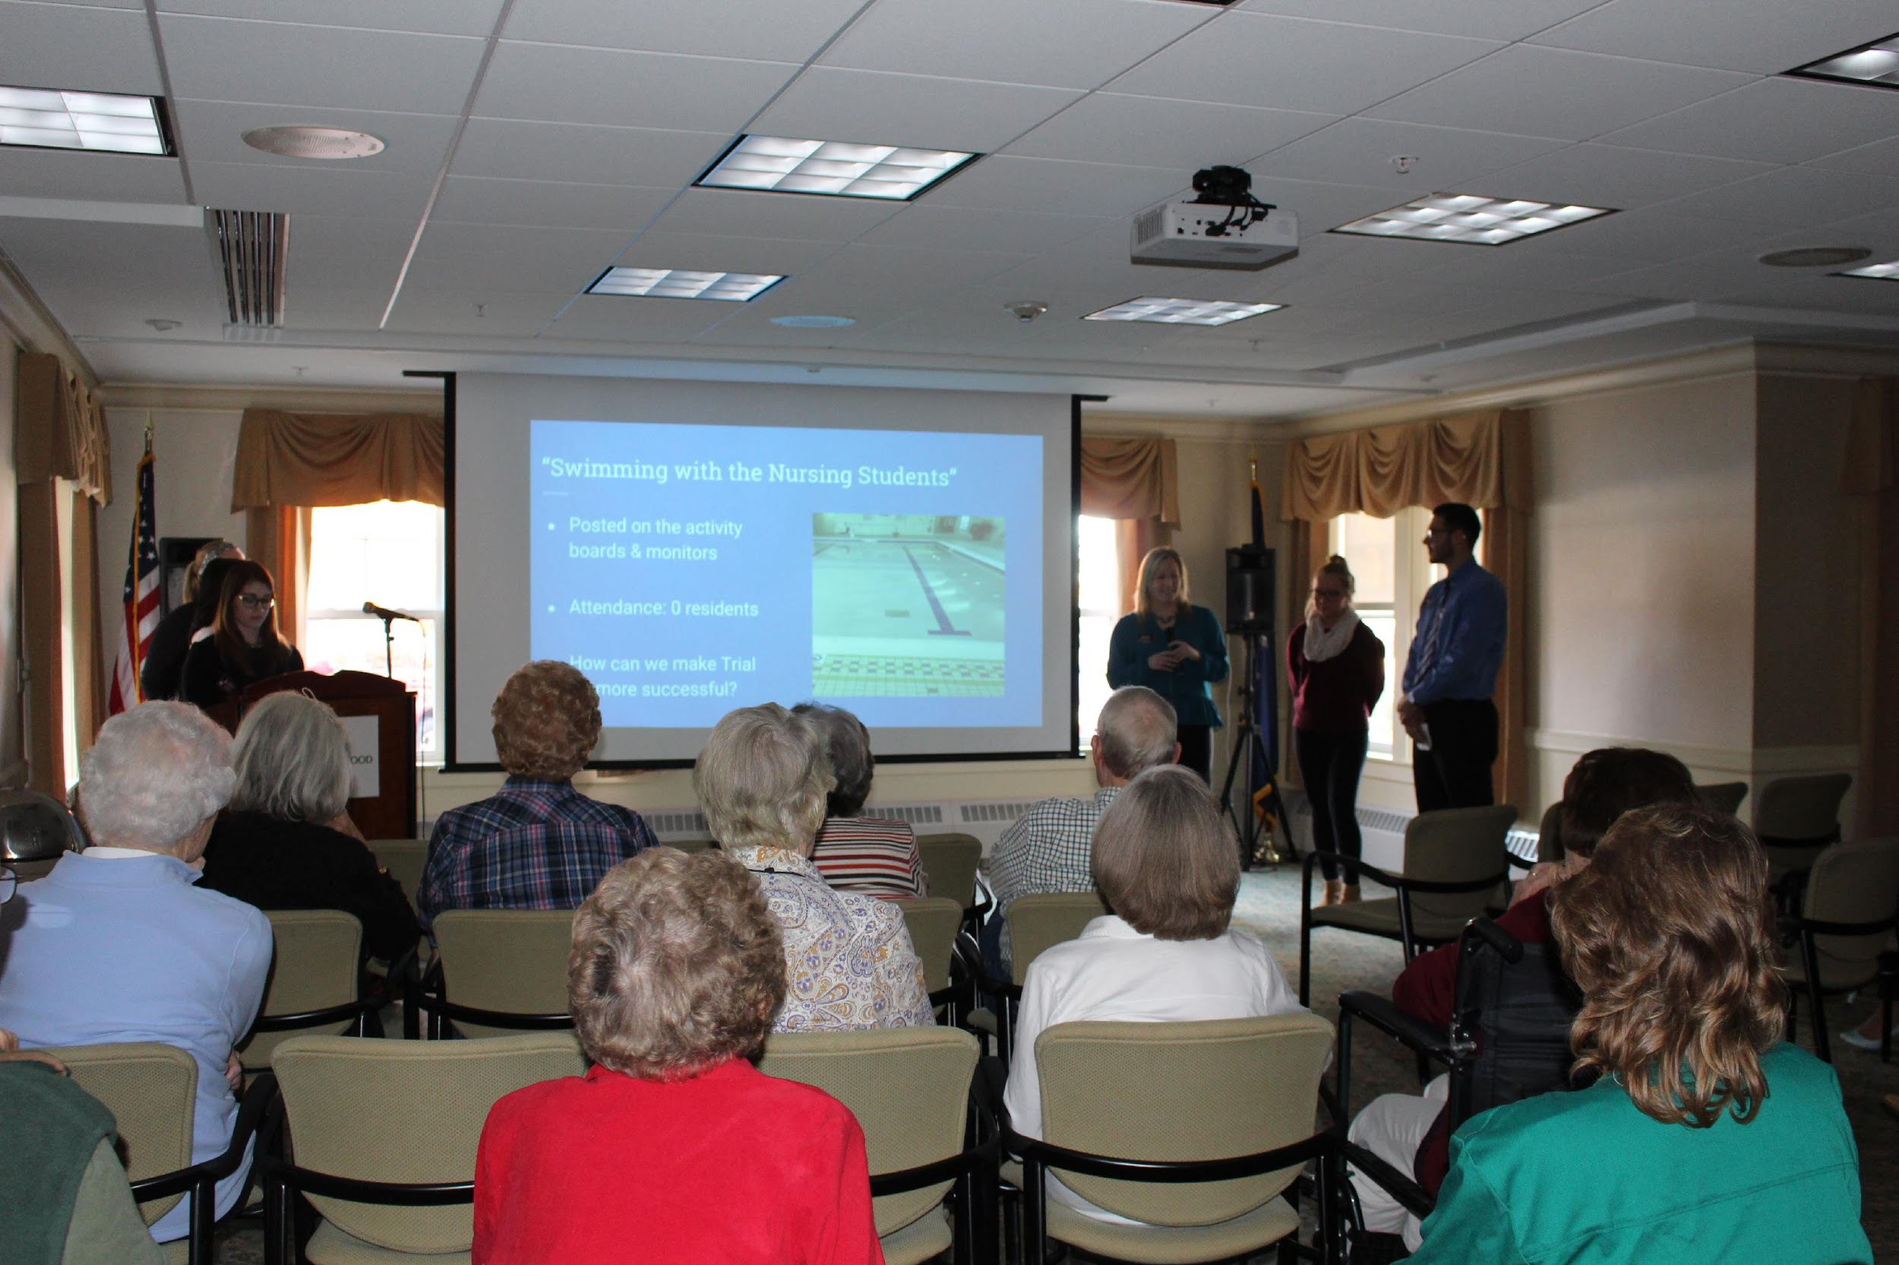
Tips for Success
#1: Challenge Yourself
#2: Be On Time and Reliable
#3: Know your Assignment
#4: Create a Quality Product or Service
#5: Use Professional Communication
#5: Follow the Agency’s Expectations and Policies
#6: Reduce Barriers
#7: Be Safe
#9: Respect Boundaries
#10: Have fun and a positive mindset

Slide 12
Next Steps
Additional service-learning courses (search under SLC Attribute on course registration page)
Service-learning abroad (AIFS, IPSL, faculty-led trips)
Internships (current SL community partner; related organization/field)
Market your service-learning (resume, job interview)
Advocacy work (policy making, media, public events/demonstrations)

Slide 13
Resources
SL Website and Resources:
https://www.sjfc.edu/major-minors/center-for-service-learning-and-civic-engagement/about-service-learning/
Civic Engagement Grants
Service-Learning Support
Dr. Lynn Donahue
Assistant Director, Institute for Civic and Community Engagement
Ground floor of library (Library 104)
385-7342; ldonahue@sjfc.edu

Slide 14
What Will SL Look Like in Your Course?

Slide 15
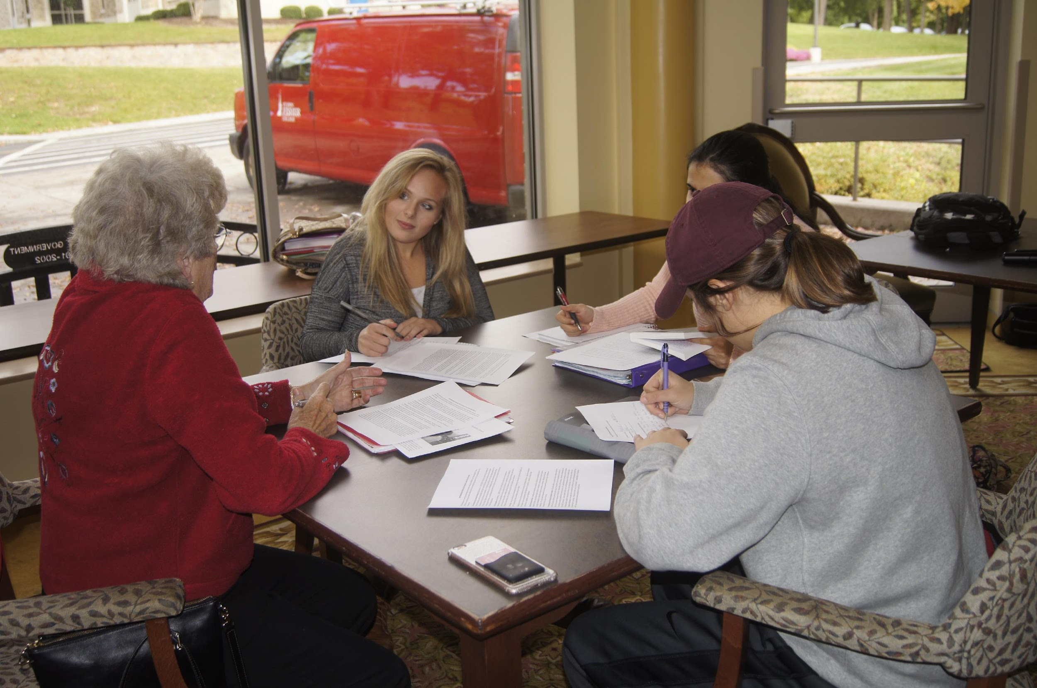
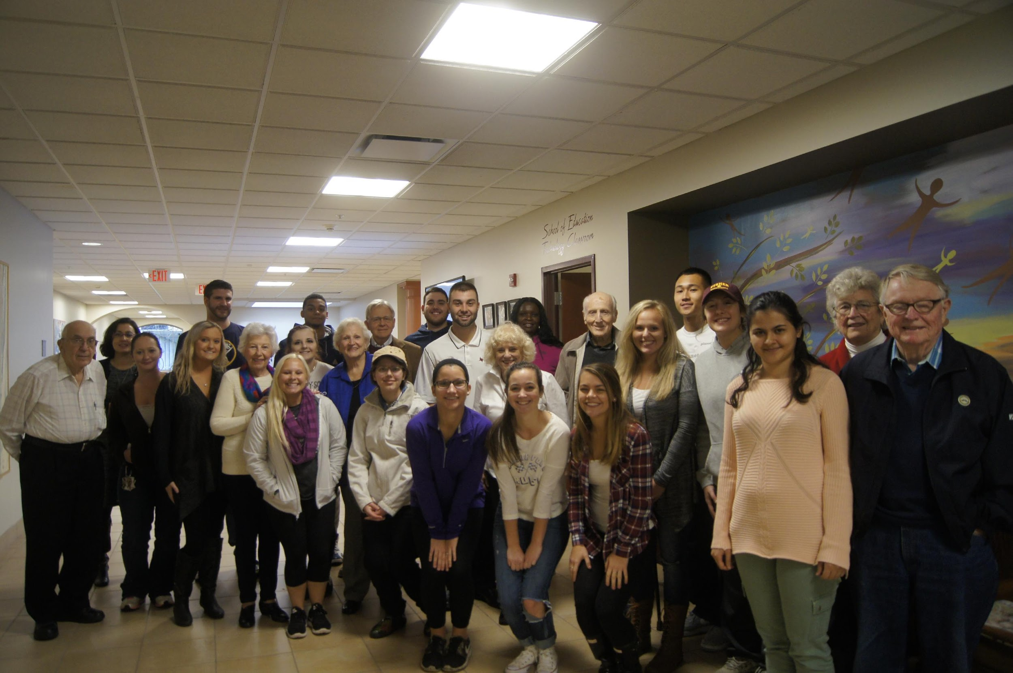
SOCI 322 Sociology of Aging and the Life Course with Episcopal Home
Students and Episcopal Home seniors will participate in a shared experience to learn about issues related to ageing, engage in small and large group discussions, and reflect and write on personal relevance.
Topics will include women, ageism, family, intergenerational relationships, peer networks, health and health care, aging in CCRC, end of life issues, religion and spirituality.
Students will collect and summarize the elder’s responses and stories for a written document to be given to the elder and his or her family and staff.

Slide 16
HRMG 483: Special Topics: Strategic Human Resource Management
Students will conduct a human resource audit and needs assessment that analyzes organizational problems and challenges and develop a strategic mindset to turn organizational threats into opportunities.
The team will apply theory, techniques, and knowledge derived from readings, research, and case studies to formulate recommendations and an implementation strategy–including solutions, communication plans, risk containment, and gaining leadership sponsorship.
The team will critically evaluate each component of their process and develop a presentation for their key stakeholders.

Slide 17
ENG 356: Editing and Publishing
Fisher students will partner with students from the Teaching and Learning Institute at East High School through a literary publishing experience focusing on literature and identity representation.
An anthology of students’ writing and a reading event in Rochester will be the final outcome. Students may focus on the I Am poems or Future of Rochester Essay for this anthology, or a new prompt developed together.
A second team of students will work in developing ANGLES, Fisher’s national online publication for creative writing by college-aged writers.
Meetings will occur at the East High campus, St. John Fisher, and potentially Writers and Books.

Slide 18
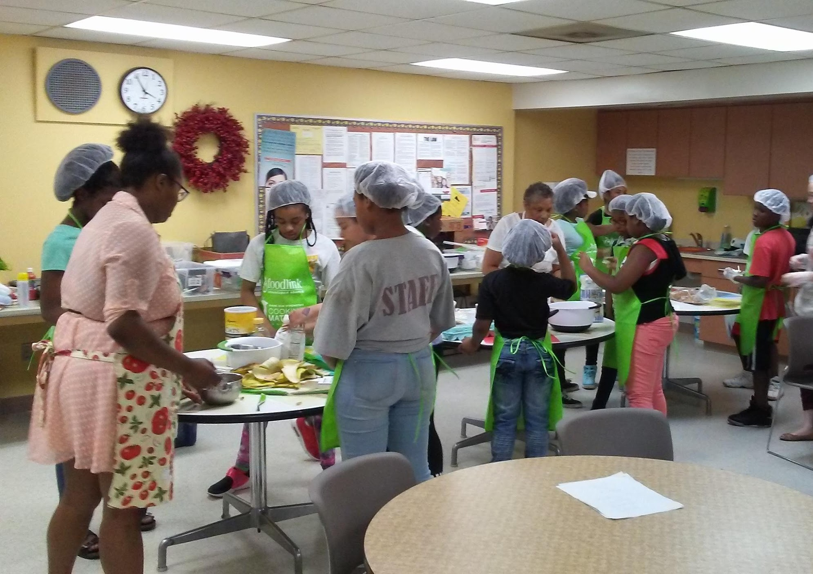
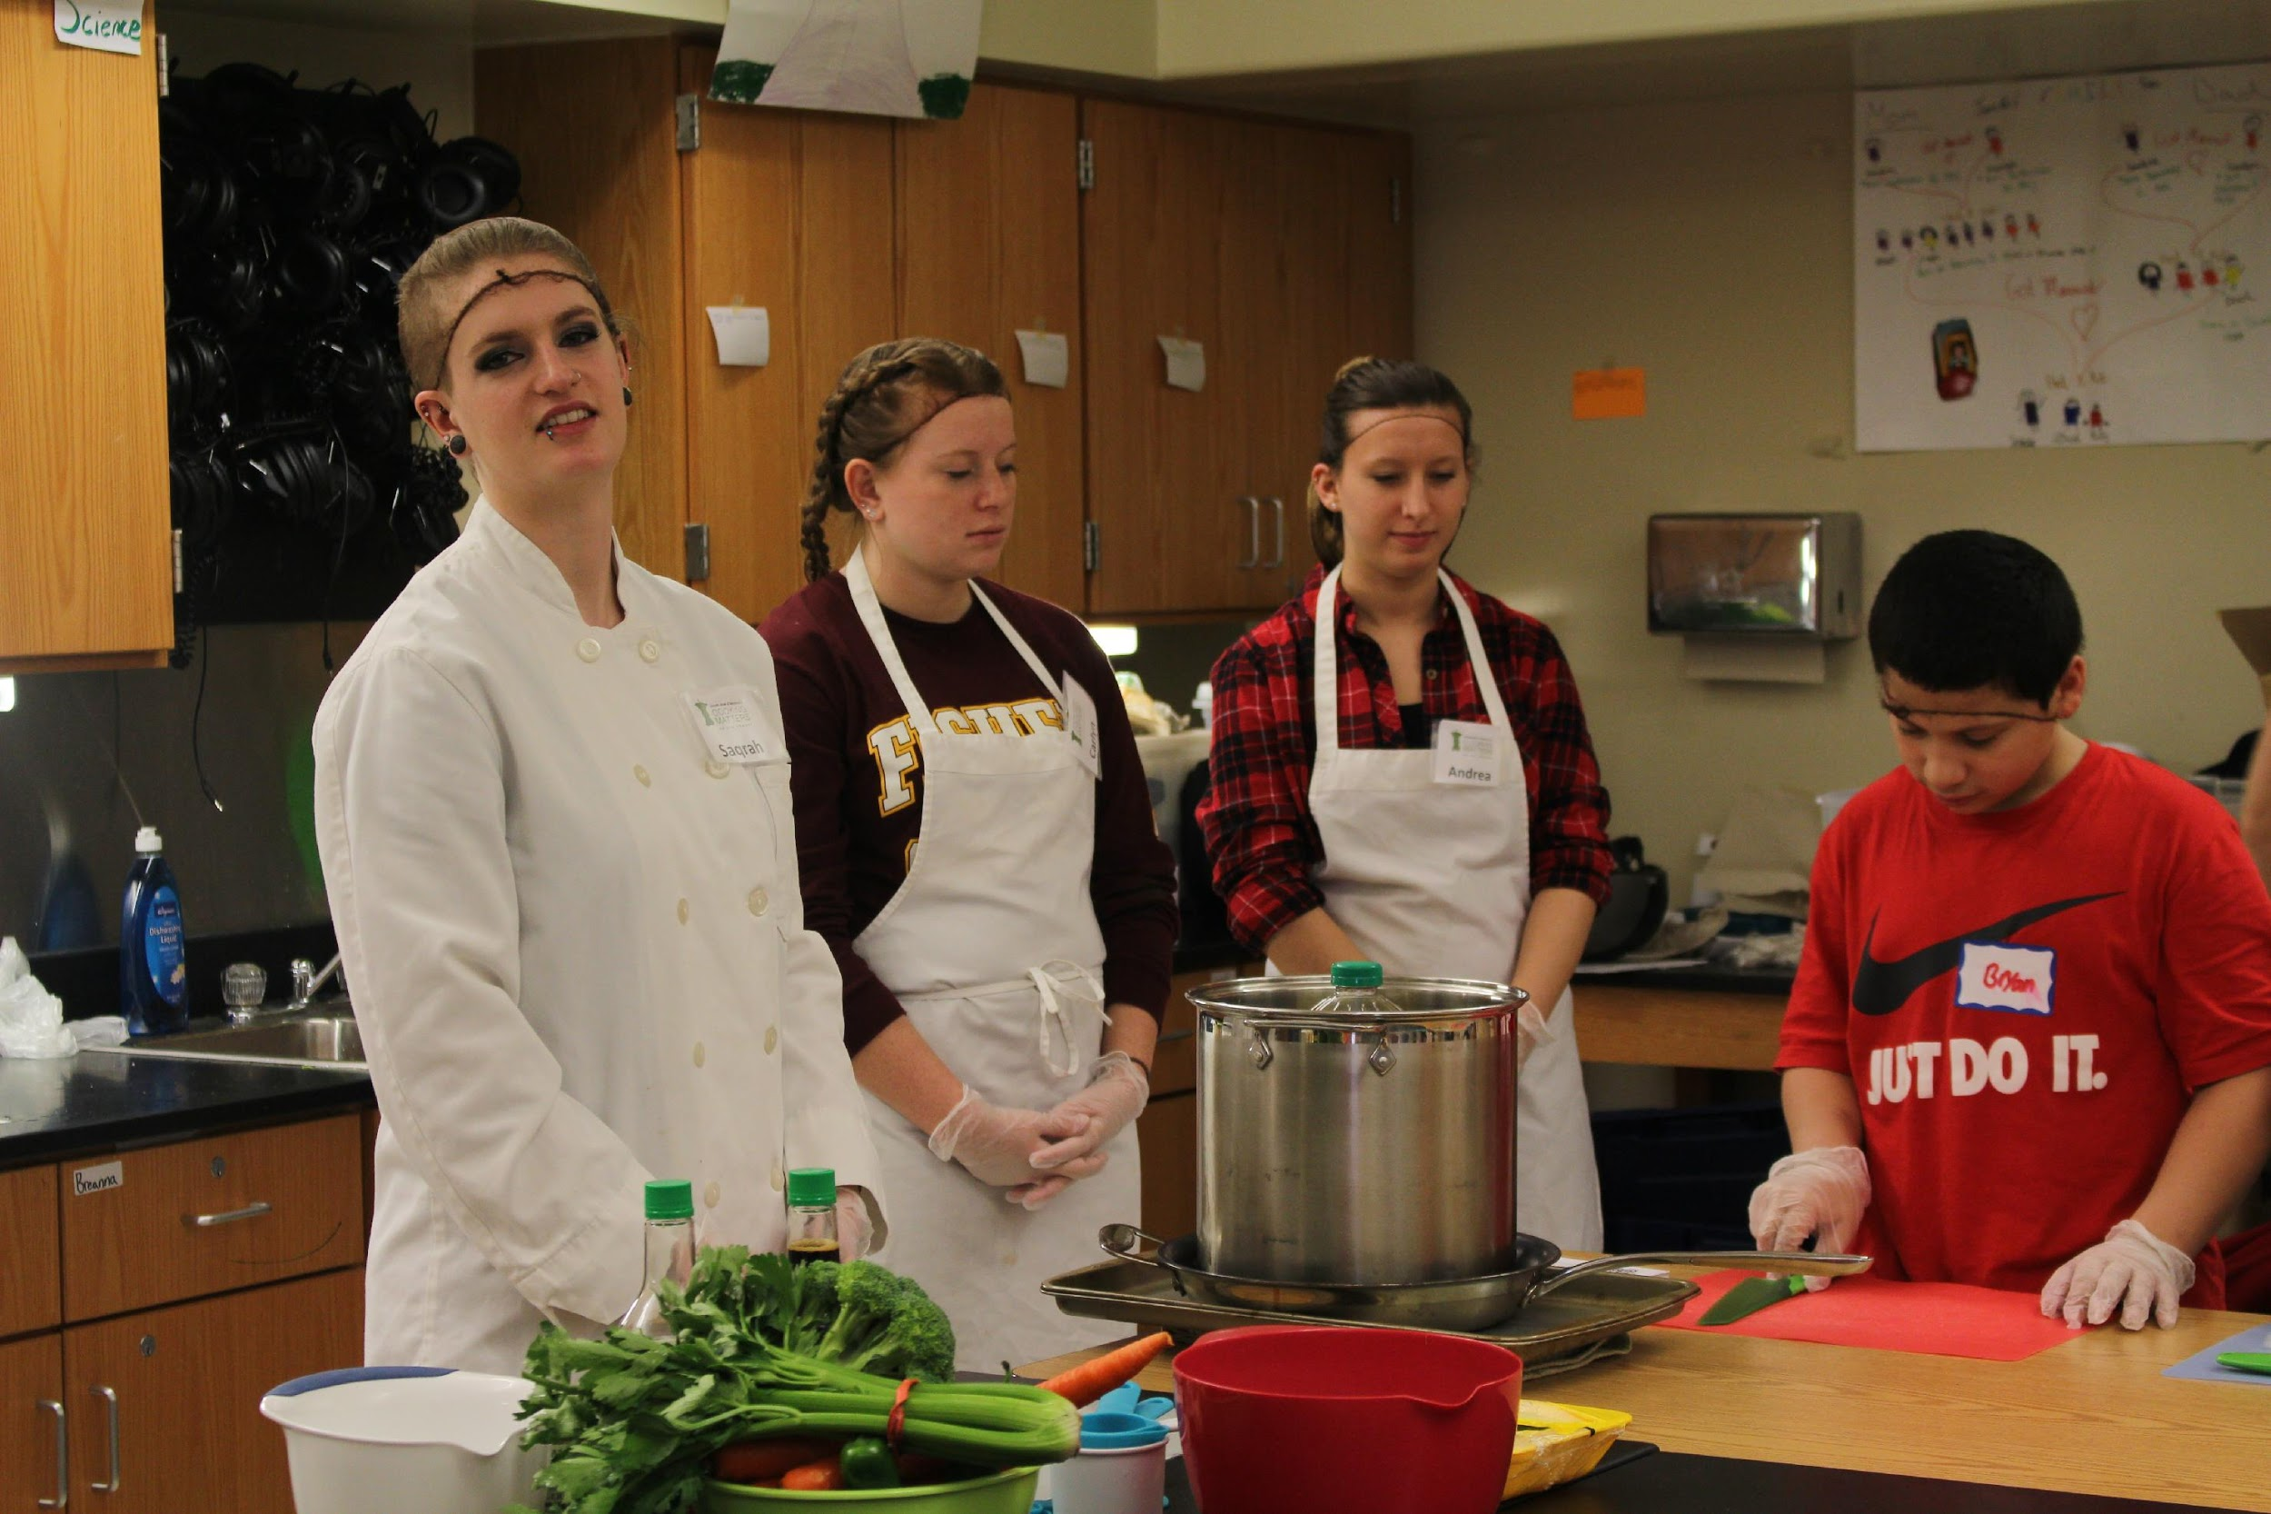
BIOL 108C Fundamentals of Nutrition with Foodlink
Foodlink is a regional food hub and the Feeding America food bank serving 10 counties. Operations target the root causes of hunger. We do this by distributing food to a network of human service agencies, serving meals though our commercial kitchen, and offering more than 30 food-related programs such as Cooking Matters classes to children and adults.
Students will provide support for the Cooking Matters program by transporting supplies, reviewing course instructor guide each week, helping to teach cooking stations, engaging participants in conversations about cooking and nutrition topics based on lesson topics at each class, doing dishes, and assisting with both set up and break down of class.

Slide 19
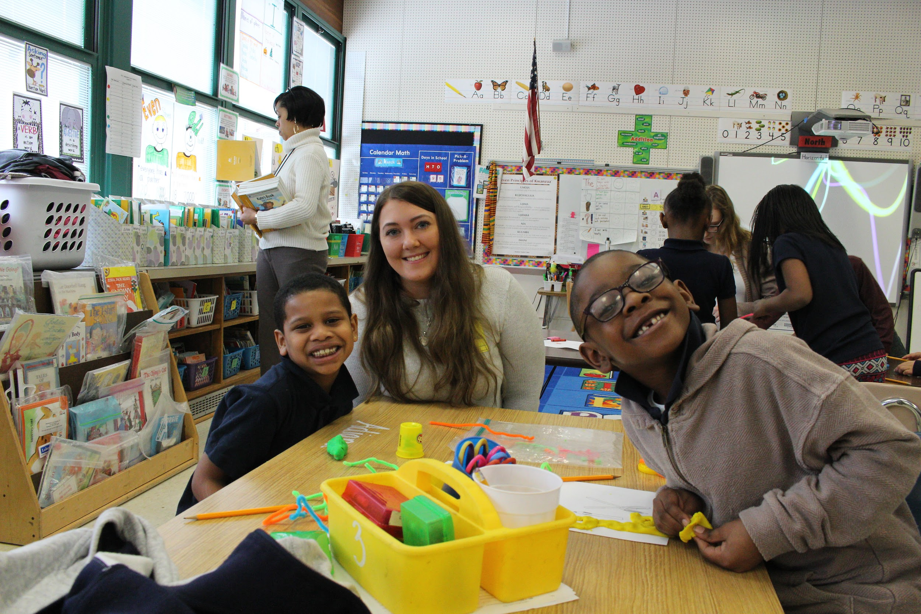
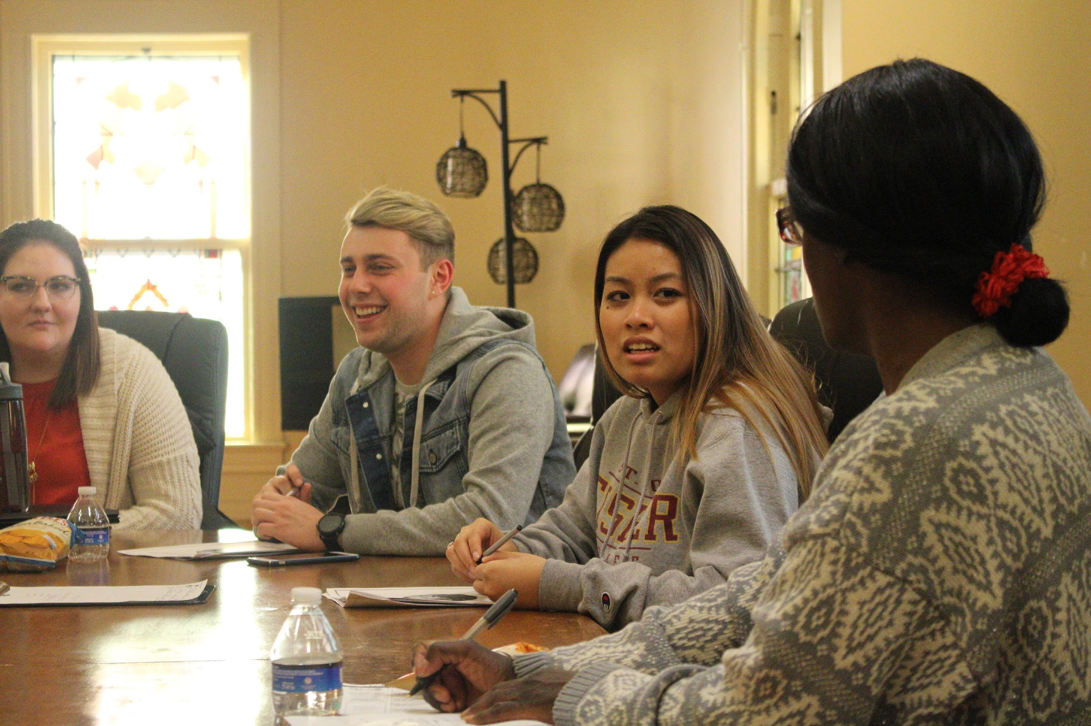
PSJS 250: Social Change through Service
http://sjfcsocialchangethroughservice.weebly.com/; http://seedsofsuccesssjfc.weebly.com/
Seeds of Success is a resiliency and social-emotional learning program offered through St. John Fisher College’s Institute for Civic and Community Engagement. Seeds of Success is designed to develop a resiliency mindset in young, underserved children (grades 1-3) residing in the city of Rochester, NY. Resiliency is defined as “a set of qualities that helps a person to withstand many of the negative effects of adversity” (Gilligan, 2000).
Steps to Wellness is a life skills education program using the Wellness Wheel to support the transition and self-sufficiency needs of adults in Rochester, NY. The program will focus on physical wellness, occupational wellness, and financial wellness.

Slide 20
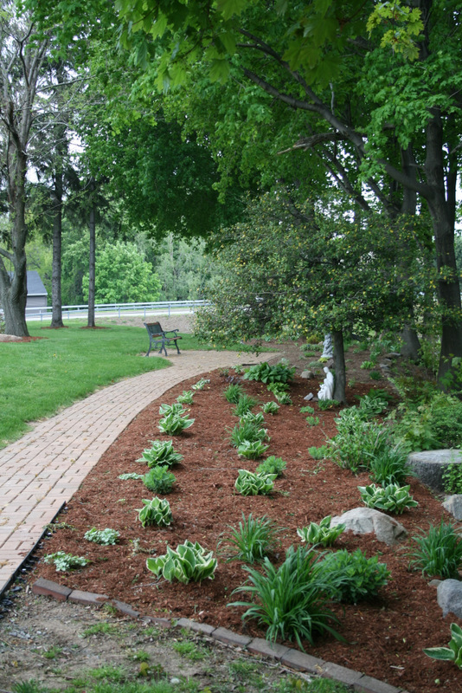
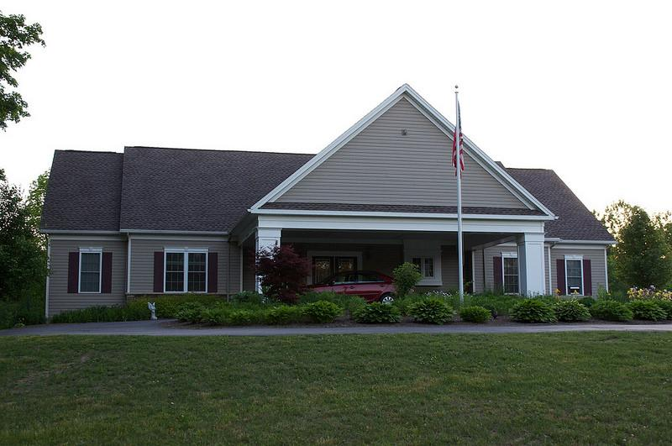
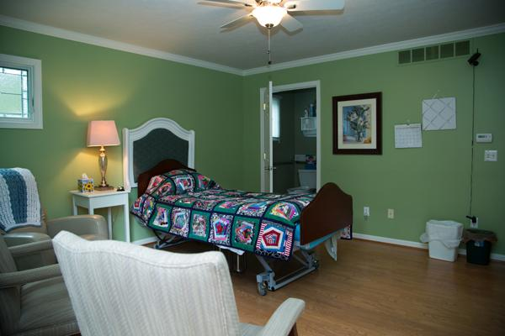
NURS 312 Palliative and End of Life Care with Comfort Care Homes
Students will engage in 16 hours of hands-on, client support work at one of the listed comfort care homes. Work can include the following:
observing clients/staff/interactions
spending time with an identified client (reading, talking, playing an instrument)
identifying a need of the home and developing a project to meet that need
supporting programmatic needs including cooking, office help etc.

Slide 21
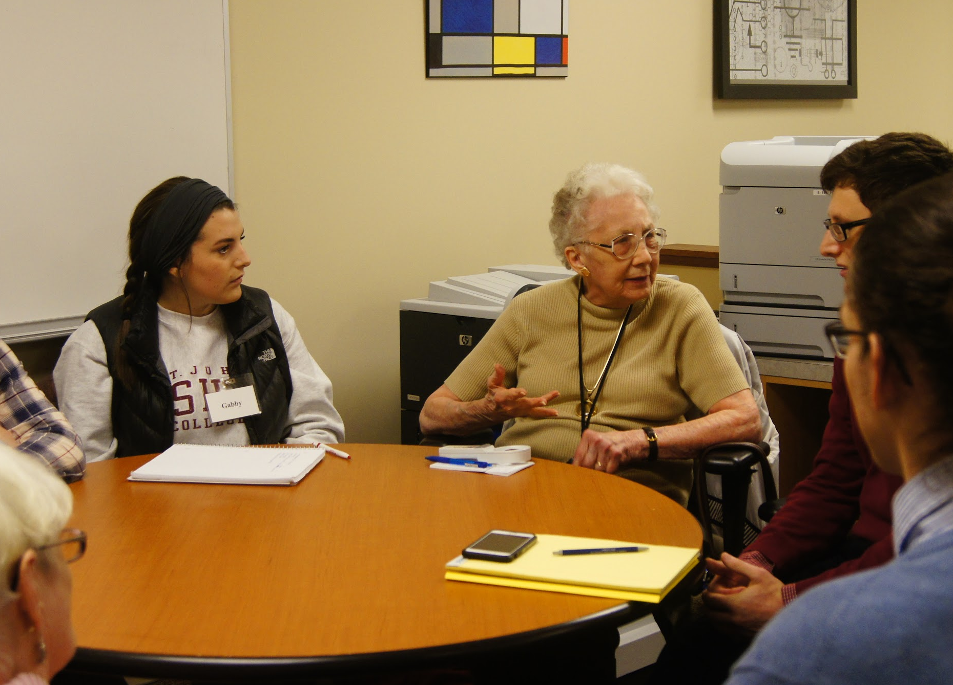
POSC 224: Campaigns and Elections
Students will participate in collaborative discussions with seniors from St. John’s Meadows on pre-identified political science topics related to campaigns and elections. All will participate in discussion as both leader and follower – as both teacher and learner.
The primary goal of the discussions is to apply and discuss concepts and theories behind campaigns and elections to the 2018 midterms. Conversations will also focus on how and why individuals have come to form the beliefs they hold.
Topics will include the following:
Political parties, gerrymandering
Policy platforms and candidate traits
Money in politics
Forecasting, media coverage
Vote choice and turnout
Modern campaigns and elections in historical and international context

Slide 22
PHIL 230CC: Philosophy of Education
The course examines modern approaches to the philosophy of education, with emphasis on the work of thinkers such as Plato, Rousseau, Maritain, Whitehead, and Dewey. Topics include educational theory, the role of the school in society, the philosophical assumptions of curriculum development, and the problems of teacher accountability.

Slide 23
COMM 363: Media Research and Analytics
It is time to put your web analytics & media research skills to test by taking on a new and previously unexplored research area for the client. While all students will be required to complete a written and presentation component, the exact deliverables will be based on the media platform selected, the needs of the client, and may change based on ongoing conversations with the client.
You will need to combine research methods, inferential statistics, and client communication in order to:
1) Audit the company’s existing digital product portfolio
2) Develop a recommended communications plan for at least one of the company’s customer facing platforms.

Slide 24
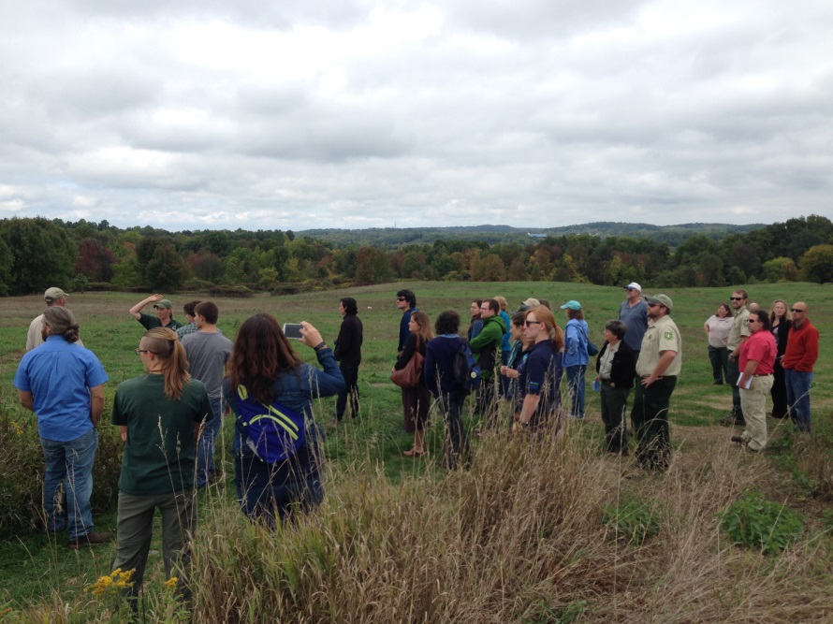
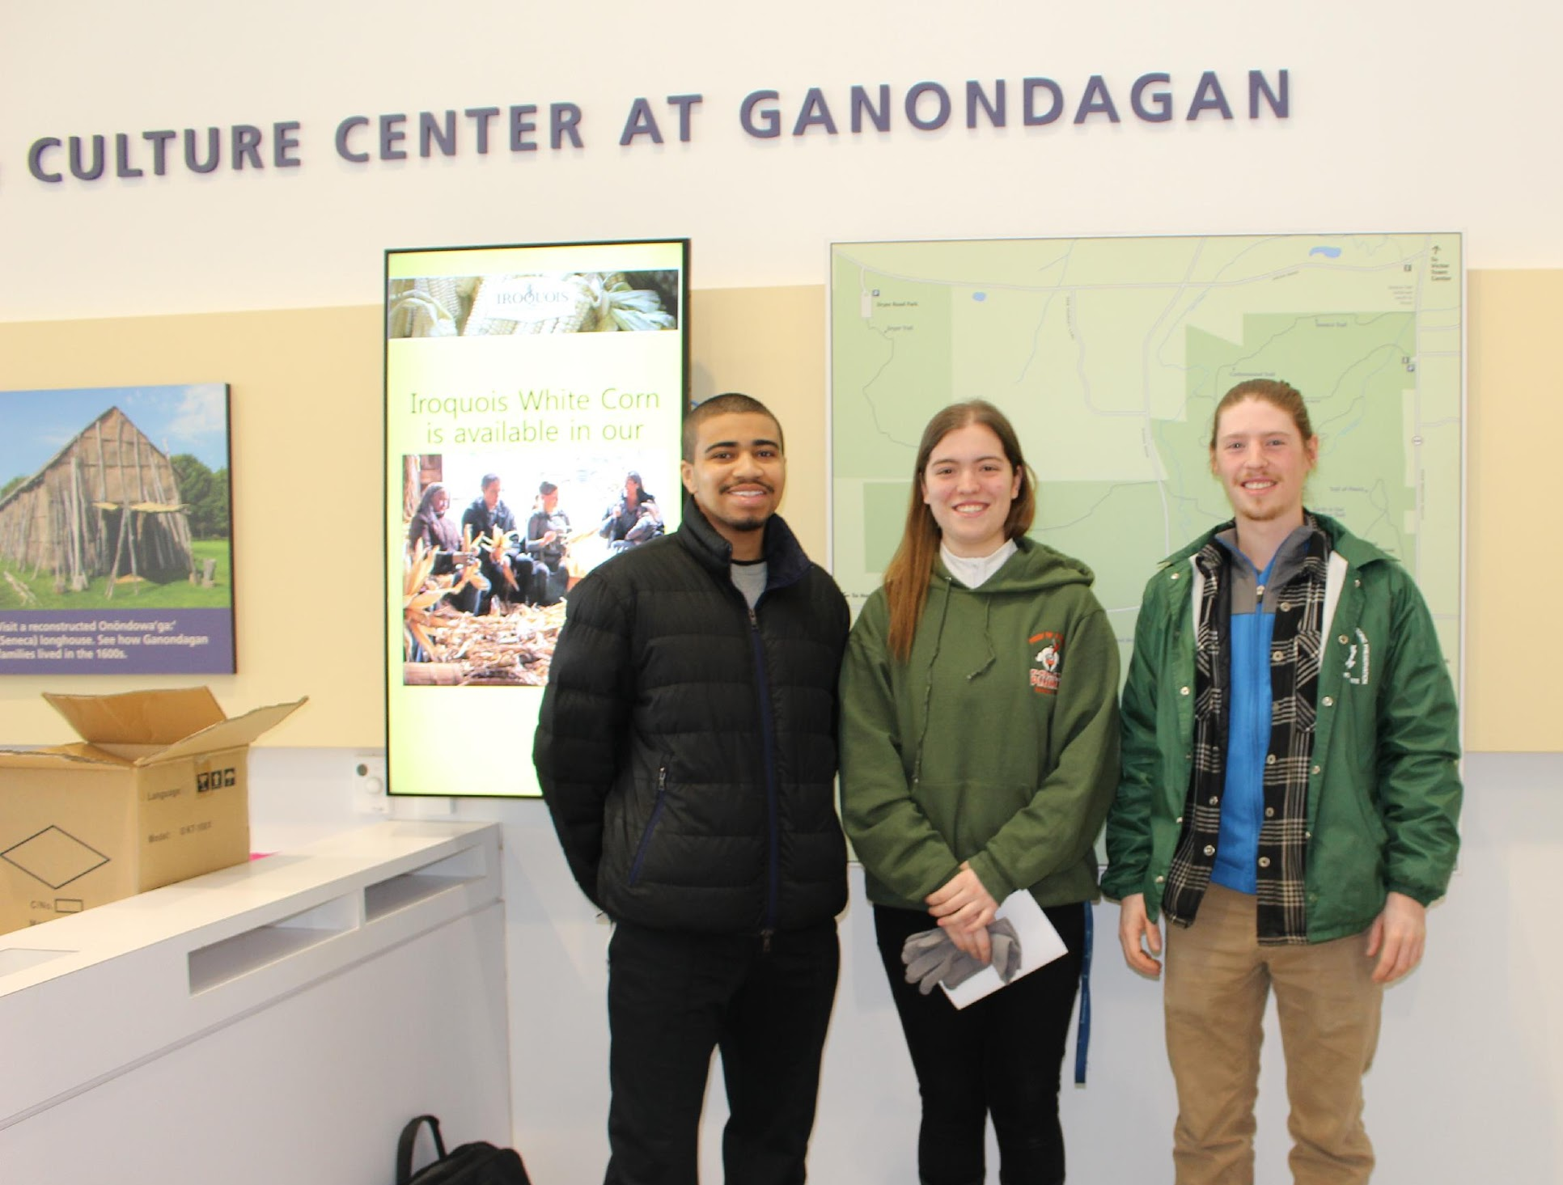
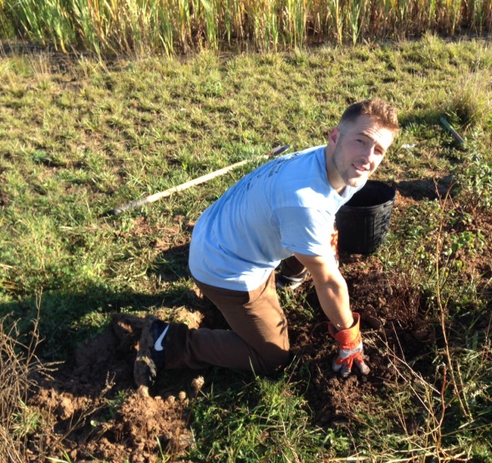
BIOL 406 Animal Natural History with Ganondagan Historic Site and Environmental Field Office
Students will monitor the health of Great Brook and White Brook streams through electrofishing. Analysis will be added to the grant report for the Great Lakes Recreation Institute.
Students can also continue the bird and raptor surveying project.
Students from both projects can present their findings to Ganondagan staff.

Slide 25
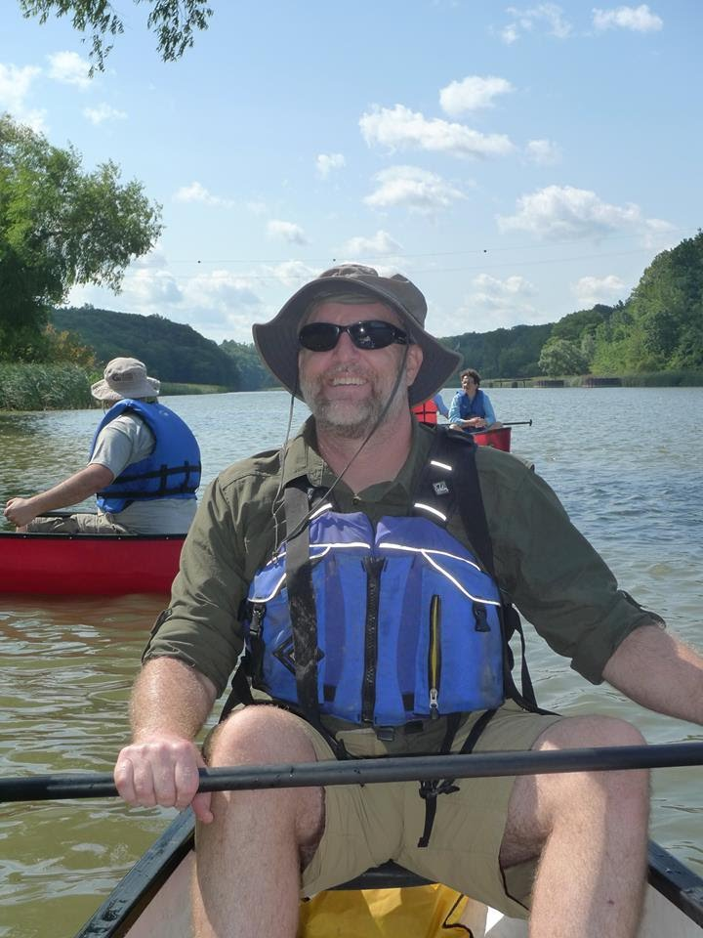
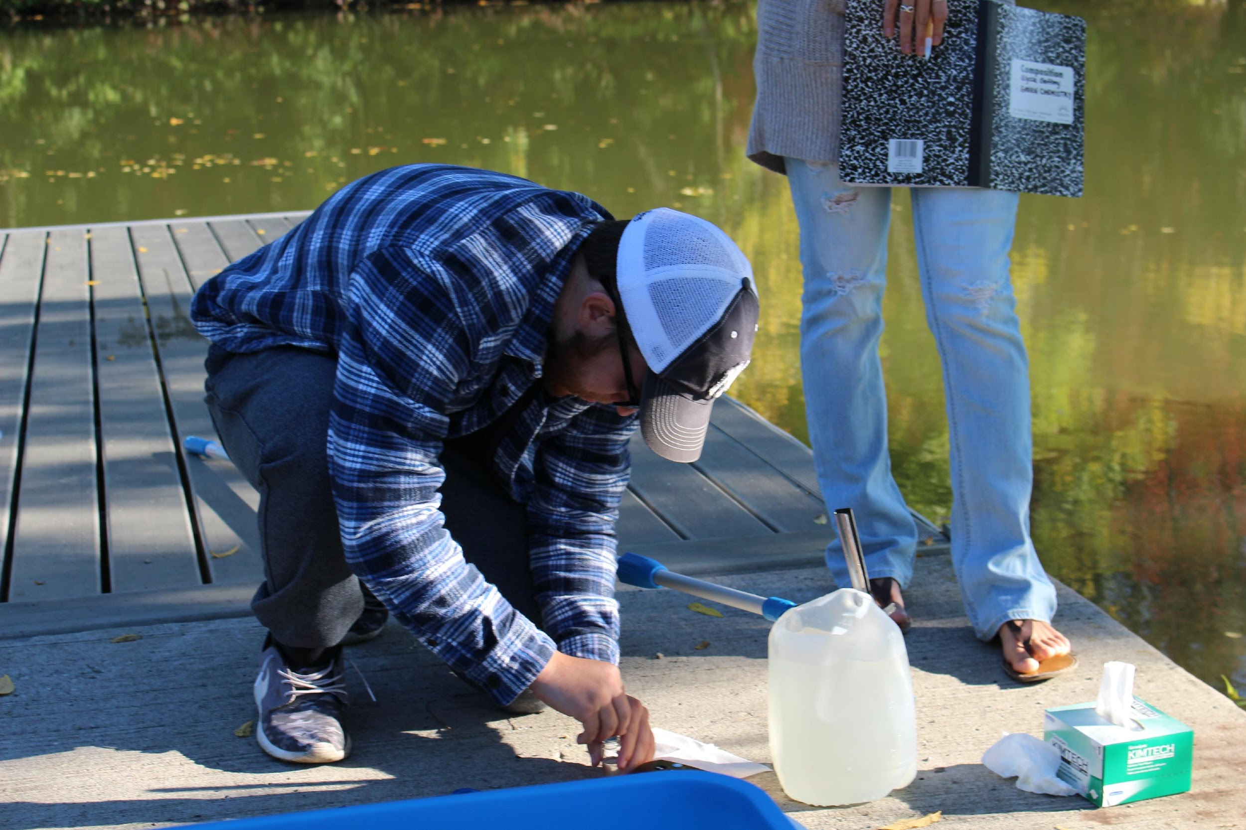
BIOL 408 Ecological Field Methods with Genesee River Watch
Students will research and gather information on biological qualities of the river including its organisms, biodiversity, and wild life.
Students will replicate the “cubic foot project” and focus their analysis on small areas of the river for broader application and education.
Students will create a report of findings for GRW to use for the new Institute planning purposes and to provide raw material (photos and data) for GRW promotional materials and exhibits.

Slide 26
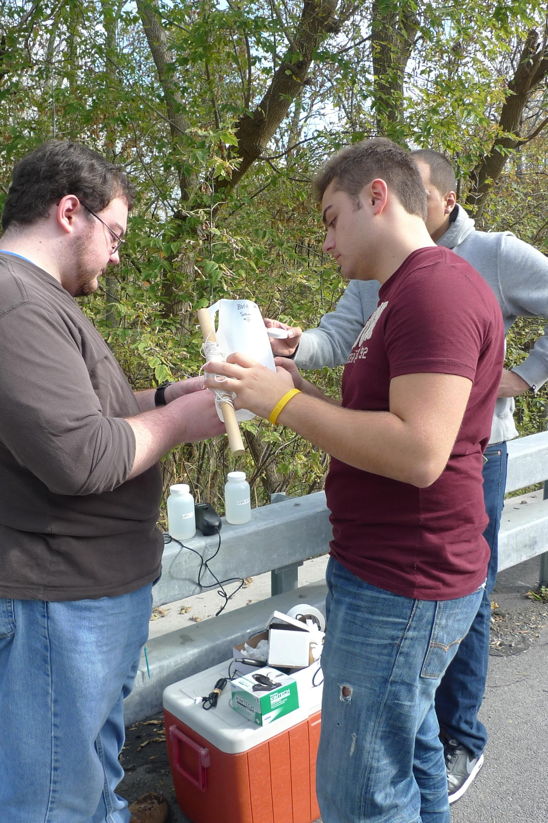
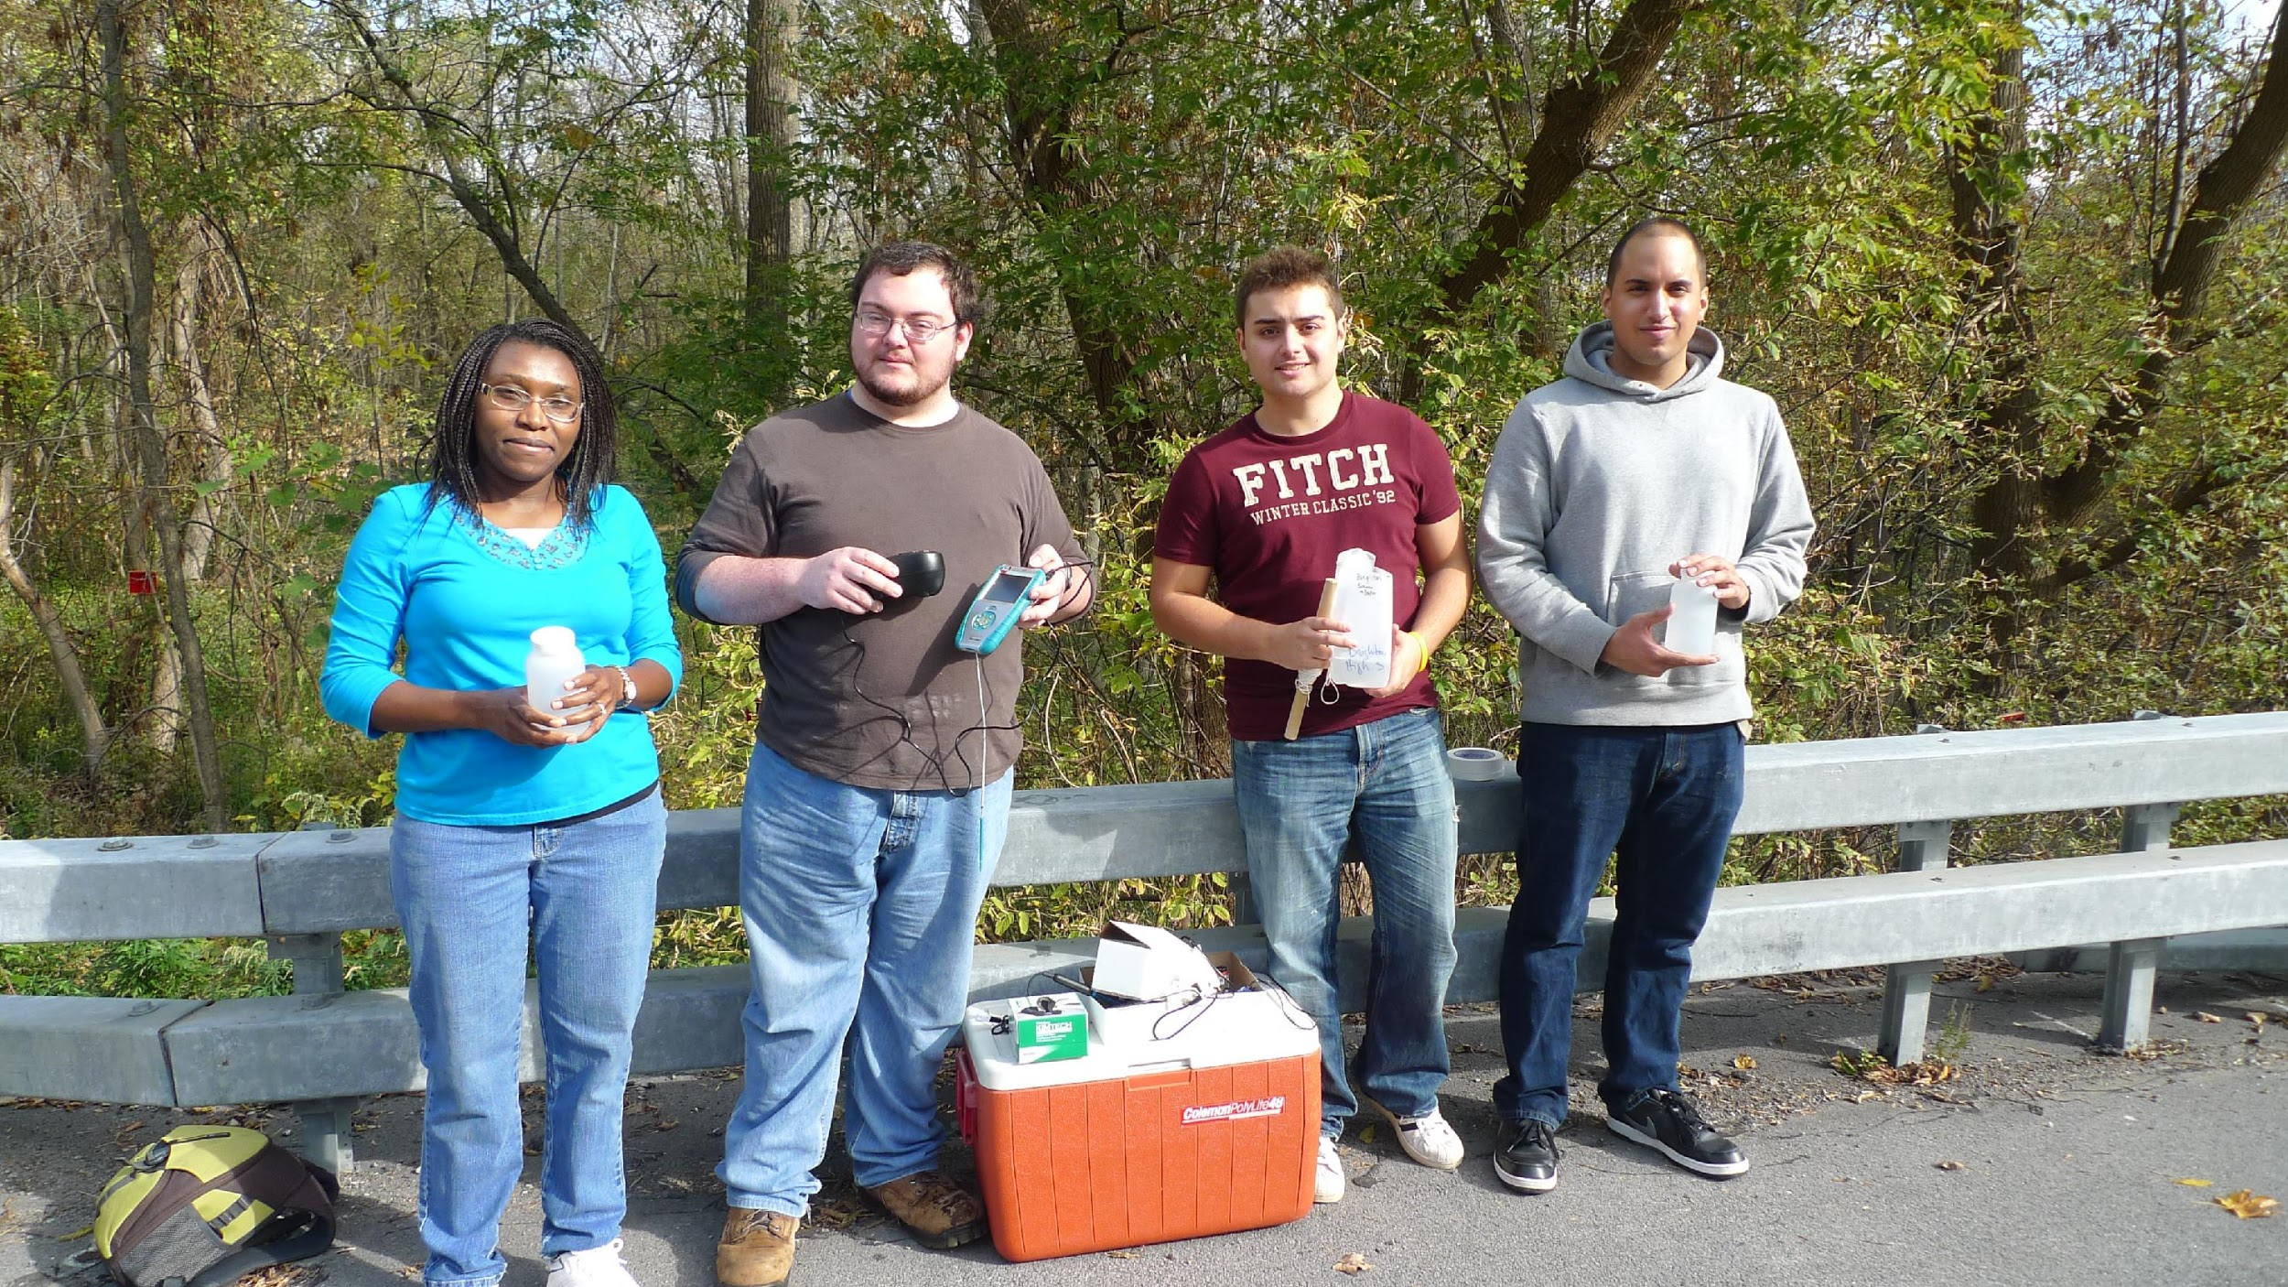
CHEM 315L: Analytical Chemistry Lab
Students will gather water from designated sites identified as important by Genesee River Watch.
Students will test for the presence of total phosphorous and reactive phosphorous from the middle of the river
Will explore if there are sediment points that need monitoring that are indicated in the Kodak study.
Students may also work alongside citizen scientists during sampling day

Slide 27
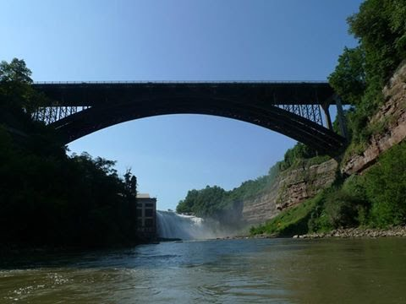
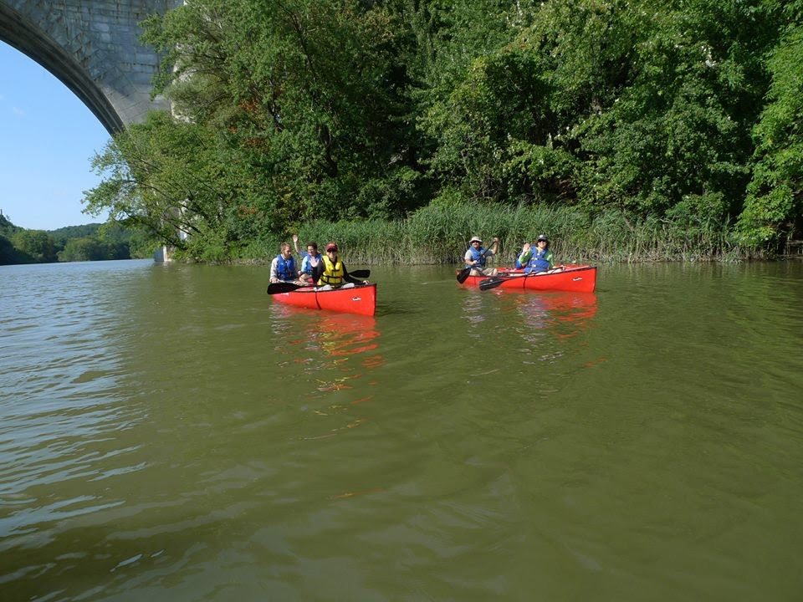
POSC 211 Introduction to Public Policy with Genesee River Watch
Students will examine the river as a case study for public policies and challenges with policy making.
Students will propose ideas for how to engage stakeholders in the river as important data for the growth of the Institute.
Students will also look at policy issues of other cities regarding how river policies came about and can they could be applied to Rochester.

Slide 28
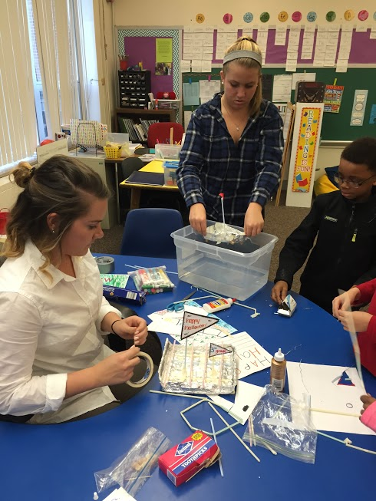
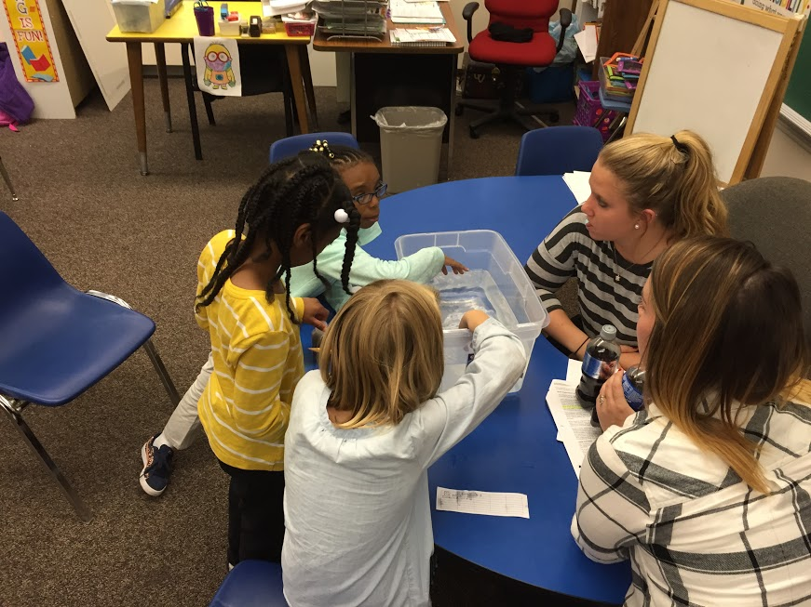
EDUC 350 C, I & A Math, Science, Technology I with YMCA After-School Program
Students will design science lesson plans and teach children enrolled in the Carlson Metro YMCA after-school program about STEM. A primary goal is to enhance comfort, interest, and engagement with science. Principles will be introduced from the perspective of the arts. Field trips to arts organizations may be integrated such as to RMSC, MAG, Fisher, Artisan Works, glass blowing.

