Slide 1
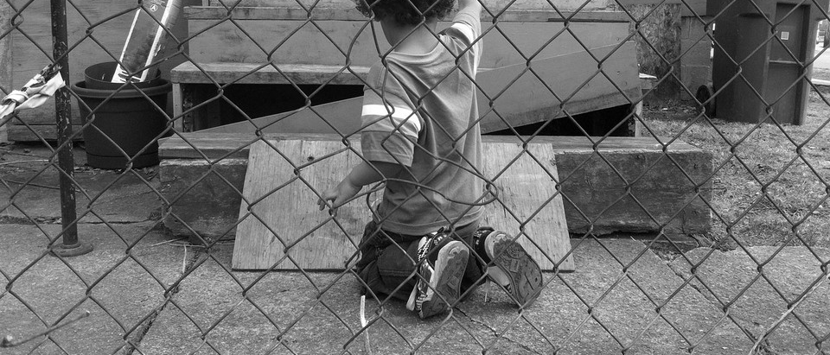
POVERTY IN ROCHESTER, NY
DR. LYNN DONAHUE
(WITH SLIDES ADAPTED FROM A PRESENTATION BY ED DOHERTY, AUTHOR OF ACT ROCHESTER POVERTY REPORT)

Slide 2
Introductory Activity
Poverty In Rochester – An Activity
Take out sheet of paper. For 1 minute write down the words that come to your mind when I say the word “poverty”.
For another 1 minute draw what you picture of what you visualize in your mind when I say the word “poverty”.
What did you write? What did you draw?
Tape the writing and drawings on the white board.
What are stereotypes about poverty that you see written/drawn?
What is correct and known about poverty?

Slide 3
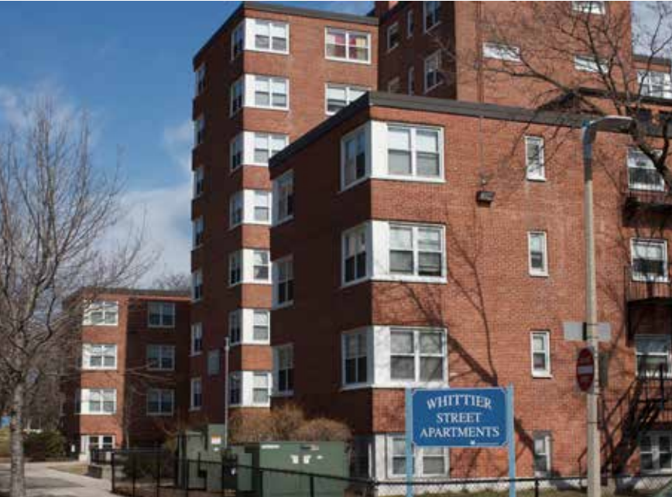
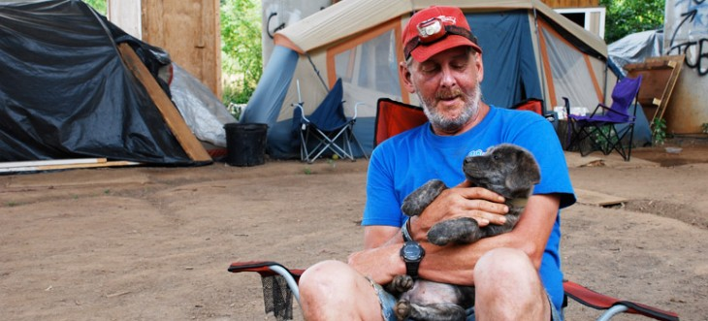
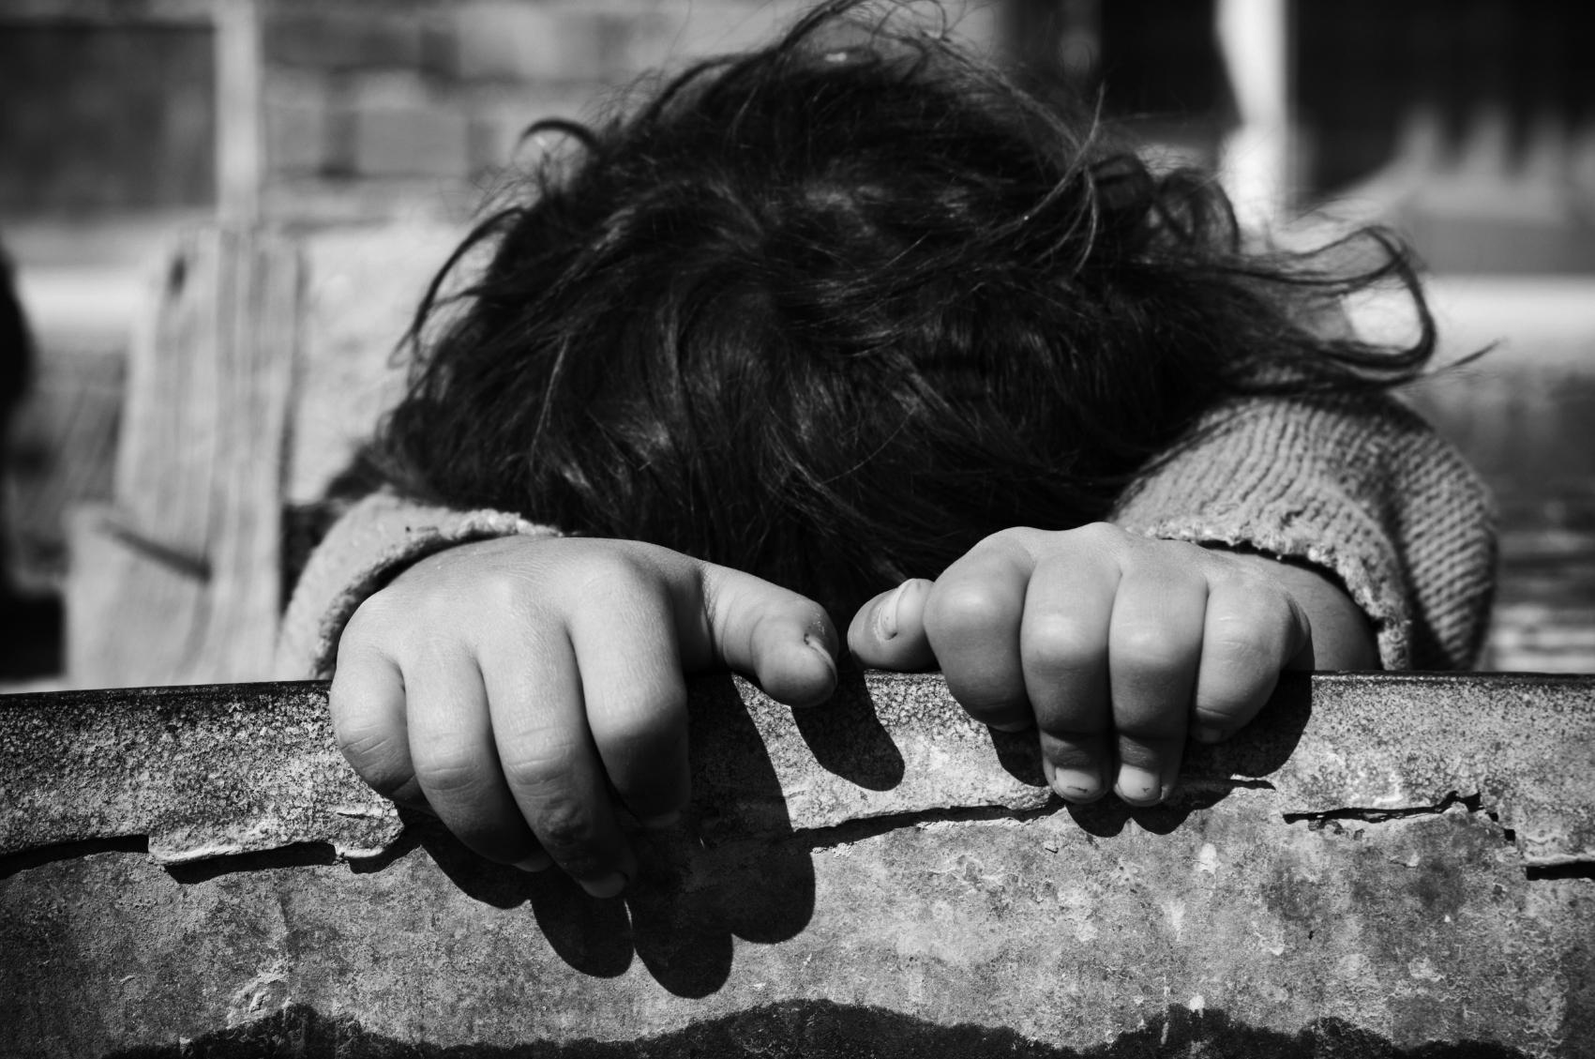
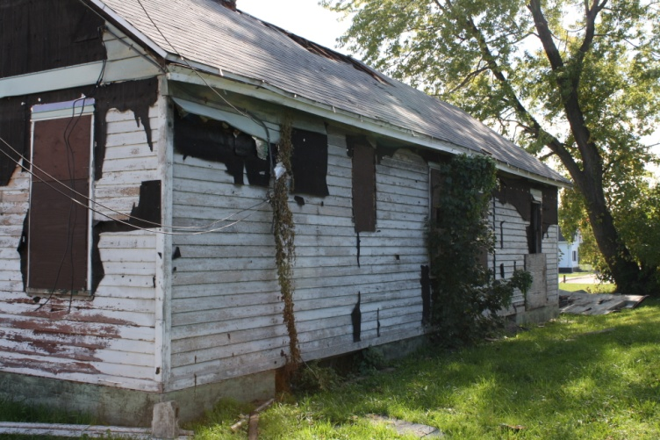
Can You Picture It?

Slide 4
Poverty – A Quiz
Poverty in Rochester:
3. True or False: Greater Rochester’s childhood poverty rate now ranks No. 1 among cities in comparably sized metro areas according to the RMAPI Poverty Report.
4. True or False: Poverty is found exclusively in the city of Rochester.
5. What percentage of RCSD 3rd grade students scored 1 or 2 (not proficient) on the New York state assessments for ELA and Math?
20%
60%
7%
15%
80%
6. True or False: Children can develop a resilient mindset through education and supportive adult role models.
1. What percentage of the children in the City of Rochester live in poverty?
10%
23%
33%
50%
60%
2. What percentage of RCSD students graduate from high school?
23%
51%
65%
78%
82

Slide 5
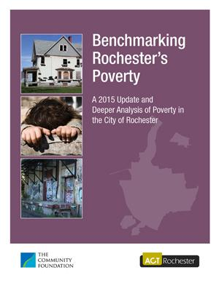
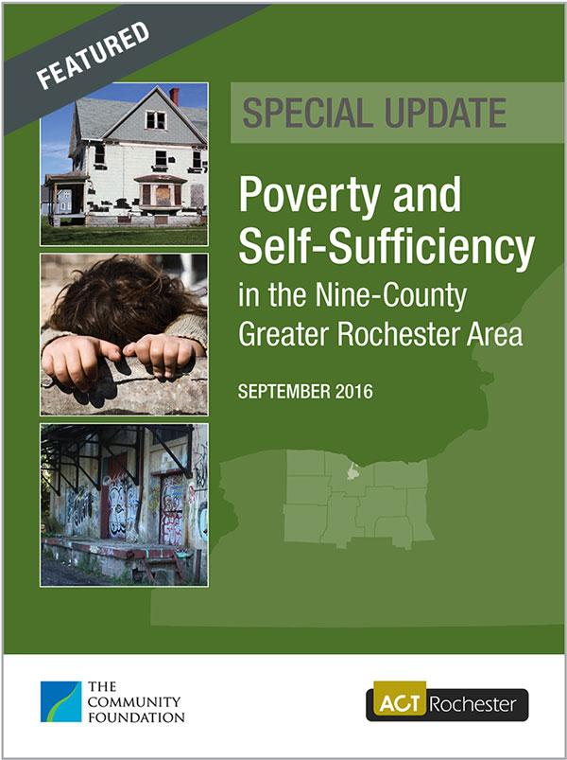
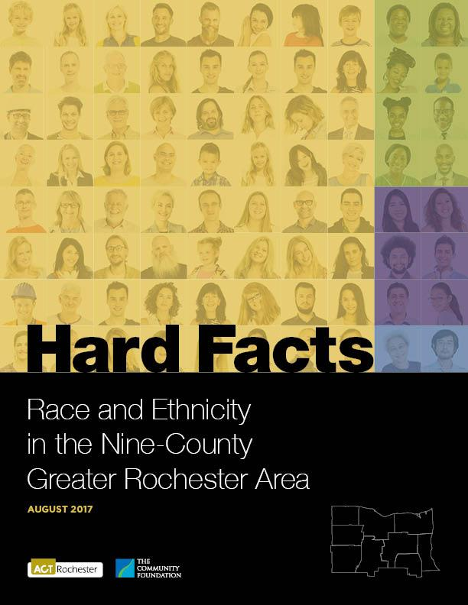
Poverty In Rochester
Available at: www.actrochester.org/poverty

Slide 6
Poverty In Rochester - Questions
What is it?
Why is it?
Where is it?
Why is it important?
What to do about it?

Slide 7
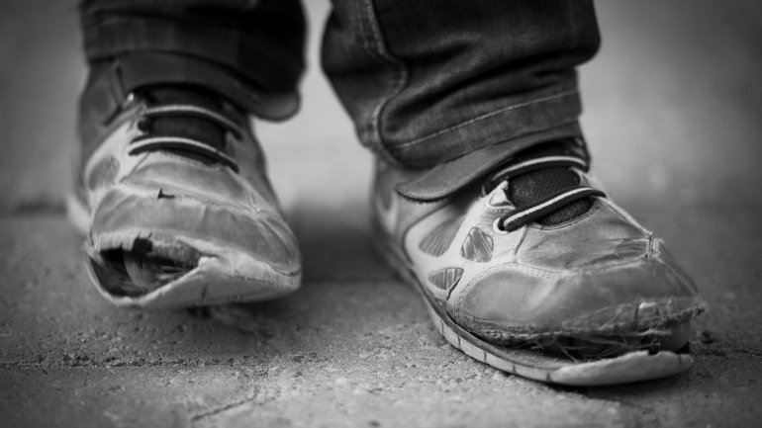
Poverty In Rochester – What is It?
1. Situational Poverty – Sudden crisis or loss
2. Generational Poverty – At least two generations born into poverty
3. Absolute Poverty – Rare in US; Scarcity of shelter, running water, food.
4. Relative Poverty – Income is insufficient to meet average standard of living.
5. Urban Poverty – Stressors include crowding, violence, noise.
6. Rural Poverty – Stressors include less access to services and support. Exceeding urban poverty.

Slide 8
Poverty In Rochester – What is It?
Definition: The Federal Poverty Level
The price of food in 1963, multiplied by 3, and adjusted since 1963 based on the increase in the Consumer Price Index.
Definition: Self-Sufficiency
Financial self-sufficiency is generally defined as the level of income needed by individuals or families to meet basic needs without external subsidy.

Slide 9
Table A: Comparison of the Self-Sufficiency Standard and Federal Poverty Level
Family Size | Self-Sufficiency Standard ^{(Monroe County)} (2016 Dollars) | Federal Poverty Level (2016) | Self-Sufficiency as a Percent of Federal Poverty Level
1 | $21,990 | $11,880 | 185 %
2 | $40,762 | $16,020 | 254 %
3 | $53,742 | $20,160 | 267 %
4 | $63,949 | $24,300 | 263 %

Slide 10
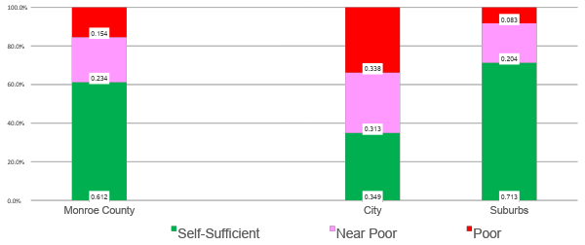
Poverty In Rochester- What is It?
How to Define Poverty: https://www.youtube.com/watch?v=4_lzKkiSx1A

Slide 11
Poverty In Rochester
Rochester now ranks 3rd in overall poverty among the nation’s 75 largest metropolitan areas. Rochester had been ranked 4th.
Compared it to poverty rates of 17 other principal cities in similar-sized metropolitan areas (those within 200,000 of Rochester’s total population). This benchmark group includes Buffalo, Hartford, Conn.; Richmond, Va.; Birmingham, Ala.; Tulsa, Okla.; and Louisville, Ky.
Among this benchmark group, the Census data found that Rochester continues to rank 1st in overall poverty, childhood poverty, and extreme poverty.

Slide 12
Poverty In Rochester – Where is It?
African Americans and Latinos are more than three times likelier to be poor than those identifying as non-Latino white.
Rochester has the second-highest poverty rate for those with bachelor’s or advanced college degrees (Chart R). This may be a reflection of the precipitous decline in higher salary jobs in the Rochester market.

Slide 13
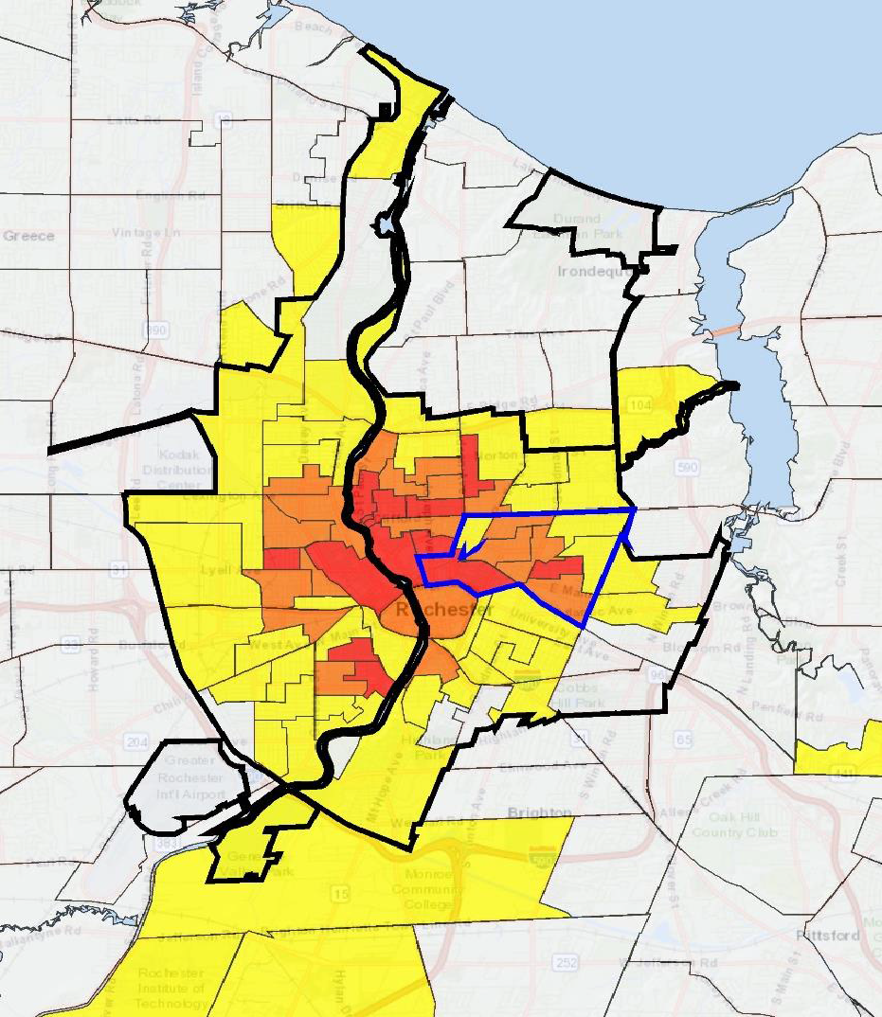
Rochester ranks 3rd highest in the degree of concentration of the poor – among the top 100 US metro areas.
Red: 50% of Households in Poverty
Orange: 40%-50% of Households in Poverty
Yellow: 15%-40% of Households in Poverty
Blue: RMAPI Target Area

Slide 14
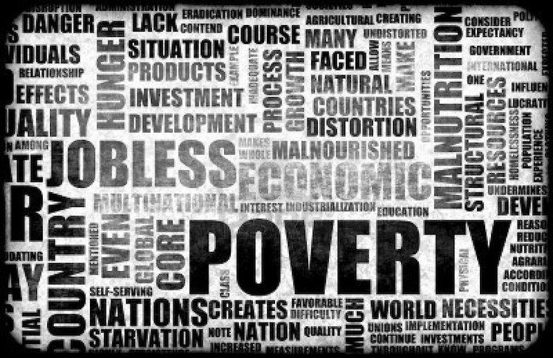
Poverty In Rochester – What are the Causes?
Lack of high quality, well paying jobs
Lack of affordable housing
Lack of education (graduation/reading levels/access to preschool)
Credit Card Debt (living expenses exceeds budget)
Closure of businesses; laying off of employees
Drug use
Medical expenses
Individual and Institutional Racism (Redlining)
Geographic Location
Family trauma and instability

Slide 15
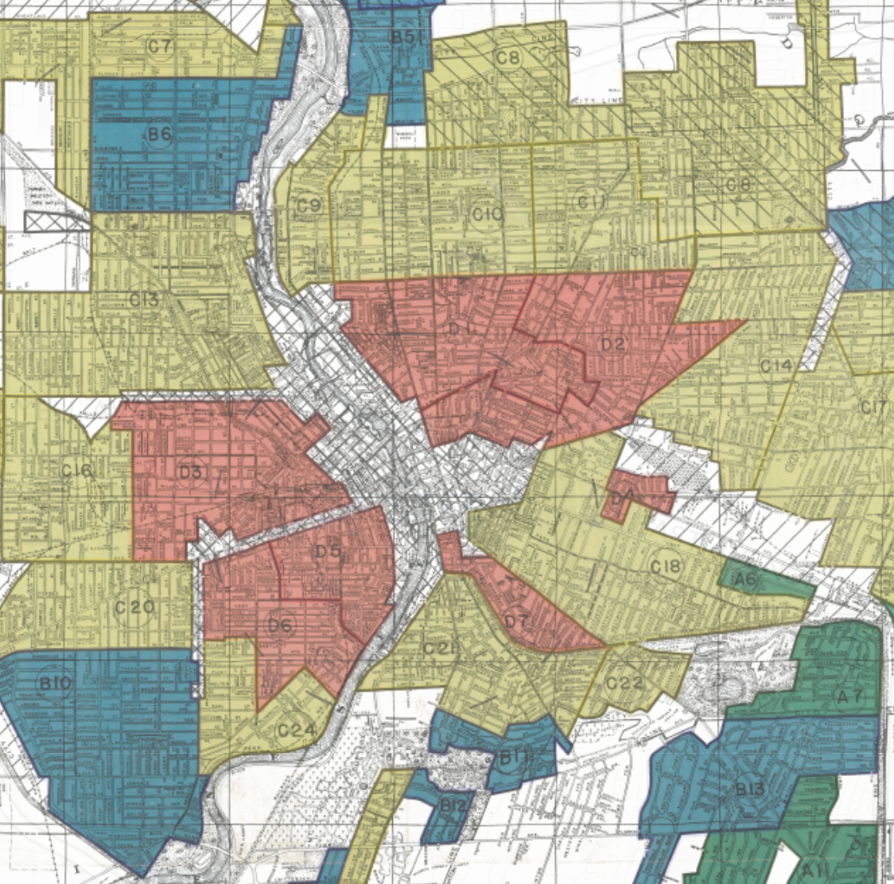
Redlining – Adam Ruins Everything
https://www.youtube.com/watch?v=ETR9qrVS17g
Zone D5, the northern tip of the ward, directly adjacent from downtown, was recorded to be ten-percent Italian and seventy-five percent “Negro” (Nelson, et al. 2016).
Years ago this was a section of beautiful old homes. Some still remain — massive structures and still handsome but with no value except for conversion purposes. Negroes have come into the area and today it is the poorest section of the entire city. The most that can be said for it is that it is convenient… Pride in ownership is lacking… Many properties only have nominal values or values for [minimum] cost of shelter. (Nelson, et al. 2016)

Slide 16
Poverty and Education – What is the Impact?
Any given poor child can learn.
But, poverty is the greatest predictor of poor educational outcomes.
Experts suggest that educational learning deteriorates rapidly in classrooms of 40% poverty or higher.
Aggregate educational outcomes are strongly correlated with poverty.

Slide 17
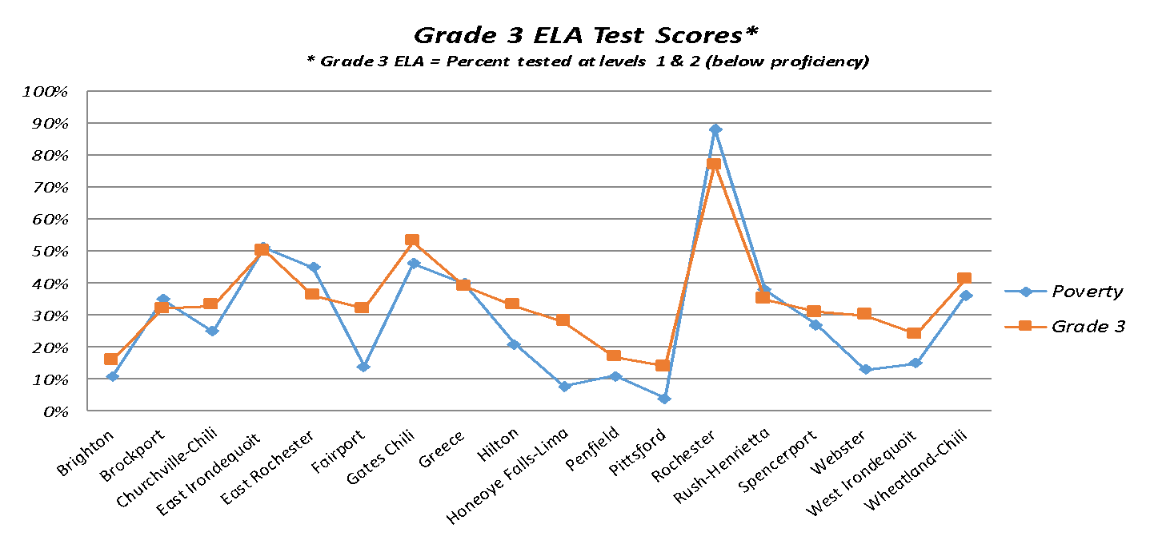
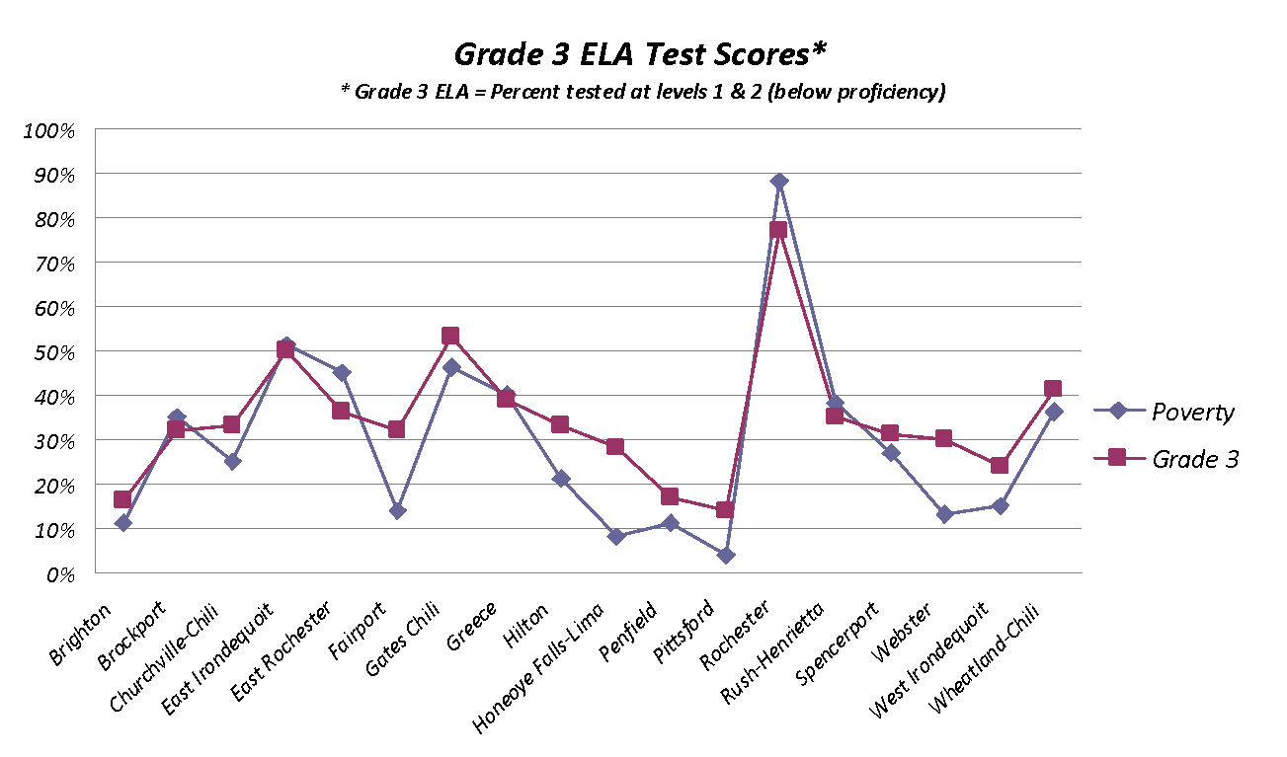
Poverty and Education – What is the Impact?
Source: New York State Department of Education, 2011-12

Slide 18
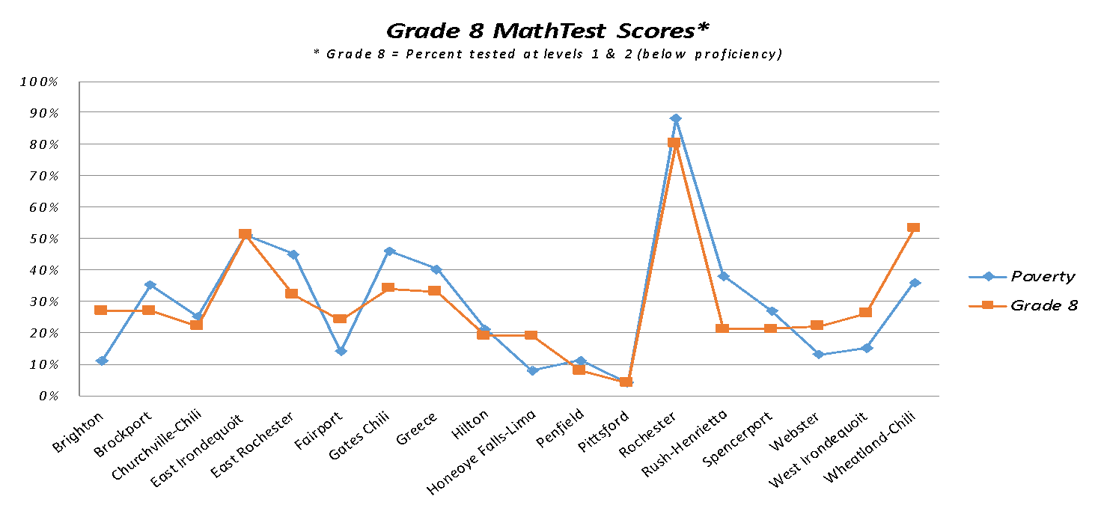
Poverty and Education – What is the Impact?
Source: New York State Department of Education, 2011-12

Slide 19
Poverty in Rochester Articles
Too Little, Too Much: How Poverty and Wealth Affect our Minds
Rochester Childhood Poverty Rate Ranks Third in the Nation
Americans Want to Believe Jobs are the Solution to Poverty. They're Not.
New Youth Trauma Data Shows Needs for Adult Support
New Study: Rochester is 5th Poorest City in the Country
How the Poor Get By in America
United Way report: High percentage of employed struggle financially
Rochester Tops "Extreme Poverty" List
Homelessness Hub - Resources on homelessness
Families Come to Terms with Needing Help

Slide 20
Risk Factors of Poverty (Jensen)
Lack of Emotional and social challenges (Children need reliable, loving caregiver; safe, predictable environment; 10-20 hours a week of reciprocal interactions; enrichment; opportunities to master their environment).
Acute and chronic stressors (Children can learn from healthy stress, but are negatively impacted by high stress over time such as insufficient nurturing, family violence and separation, eviction from homes, etc.)
Cognitive Lags (All children can learn, but strong association between low grades, literacy, retention rates, and socioeconomic status, complex language spoken in the home, prevalence of books, enrichment through play and activities.
Health and Safety Issues (Poverty weakens immunity, increases exposure to hazards and toxins in the environment, decrease access to health foods, decrease access to well child visits, dental care and vision care.

Slide 21
Meet Marcell and Janice
https://www.youtube.com/watch?v=98qDo59j0VM
https://www.youtube.com/watch?time_continue=1&v=iv7A99DKtFE

Slide 22
REFLECTION AND DISCUSSION
What type of poverty is Marcell in? Is Janice in?
Which of the causes of poverty are most relevant? Why?
What risk factors of poverty did you see?

Slide 23
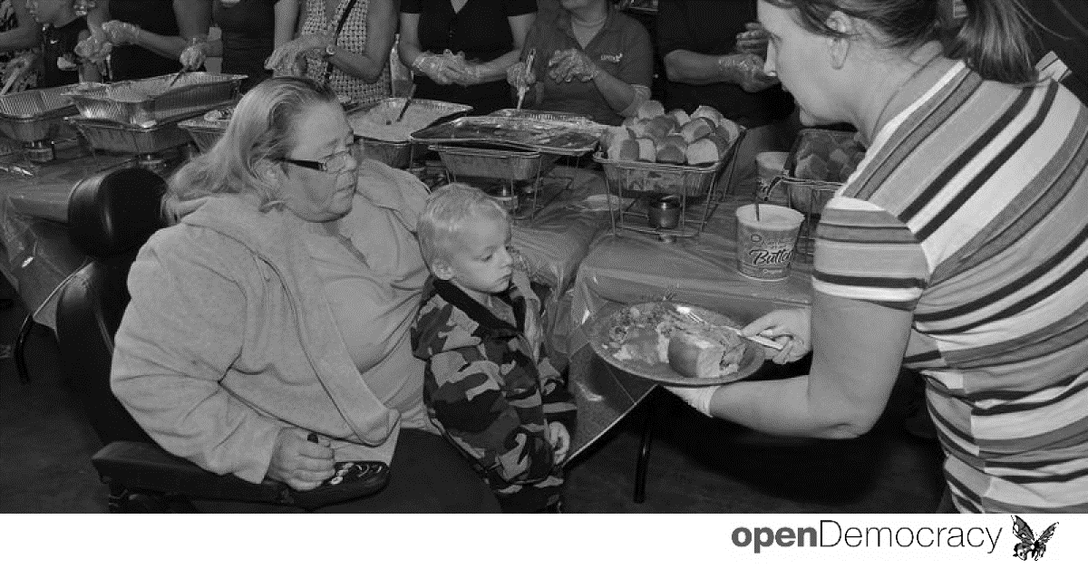
What is it like to live on a limited income? Play the game Spent: http://playspent.org/html/

Slide 24
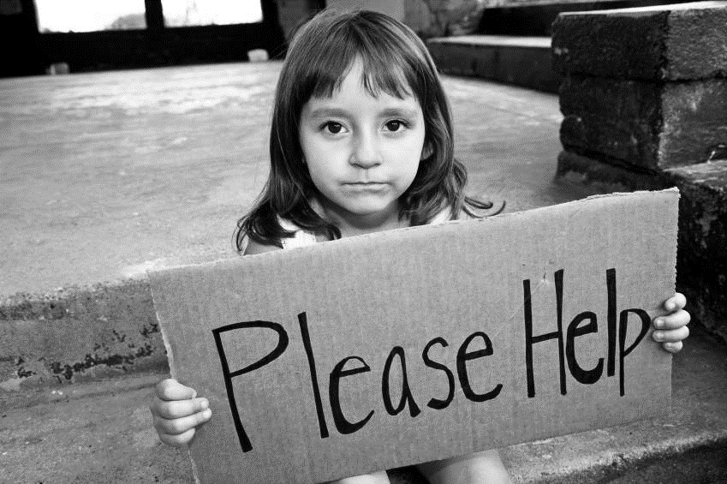
Cultural Rules of Poverty

Slide 25
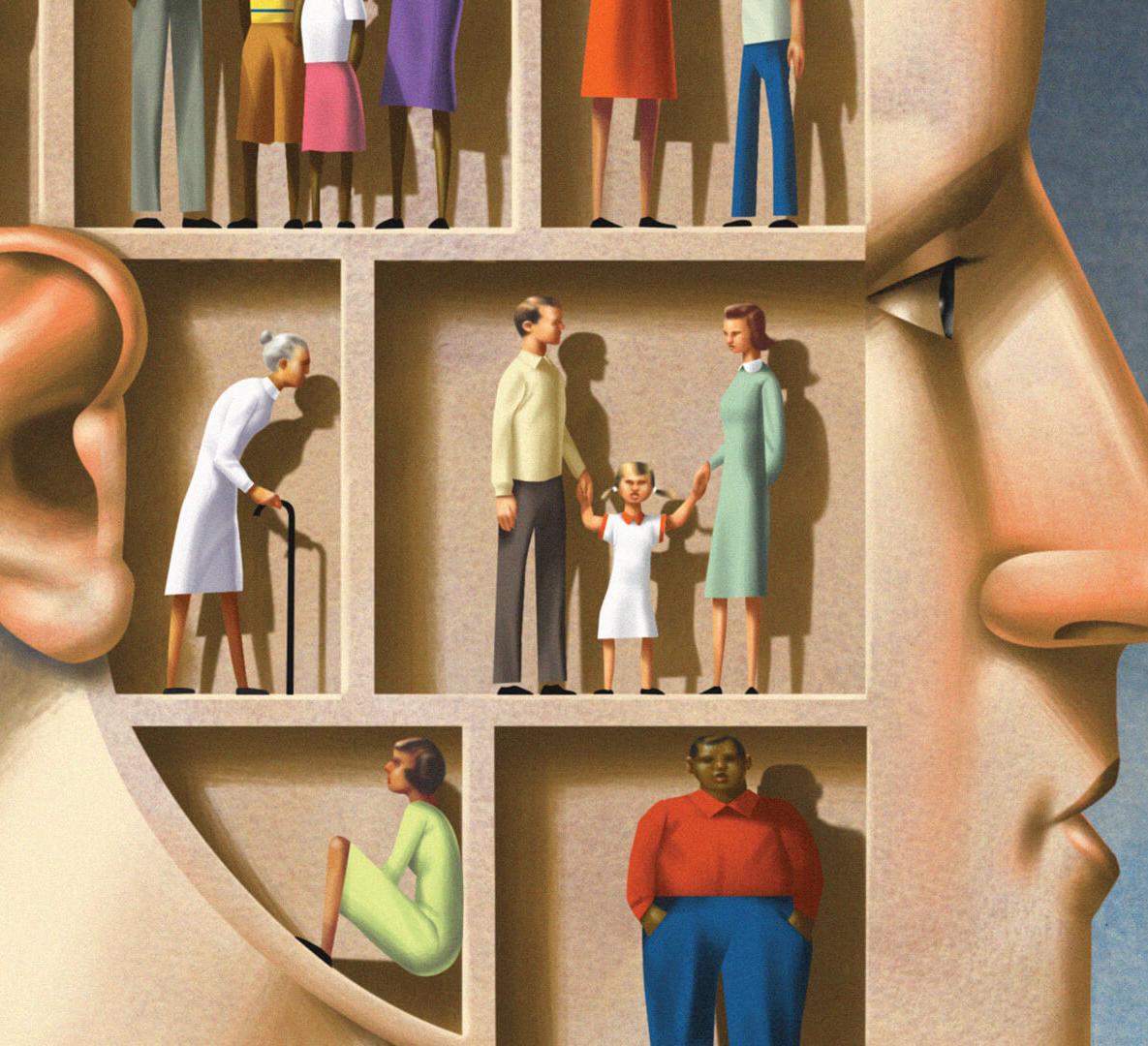
Hidden Rules of Poverty
Break into groups of 2-3; Assign one person to be in poverty, one in middle class and one in wealth.
Look at the hidden rule of food. Explain from the perspective of your position why this hidden rule may be true. Can you give an example from your assigned position?
Do the same for hidden rule of language. Why might this be true? Can you give an example from your assigned position?
Now last, do this for driving force. Why might this be true? Can you give an example from your assigned position?

Slide 26
RULES OF POVERTY AND WEALTH
POVERTY MIDDLE WEALTH
Work & Achievement
Personal Growth
Material Security
Survival
Relationships
Entertainment
Political, financial, social connections
Legacy and tradition
Notes:
Shown on this diagram are the key points concerning patterns about poverty, middle class, and wealth.
Remember, we are talking about patterns, not stereotypes. When we stereotype, we apply a pattern to everyone in the group. Be sure this is not the case.
If you've been in that middle-class mindset two generations or more, virtually all your decision making is made against three things: work, achievement, and material security. Those three things shape middle-class lives every day.
In wealth, your decision making is made against three things: social, financial, and political connections—for two reasons: No. 1, they keep you safe, and No. 2, they help you make more money. The rule about money is that you just don't talk about it. Investments yes, money no.
After two generations in poverty, you don't have much stuff. Virtually all your decision making is made against three things: relationships, entertainment, and survival, because you have only one real possession, and that's people.
Additional patterns in wealth:
It is not OK not to be perfect.
Details are very important.
A person is not respected unless he/she has expertise.
Rules do not apply to my child.
Social exclusion is a key weapon of choice in wealth.
Additional patterns in generational poverty:
Noise level is higher.
Important information is given non-verbally.
Entertainment gives value to your group.
Respect is given to those who are personally strong.

Slide 27
RULES OF POVERTY AND WEALTH
POVERTY MIDDLE WEALTH
Food – Quality of the dish; Can count on it
Child Rearing – “Concerted Cultivation” – focus on activities, discussions, academics
Possessions – houses, furnishings, technology; less time together as a family
Food – Quantity; No guarantee have enough
Child Rearing – “Natural Accomplishments” – focus on love, shelter, survival.
Possessions – “My child”; “My man” – value belonging over belonings
Food – Quantity and Quality are assured; Appearance and presentation
Child Rearing – focus on preparation for success in society
Possessions – One of a kind objects, properties, businesses
Notes:
Shown on this diagram are the key points concerning patterns about poverty, middle class, and wealth.
Remember, we are talking about patterns, not stereotypes. When we stereotype, we apply a pattern to everyone in the group. Be sure this is not the case.
If you've been in that middle-class mindset two generations or more, virtually all your decision making is made against three things: work, achievement, and material security. Those three things shape middle-class lives every day.
In wealth, your decision making is made against three things: social, financial, and political connections—for two reasons: No. 1, they keep you safe, and No. 2, they help you make more money. The rule about money is that you just don't talk about it. Investments yes, money no.
After two generations in poverty, you don't have much stuff. Virtually all your decision making is made against three things: relationships, entertainment, and survival, because you have only one real possession, and that's people.
Additional patterns in wealth:
It is not OK not to be perfect.
Details are very important.
A person is not respected unless he/she has expertise.
Rules do not apply to my child.
Social exclusion is a key weapon of choice in wealth.
Additional patterns in generational poverty:
Noise level is higher.
Important information is given non-verbally.
Entertainment gives value to your group.
Respect is given to those who are personally strong.

Slide 28
IMPACT OF RULES ON POVERTY AND EDUCATION
Poverty is a concrete, sensory, reactive world.
School is verbal, abstract representational, and proactive.
Without these skills, one lacks the tools necessary to negotiate and manipulate his/her position in the world.
Notes:
One of the reasons there's so much violence in poverty is that when you have only casual register, you don't have the words to resolve a conflict. What they tell you in conflict resolution is this: To resolve a conflict, you have to get away from the personal and get to the issue. To get to issues, you must have abstract words.
All registers have power. Speak formal register in a poverty neighborhood and you will likely be in trouble. Formal register does not have power in that situation. Schools can use mental models, high-frequency words, videos, and stories to communicate. Using formal register to negotiate nurtures one’s ability to think abstractly and hold concepts inside the head.
People in generational poverty tend to utilize the casual register of language to survive. In poverty you must attend to sights and sounds to survive; your world is often about processing the external environment. Because you are processing the sensory environment in poverty, nonverbals become crucial, and you become an expert at reading them.

Slide 29
The Critique
They focus on individual interventions and ignore the systems that cause, worsen and perpetuate poverty.
They overgeneralize about people living in poverty and rely upon stereotypes.
They focus on perceived weaknesses (or deficits) of children and families living in poverty.

Slide 30
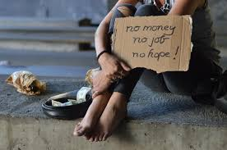
HOW POVERTY AFFECTS OUR MINDS
- How the cultural rules of poverty are developed and reinforced.
https://www.npr.org/2018/10/04/651468312/too-little-too-much-how-poverty-and-wealth-affect-our-minds
(~12 minutes)

Slide 31
Building Resources (Payne)
Financial – Having the money to purchase goods and services; save for emergency; know how money works.
Emotional – Being able to chose and control responses and manage emotions without being self-destructive.
Knowledge/Education – Learning to read and write; have education for college and career
Spiritual – Believing in a divine purpose and guidance; having a rich culture and support system.
Physical – Having physical health and mobility.
Relationships and role models – Access to social supports who are positive influences and trustworthy.

Slide 32
REFLECTION #2
What new realizations or insights about poverty do you now have? What are its causes and effects?
How will you use this information for your service-learning work?

Slide 33
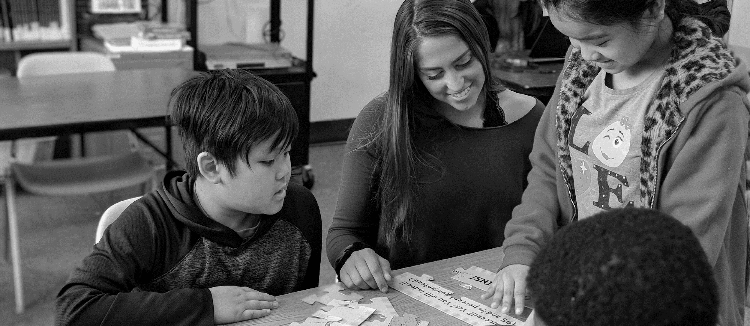
Poverty, Trauma & Resiliency

Slide 34
Trauma – What is It?
An exceptional powerful or dangerous event that overwhelms the child’s ability to cope.
Witnessing or experiencing an event that poses a real or perceived threat to the life or well-being of the child or someone close to the child.
Impact of trauma can depend on many factors such as severity and number, significance, age, history of trauma, presence of support systems and adults, and genetics.
Long-lasting adverse effects may include fear, helplessness, sadness, withdrawal, and disorganized/agitated behavior.

Slide 35
Trauma – What is It?

Slide 36
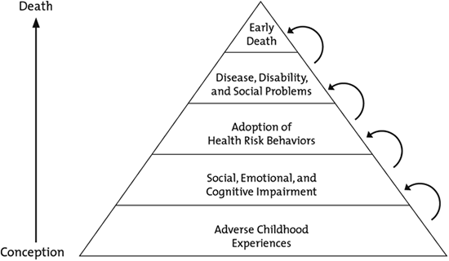
Trauma – What is the impact?

Slide 37
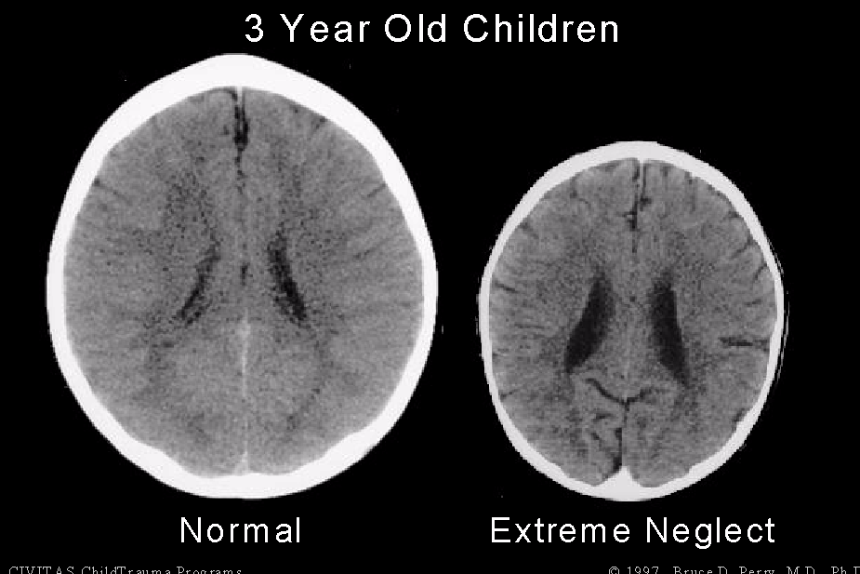
Trauma – What is the Impact?
Impact of Neglect Video

Slide 38
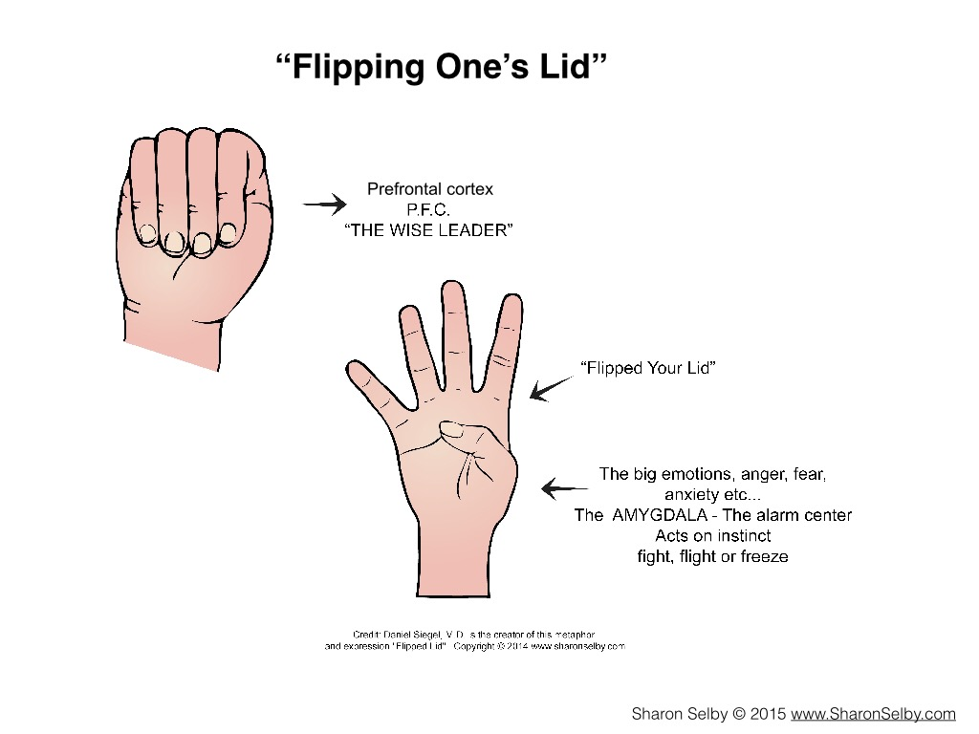
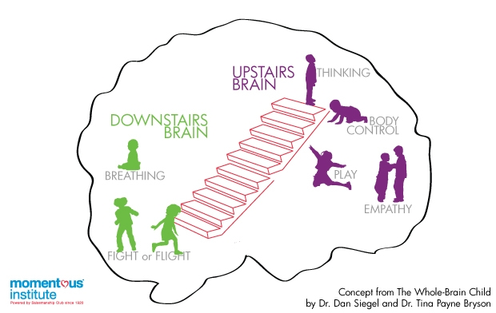

Slide 39
Trauma – What is the Impact?
Think of the ‘learning brain’ as the rider, and the ‘survival brain’ as the horse. When a student is triggered into survival mode by a trauma reminder, the ‘learning brain’ largely goes offline. The rider’s off the horse, and you’re just dealing with a really terrified horse.
In this state, a child is neurobiologically unable to learn. No amount of working harder will change things. The child’s behavior is a normal response to toxic stress; it is not “willful” or intentionally directed against a teacher.
The good news is that the brain is plastic, and if toxic stress stops and is replaced by practices that build resilience, the brain can slowly repair much of the damage.
(Jane Ellen Stevens, 2013; Joyce Dorado, Director of HEARTS and associate clinical professor at the University of California, San Francisco, School of Medicine.)

Slide 40
Trauma – What is the Impact?
Trauma effects the “cross-talk” between the brain’s hemispheres
and development of prefrontal cortex which may affect:
- management of fears, anxieties, and aggression
- sense of safety and protection; realistic appraisal of danger and safety
- ability to sustain attention for learning and problem solving
- control of impulses and understanding of consequences of behavior
- obtainment of long-term goals

Slide 41
Fostering Resiliency
Social Competence - Resilient children are empathic, caring, flexible, and responsive in social situations.
Problem-Solving Skills - Resilient children can find alternate solutions for cognitive and social problems and create change in frustrating situations.
Autonomy - Resilient children have a strong sense of power and ability to change their situation, independence, and self-esteem.
Sense of Purpose and Future - Resilient children are goal-directed, success oriented, and have a sense of a compelling future.
Fostering Resiliency in Kids by Bonnie Benard, August 1991

Slide 42
In the Classroom
When students are behaving in a way that seems. . . | They Could Have . . . | If So . . .
Manipulative, bossy, dramatic, aggressive, attention-seeking, oppositional, indifferent, passive-aggressive, distracted, disinterested, pleasing | Emotional Needs: the need to regulate their feelings and responses | Provide a safe break. Give students a brain tool (stress ball) to help get them back in thinking brain.
 | Relationship Needs: the need to connect with fellow human beings | Check in and connect with students. Connect the student with another safe adult.
 | Control Needs: the need to be in charge of their own situation | Give the student a job. Provide some predictability and choices.
 | Physical Needs: the need to eat, sleep, exercise, and take care of the body | Provide a healthy snack. Give the student a few minutes to put their head down and rest.
Creating a Trauma-Sensitive Classroom by Kristin Souers and Pete Hall, 2018

Slide 43
Building Resources to Overcome Effects of Poverty (Payne)
Financial – Having the money to purchase goods and services; save for emergency; know how money works.
Emotional – Being able to chose and control responses and manage emotions without being self-destructive.
Knowledge/Education – Learning to read and write; have education for college and career
Spiritual – Believing in a divine purpose and guidance; having a rich culture and support system.
Physical – Having physical health and mobility.
Relationships and role models – Access to social supports who are positive influences and trustworthy.

Slide 44
REFLECTION AND DISCUSSION
Referencing the readings on the impact of poverty and trauma (Jensen, Emotional and Social Challenges and Cognitive Lags sections), and the class presentation, what are the negative impacts of trauma on children and adults?
How can behaviors be explained through the lens of trauma?
How can these impacts be overcome through developing resiliency (Jensen, Action Steps sections and Petty and Bernard articles)?
Last, how will your understanding of poverty, trauma, and resiliency help you understand and work effectively with the children and adults?

