Slide 1
Rochester solutions
Dr. Lynn Donahue – PSJS 250: Social Change through Service

Slide 2
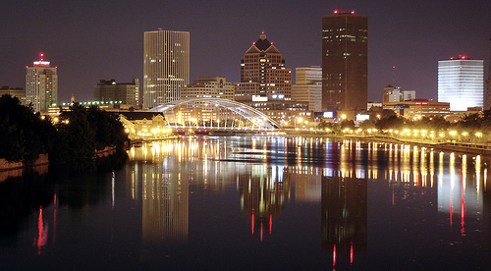
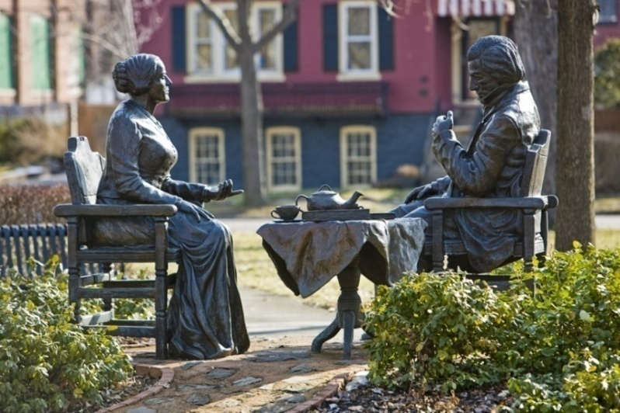
A Few Facts
Rochester city population is over 200,000, making it New York's third largest city. The greater Rochester area has a population of about 1,000,000.
Largest Employers:
University of Rochester/UR Medicine, 22,500
Wegmans, 13,582
Rochester General Health System, 8,200
Xerox, 6,300
Rochester City School District, 5,574
Monroe County Government, 4,549
Paychex, 3,877 (Tom Golisano)
Famous People:
Eastman Kodak Company is Rochester’s most well-known company (prior to 2005, it was also the city’s biggest employer). Innovator extraordinaire George Eastman launched the company in 1892.
Rochester was home to civil rights leaders Frederick Douglas and Susan B. Anthony.

Slide 3
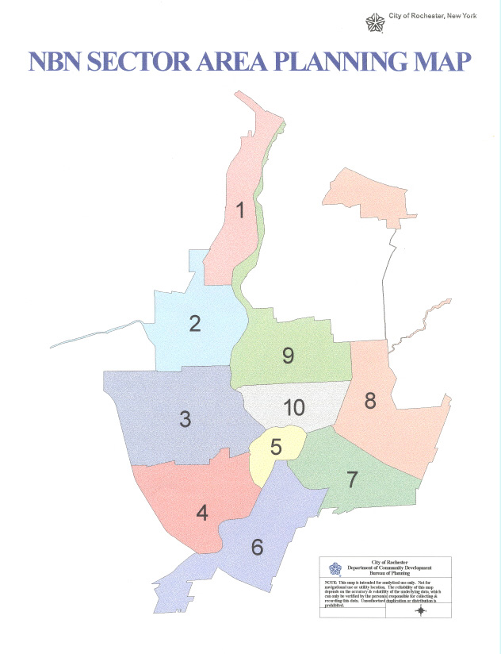
Rochester City Neighborhoods
Sector 1: Charlotte
Sector 2: Maplewood
Sector 3: Brown Square, Charles House Area Council (CHAC), Edgerton, Lyell-Otis, People of Dutchtown, Susan B. Anthony
Sector 4: B.E.S.T., Genesee-Jefferson, Mayor's Heights, Plymouth-Exchange, and 19th Ward
Sector 5: Corn Hill and Central Business District
Sector 6: Ellwanger-Barry, Highland, South Wedge, Strong, and Swillburg
Sector 7: Atlantic-University, Cobbs Hill, East Avenue, Park Avenue, Pearl-Meigs-Monroe, and Upper Monroe
Sector 8: Beechwood, Browncroft, Culver/Winton, Homestead Heights, and Northland-Lyceum
Sector 9: 14621
Sector 10: N. Marketview Heights, S. Marketview Heights, and Upper Falls

Slide 4
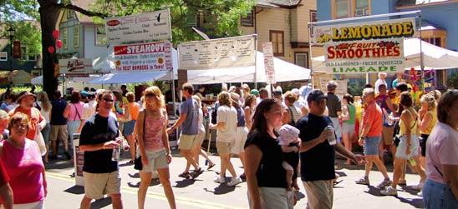
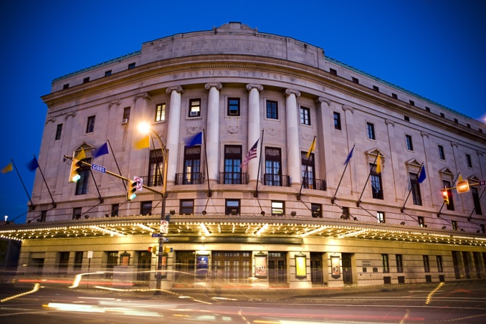
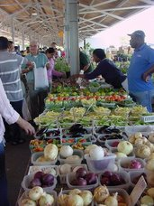
Rochester City Neighborhoods
Park Avenue: A popular area, especially for students and young people. Lining the streets are cafes, shops, pubs and restaurants.
University Avenue: The most culture and art-rich sections of the city. Located here are the Village Gate, Memorial Art Gallery, Rochester Museum and Science Center, Rochester Public Market, ArtWalk, and George Eastman House.
East End: A residential neighborhood in Downtown Rochester but also the main nightlife district. The Eastman Theater and the Eastman School of Music and many clubs, bars and high-end restaurants are here.
South Wedge: The South Wedge neighborhood dates back to 1827, prior to the incorporation of Rochester Village. It is currently undergoing revitalization due to a recent increase in homeownership.
Downtown: Frontier Field, Strong Museum, Loft residents, Rochester Public Library, High Falls

Slide 5
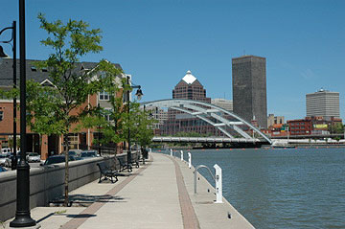
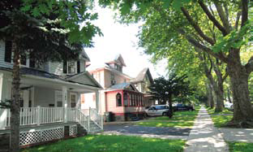
Rochester City Neighborhoods
Highland Park: Site of the Ellwanger-Berry nursery and home to the Highland Park Festival every May.
Corn Hill: Near downtown, it is one of the nation's best preserved Victorian neighborhoods and the Corn Hill Art Festival is one of the city's most popular.
Charlotte: A lake front community in Rochester home to Ontario Beach Park.
Maplewood: A northwest neighborhood located south of Kodak Park next to the Genesee River and home to the Maplewood Rose Garden.
Monroe Avenue: Stretches from Pittsford to Downtown, contains many trendy shops and small businesses.

Slide 7
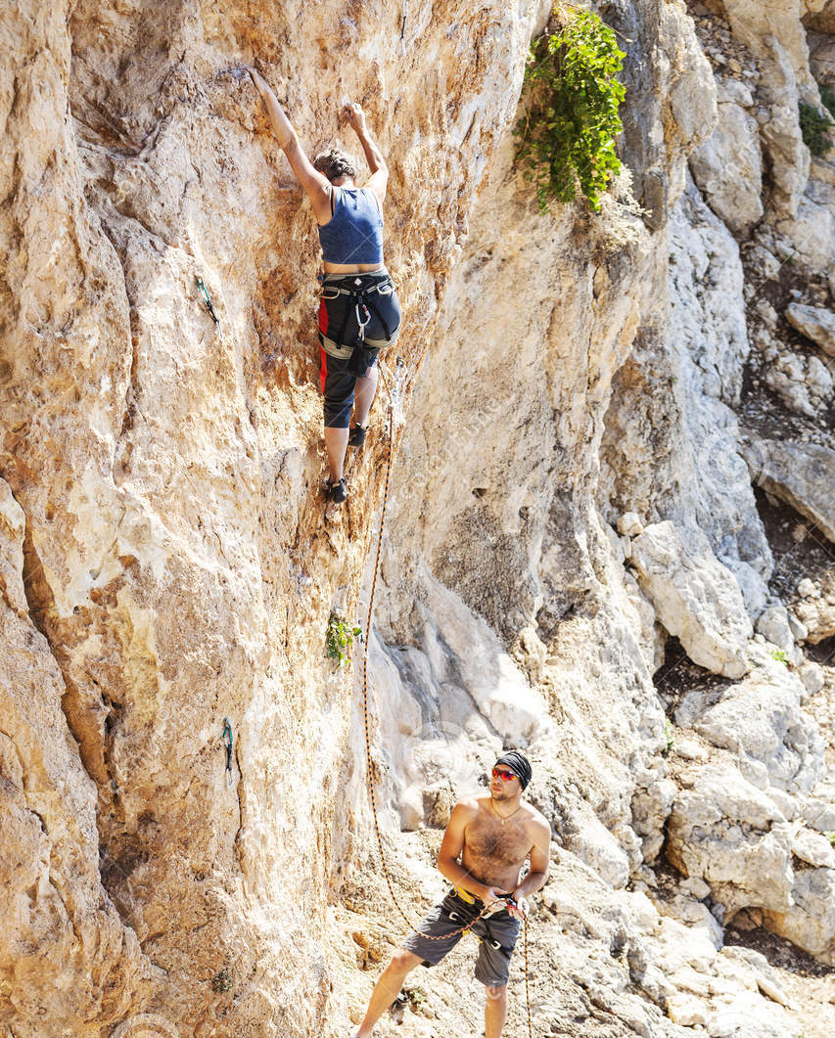
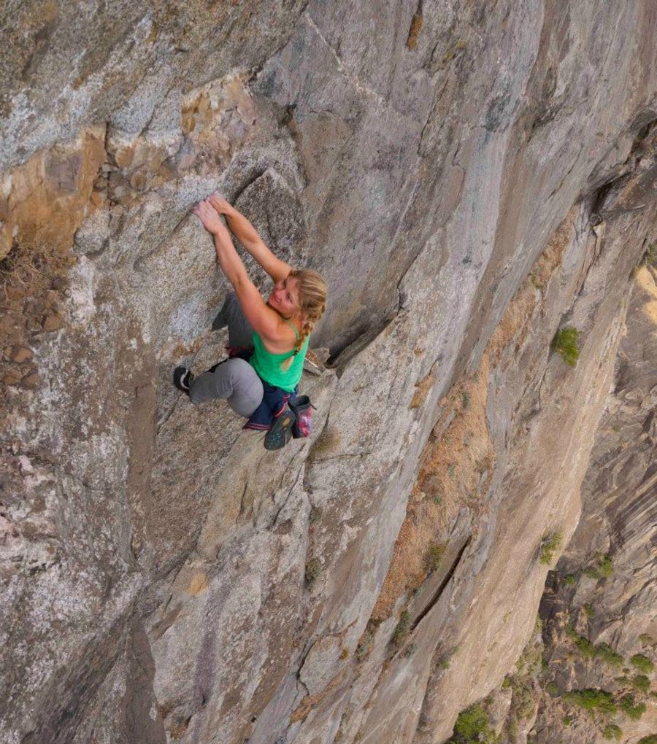
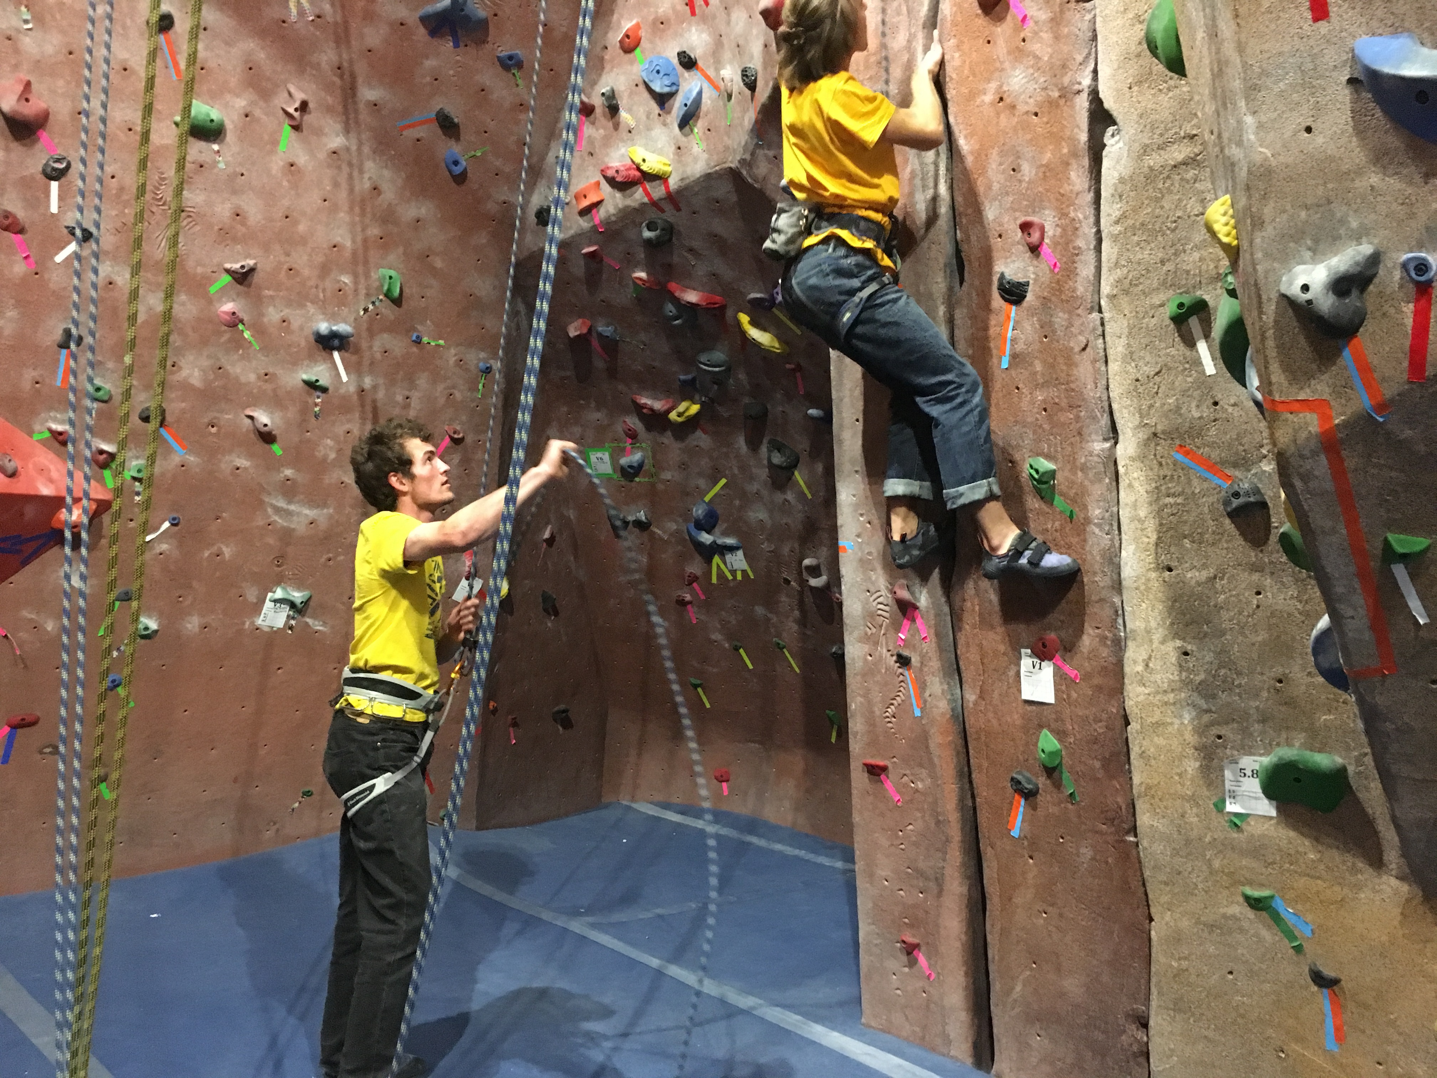
Expert vs. “non-expert” approach
Focus on individual vs. experience as the source of knowledge.

Slide 8
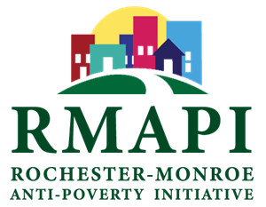
The Rochester-Monroe Anti-Poverty Initiative (RMAPI) is a multi-sector community collaborative with a goal to improve quality of life by reducing poverty and increasing self-sufficiency. To do this, RMAPI is focused on increasing income, making basic needs more affordable and accessible, and lowering concentrations of poverty.
Increased accessibility and affordability of basic needs, through more affordable housing, better coordination of services and more effective utilization of benefits
Increased income, through better jobs and access to critical supports
Decreased concentration of poverty, through strengthened communities, home to self-sufficient families
https://www.youtube.com/watch?v=pbY4-6Rd-www
https://endingpovertynow.org/about-us/

Slide 9
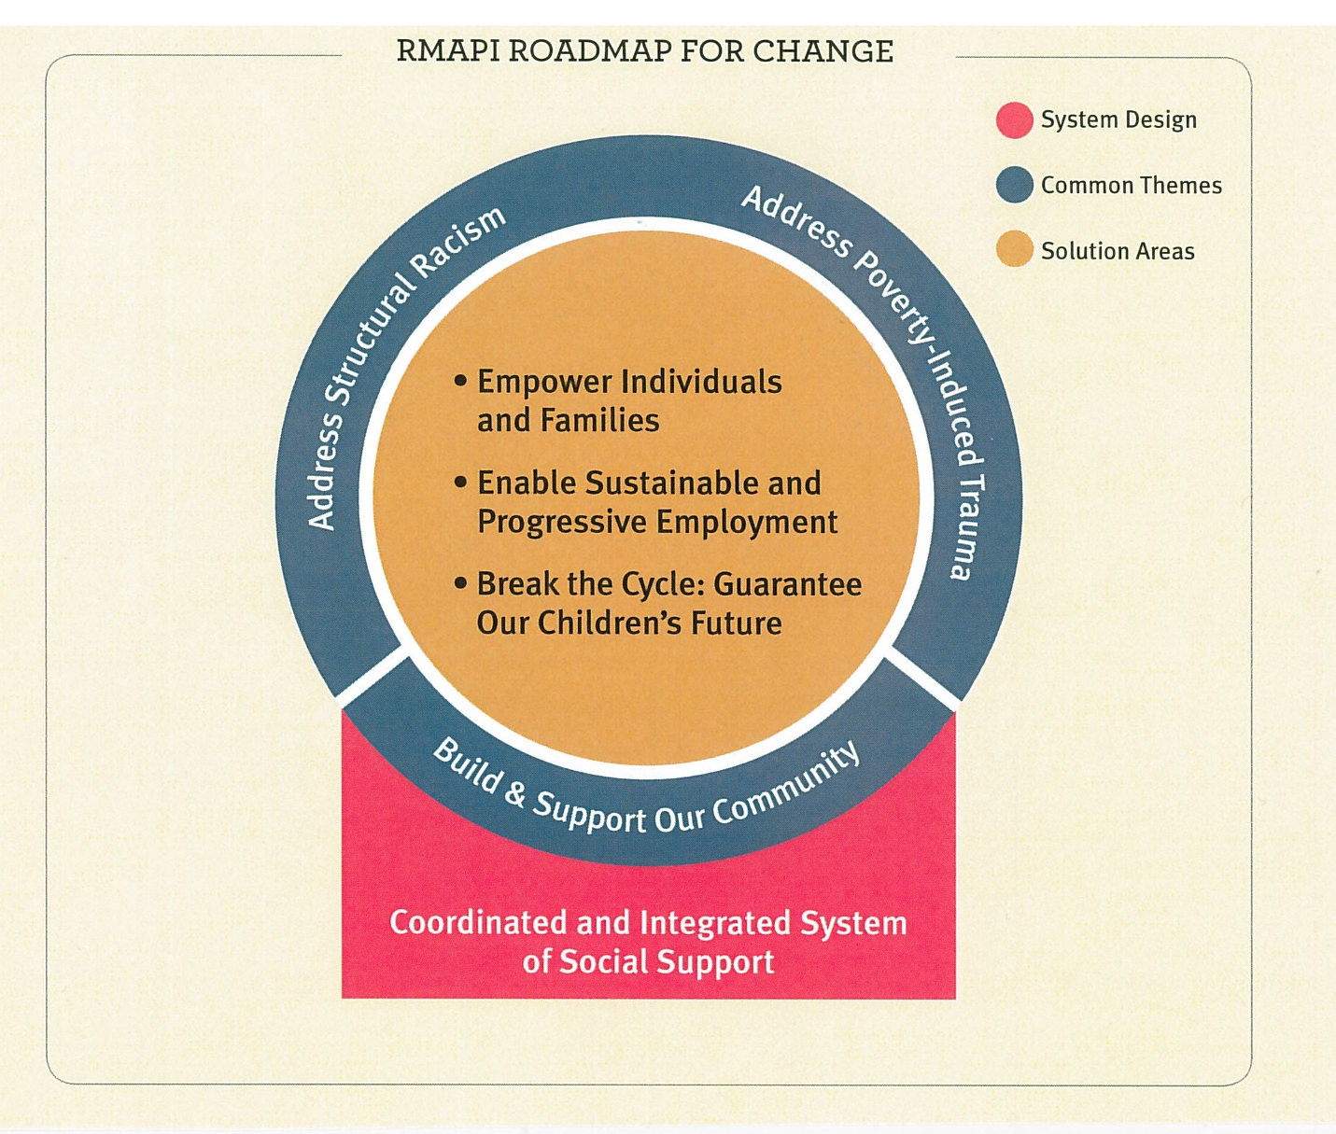
RMAPI
PHASE 1: 2015-2020: Strategies focused on Process Changes, beginning with mapping the system, identifying priority short and long-term changes within organizations and a new way to collaborate.
PHASE 2: 2020 – 2025: Strategies focused on Systems Changes. With critical processes and players actively improving their collaboration and outcomes, the broader system can begin to see improvements in its own results.
PHASE 3: 2025-2030: Strategies focused on Population Changes. At this stage, mature interventions are functioning effectively in an integrated system that is responsive to changing needs and continually improving the quality of life for our community.

Slide 10
RMAPI Covid-19 crisis and response
Community Concerns During COVID-19 Crisis Update: 4/09/20
The Rochester-Monroe Anti-Poverty Initiative is a community collaborative working to improve quality of life in Rochester by reducing poverty and increasing self-sufficiency. Amidst the COVID-19outbreak, RMAPI is focused on mitigating the negative effects of this public health crisis on the economic well-being of persons experiencing poverty.
http://endingpovertynow.org/wp-content/uploads/2020/03/Rochester-Community-Feedback-April-9.pdf
https://endingpovertynow.org/important-covid-19-updates/

Slide 11
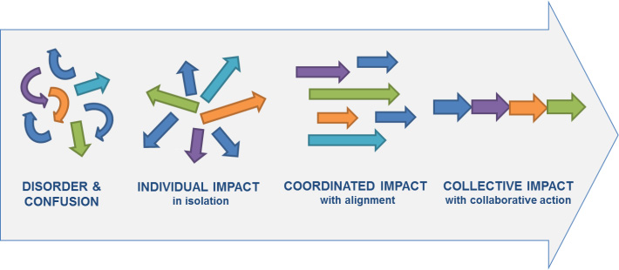
Collective impact

Slide 12
Dedicated to building up EMMA and Beechwood neighborhoods from within by engaging residents, service providers, and community partners in our holistic approach.
“Personal responsibility is essential for emotional, social, and spiritual well-being. To do for others what they have the capacity to do for themselves is to disempower them. Getting to know community leaders first requires us to listen and respect indigenous leadership and learn the dreams of the people. And be willing to have our own ideas transformed. Connected Communities efforts seeks to be community-driven rather than volunteer-driven, community-led rather than volunteer-led.”
http://www.connectedcommunitiesroc.org/challenge/

Slide 13
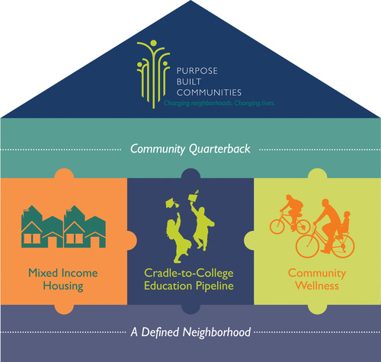
Connected Communities Roadmap
Asset Based Development
Geographically Focused
Holistic Revitalization
Collective Impact

Slide 14
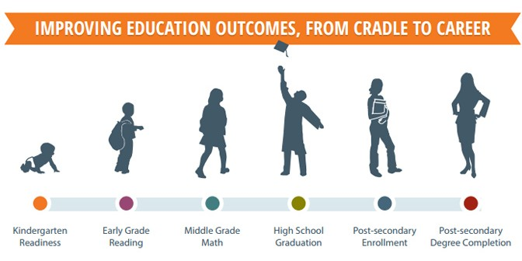

Slide 15
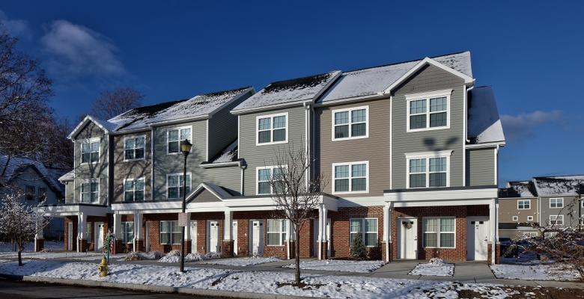
Warfield Square – new start for EMMA/Beechwood residents
Video: https://www.facebook.com/connectedcommunitiesroc/videos/1064678207038933/
(5 minutes)

Slide 16
Blackboard discussion
Pick RMAPI or Connected Communities and using the RMAPI report, PowerPoint presentation, and websites provided, answer these two questions:
What are their overarching goals and framework?
How do they address the root causes and/or impact of poverty (ex. trauma, low educational outcomes, institutional racism, privilege)?
How might they address the challenges your Seeds’ kids faced?

Slide 17
Blackboard discussion
Please find one other program in Rochester that also addresses poverty, low educational outcomes, and/or trauma in children and review how they address these challenges and if they seem to use an asset-based perspective.

